Slide 1
POSTER Competition

Slide 2
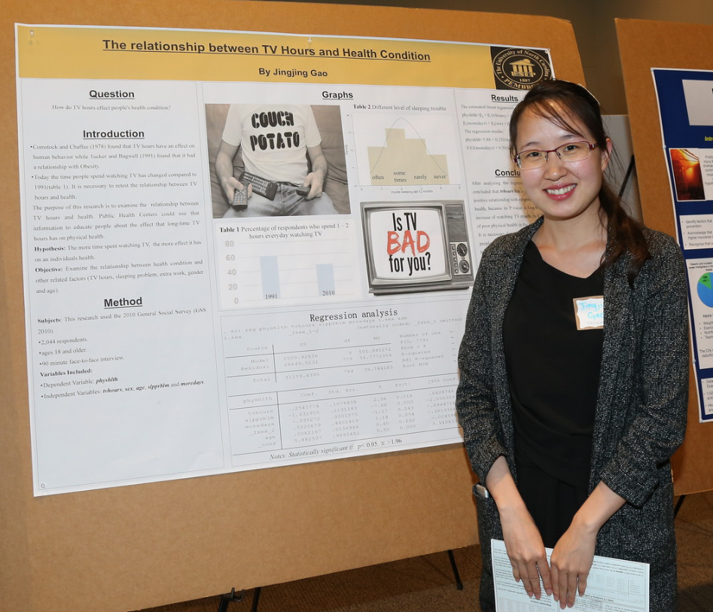
EFFECTIVE POSTER PRESENTATIONS
Address questions related to a specific topic:
What is it about?
Why is this topic important?
Why is this topic unique?
How does this relate to other topics?
What comes next?
Purpose of a poster presentation
Stimulate interest and discussion
Receive feedback on research

Slide 3
POSTER SUGGESTIONS
Consider having handouts
miniatures of poster
additional details not included in poster
Keep it short and simple
Remove all non-essential information
Attract visual attention: use graphics
Aim for:
40-50% text
30-40% graphics
20% empty space

Slide 4
Plan the poster
Make it easy to understand
Make it easy to read
Poster should stand alone
verbal explanations should supply details, not essentials
Decide on one concept or question
Determine poster size
Choose poster orientation
Portrait
Landscape

Slide 5
Poster layout
Determine logical sequence for material
Organize material into sections
Number sections to make flow obvious
Typically, use 3 to 5 columns
Arrange material vertically from top left corner to bottom right corner
This makes it easier for people to read, without having to move back and forth

Slide 6
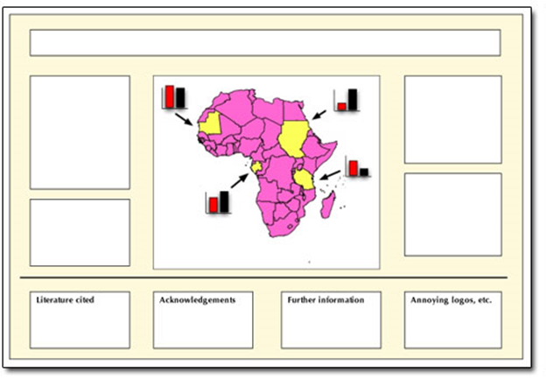
Consider the layout
http://ucanr.edu/sites/Toolkit/UC_ANR_logo/ANR_Templates/Poster_templates/
http://www.uncp.edu/academics/colleges-schools-departments/colleges-schools/graduate-school/graduate-students/graduate-research-symposium
http://www.ncsu.edu/project/posters/

Slide 7
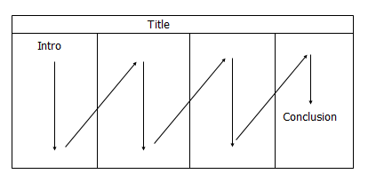
Poster layout
Sketch your layout and flow early in the process

Slide 8
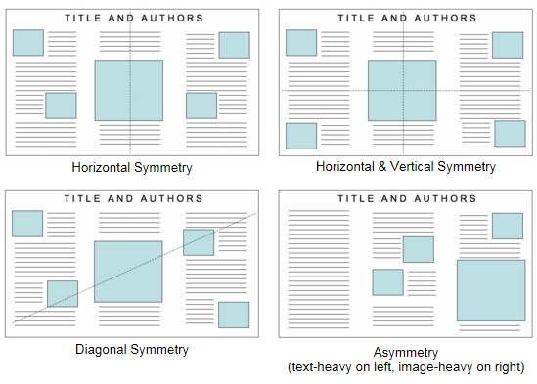
Balance and white space
Your poster should have a good visual balance of figures and text, separated by white space.
Balance occurs when images and text are reflected (at least approximately) across a central horizontal, vertical, or diagonal axis. This axis is know as the axis of symmetry.

Slide 9
Content advice
Title
Authors and Affiliations (include full name and contact information)
Introduction
Methods
Data and Results
Conclusions and Future Work
Reference and Acknowledgements
Not every poster needs to include ALL of these items, but should include MOST of them!

Slide 10
Make it interesting!
You want to lure people from a distance
Should be easy to read from 15 feet
If title is too long, shorten it (don’t reduce the font size)
Poster text
Poster title
Design advice
Left align text
Double space
Pick one font and stick to it
Avoid italics
Use larger/colored font for emphasis
Use bulleted points rather than paragraphs
Make large enough for viewing from at least 3 feet away
Text should support graphics, not vice versa
Use heavier lines in tables and graphs for easier viewing
One background color to unify poster
Stick to muted colors
Avoid red/green combinations (red/green color blindness is common)
Avoid overusing or under-using color
Be consistent
Title: 96 pt
Authors: 72 pt
Affiliations: 36-48 pt
Section headings: 36 pt
Text: 24 pt
Acknowledgements: 18 pt
Graphics
color
Suggested font

Slide 11
Creating Effective Poster Presentations
(opens in a new window)

Slide 12
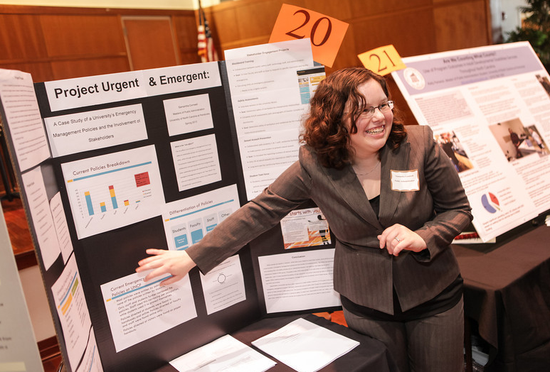
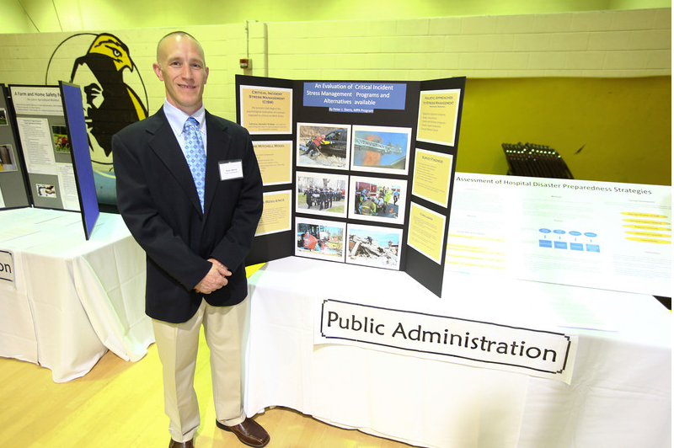
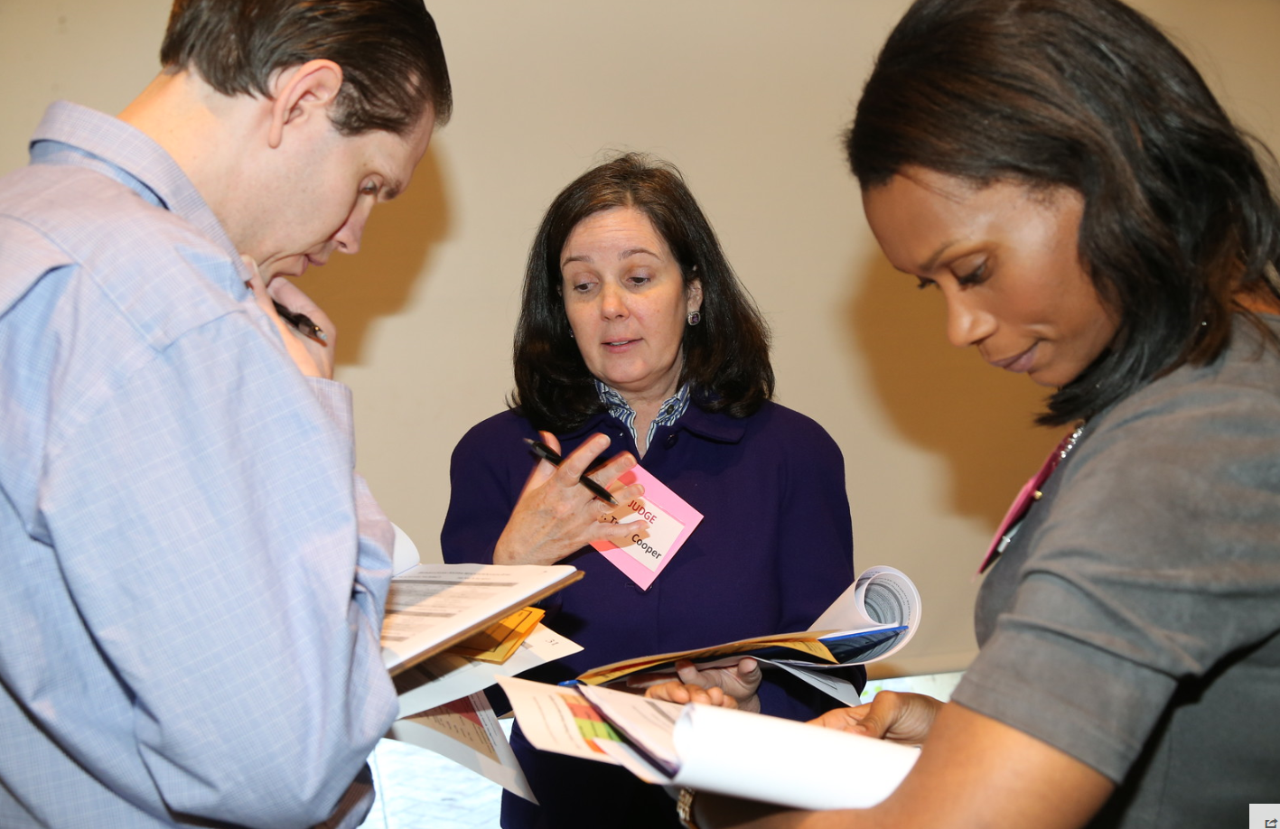
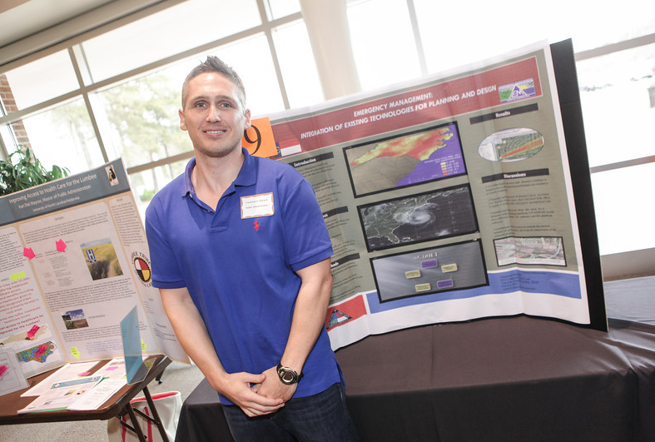
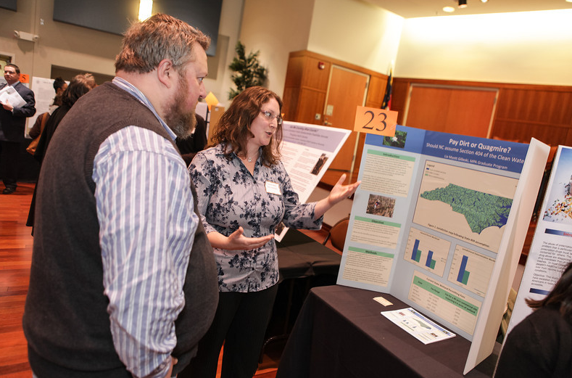
Research poster presenters can elect to have their work judged by a panel, the winners of which attend and present their work with other graduate students from across the state to NC legislators at an annual Graduate Education Day held each May at the legislative building in Raleigh, NC.
During the symposium, program directors and students from the various graduate programs are available to address inquiries related to program-specific admission requirements, program components, and curricula for the Open House portion of the event.

