Slide 1
KDP Initiation Ceremony Template
November 7th, 2023

Slide 2
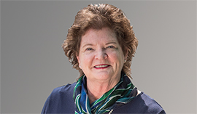
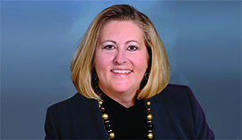
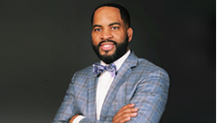
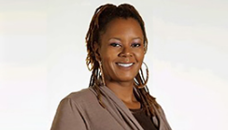
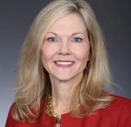
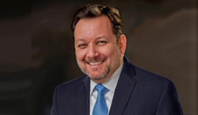
Dr. Elizabeth Elliott
Dr. Misty Hathcock
Dr. Nichelle Cook
Fred Yeakey
Kimberly
Stewart-Brinston
Society President
President-Elect
Council Member
Council Member
Council Member
Brad Gillum
Paul Kleinkauf
Dr. Irene Aiken
Council Member
Board Treasurer
Chi Zeta Chapter
Counselor

Slide 3
Benefits!
Get up to $1 million in professional liability Insurance coverage for free to protect you in your career.
Prepare for your job search, find positions, get job alerts, and post your résumé in the Career Center.
Read valuable teaching tips and advice weekly that address a wide variety of challenging issues you may encounter as a new teacher.
Use nation-wide banking and financial services ranging from Signature Federal Credit Union.
Experience KDP Convocation for aspiring teachers filled with inspiration, ideas, and interactive events --St. Louis, MO Nov. 2-4, 2023!
Save money on everything from classroom supplies to car insurance offered to KDP members through discounts from KDP Partners.
Connect 24/7 in our member-only online community for peer collaboration and guidance.
Access to nearly $50,000 in KDP scholarships – applications open Spring.

Slide 4
Jasmine Ake Cecilia Joy Becerra Brandon P. Bowden Jamie Lynne Bradley Patricia S. Brayboy Michelle J. Bryant Sonja Butler-Alford Melissa J. Chiti Anthony Church Chentia C. Cloud Pamela Danette Eseigbe Caitlin Janee’ Faison Kiaynne Mychelle Fletcher Carmi Green Kristie Florido Ruiz Schnelle Garcia Lopez Helen Ann Goodrich Crystal Shamera Graham Susan Hawkins Merrica Hoskins Alaina C. Hunt Katina Lazette Hunt Heather Junell Jacobs Jakya Z. Johnson Reneba Dayon H. Johnson Ernesha T. Knight Dora Renee Locklear Amber Meares-Howard Jennifer M. Moses April F. Payne Darlene Renee Revoir Sheila Ann Sandidge Mary Singletary-Hinson Sonya Kay Smith Tiffany Sutton Hailey Sweat Jamie Thaggard Aytoiya Katrice Thompson Camille Ashley Wallace Jon Weavil Tonya L. White

Slide 5
KDP History
Kappa Delta Pi, known as KDP, was founded on March 8, 1911, at the University of Illinois by Dr. William Bagley. KDP became incorporated on June 8, 1911. Annually, we celebrate March 8 as KDP’s Founders Day.
KDP has evolved over 100 years to become the largest national honor
society in education, and you are proudly joined by 35,000 peers and
more than 700 chapters.

Slide 6
The Principles of KDP

Slide 7
The symbols of KDP are infused with deeper meaning. Our Emblem contains four primary elements, all of which represent aspects of our history, purposes, and intent.

Slide 8
- I promise to abide -
- by the standards of KDP -
- and to expand the influence -
- of its purpose and Principles. -

Slide 9
As a member of KDP, you will exemplify the qualities of a teacher of excellence throughout the changes, challenges, and opportunities you experience.
Your KDP journey includes being a member in a prestigious national community, being honored and celebrated for your calling, building your professional competencies, and receiving ongoing support as you strive to provide a quality, equitable education for all.

Slide 10
Welcome to KDP!

