Slide 1
Simple conversions
LEC

Slide 2
Pre-quiz
How many liters is in 1000 milliliter?
How many kilograms is in 1000 gram?
How many meters is in 100 centimeter?
How teaspoons is in 5 milliliters?
How milliliters is in 1 tablespoon?
How many ounces is in 1 pound?
1 ounces equals how many milliliters?
1 kilograms equals how many pounds?

Slide 3
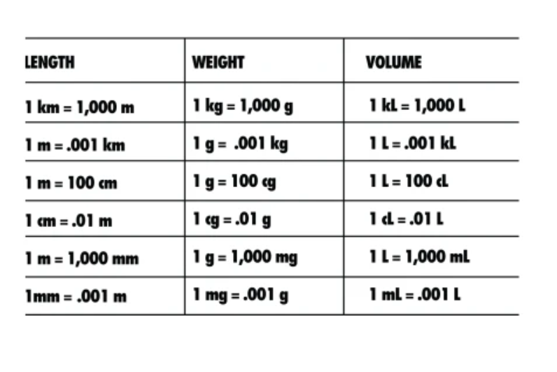
Metric System
Weights
Grams, Kilograms
Medications
Micrograms, milligrams, & grams
Measure volumes
Milliliters, Liters
Measure lengths
Millimeters, centimeters, meters

Slide 4
Simple conversions
1 teaspoon = 5 milliliters
1 tablespoon = 15 milliliters
1 ounce = 30 milliliters
2.2 pounds = 1 kilogram
Celsius (C) = (F-32)* 5/9
Fahrenheit (F) = (C * 9/5) +32

Slide 5
Post-quiz
How many liters is in 1000 milliliter?
1 liter
How many kilograms is in 1000 gram?
1 kilogram
How many meters is in 100 centimeter?
1 meter
How teaspoons is in 5 milliliters?
1 teaspoons
How milliliters is in 1 tablespoon?
15 milliliters
How many ounces is in 1 pound?
16 ounces
1 ounces equals how many milliliters?
30 milliliters
1 kilograms equals how many pounds?
2.2 pounds

