Slide 1
Important Medical terminology
LEC

Slide 2
Pre-test
What does PO stand for?
What is the approved abbreviation for topical?
What does NPO stand for?
What is the approved abbreviation for liquid?
What ID stand for?
What is the approved abbreviation for suspension?

Slide 3
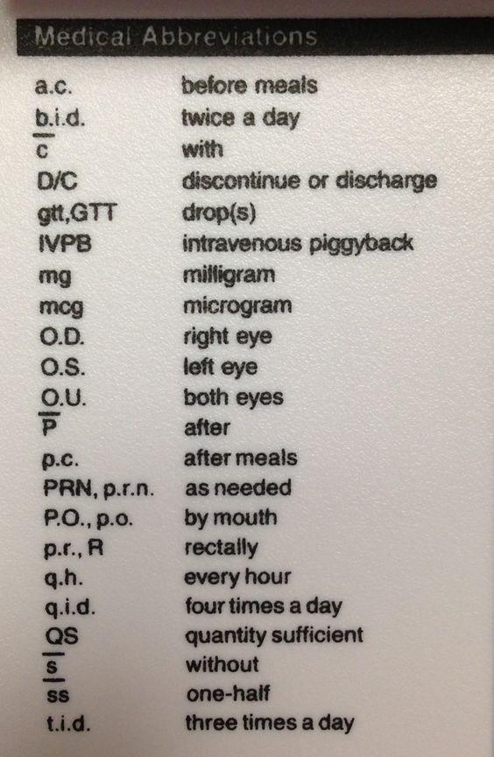
Medical terminology
Po = by mouth
Sl = sublingually
Id = intradermal
Im = intramuscular
Iv = intravenous
Top = topical
P = after
C = with
S = without
Liq = liquid
Susp = suspension
NPO = nothing by mouth

Slide 4
Post-test
What does PO stand for?
By mouth
What is the approved abbreviation for topical?
Top
What does NPO stand for?
Nothing by mouth
What is the approved abbreviation for liquid?
Liq
What ID stand for?
Intradermal
What is the approved abbreviation for suspension?
Susp

