Slide 1
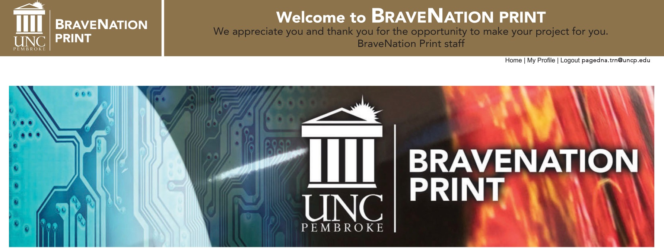
To Submit an Order
If you have a profile log in to bravenationprint.uncp.edu
From the landing page select start new order
Select product lines from the tabs along the left side

Slide 2
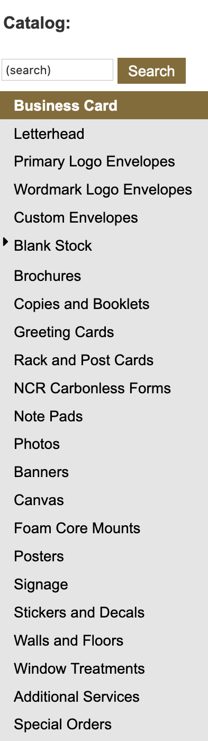




Select the desired product line from the tabs at the left

Slide 3
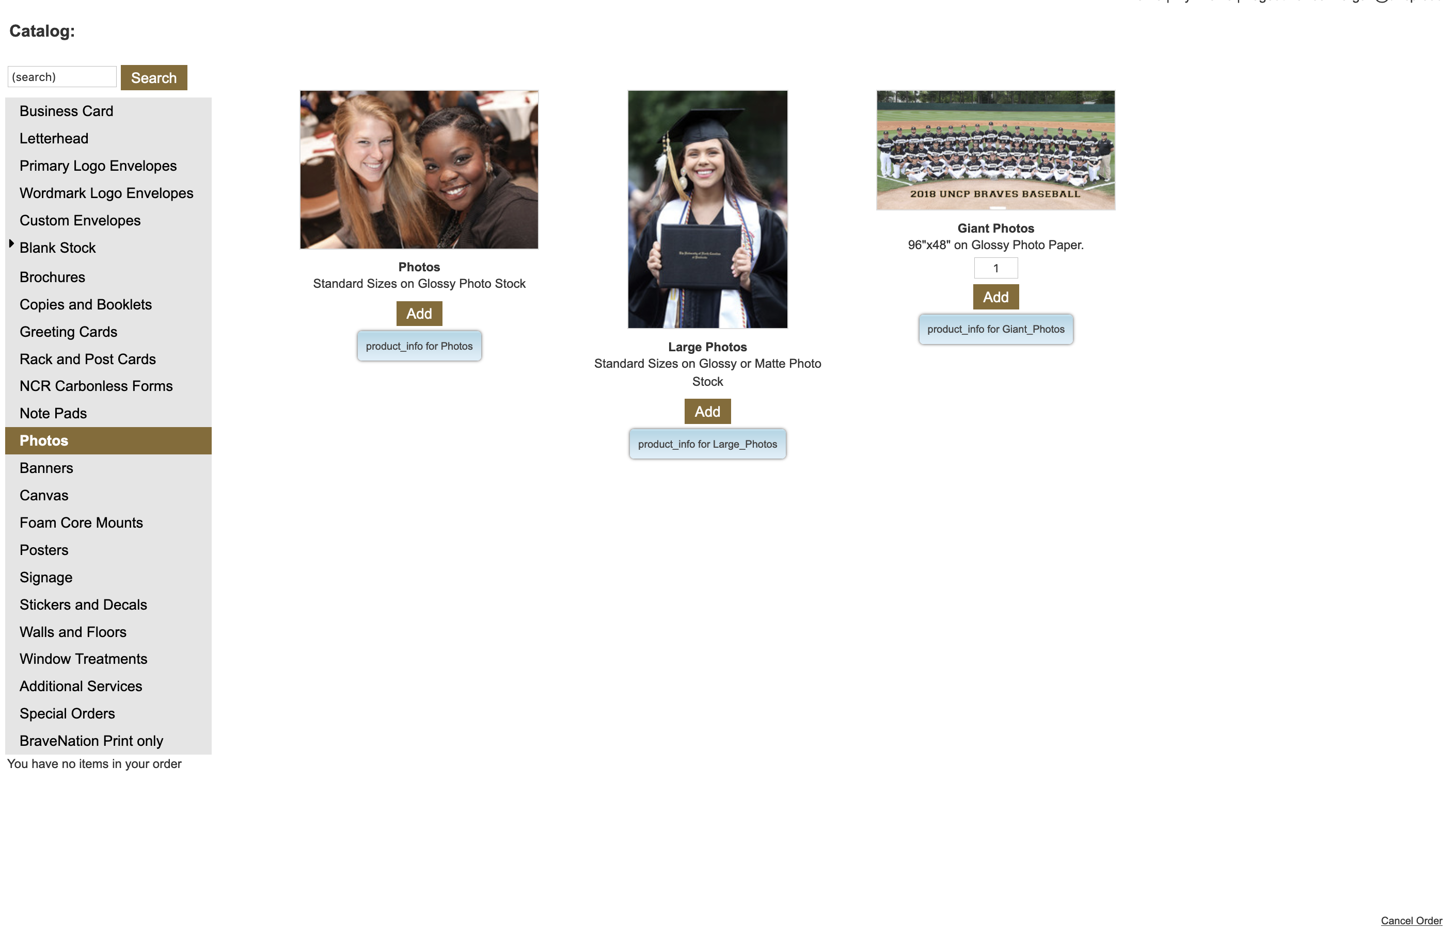
Once you have selected the product line you can filter to the exact product by selecting Add under the product that you want to order.
Cancel Order

Slide 4
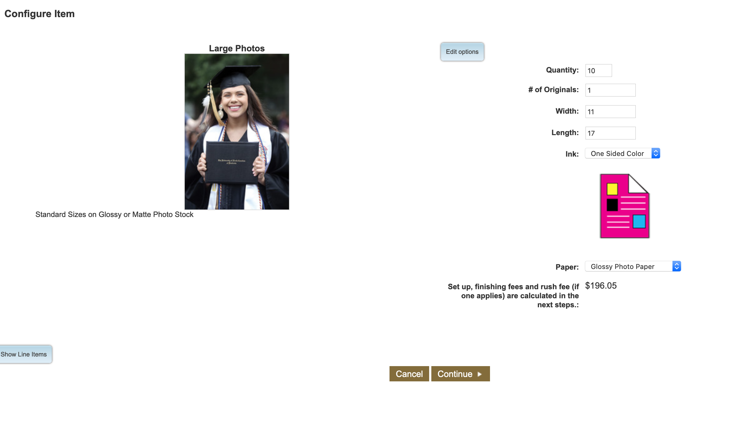
Configure the item
Fill in the information and the price will generate below.
Once you are satisfied click continue.
You will be taken to an upload page.
Cancel will take you back

Slide 5
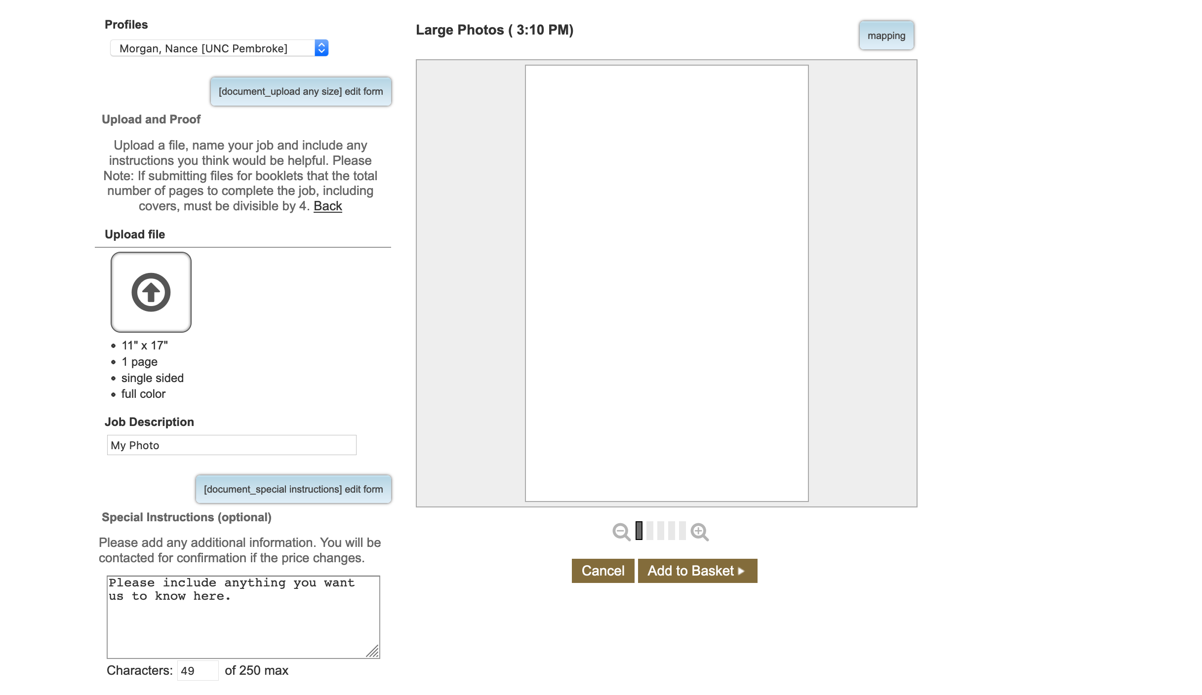
Upload your file
Click on the arrow button
Select the file to upload

Slide 6
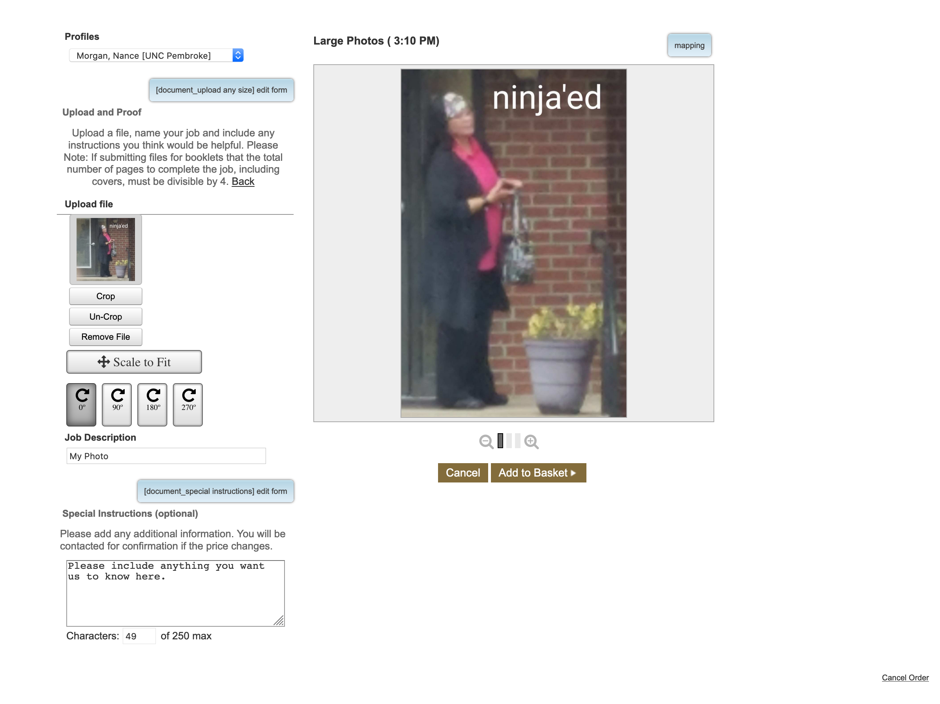
Once your file is uploaded select
add to basket to be taken to
an approval option.

Slide 7
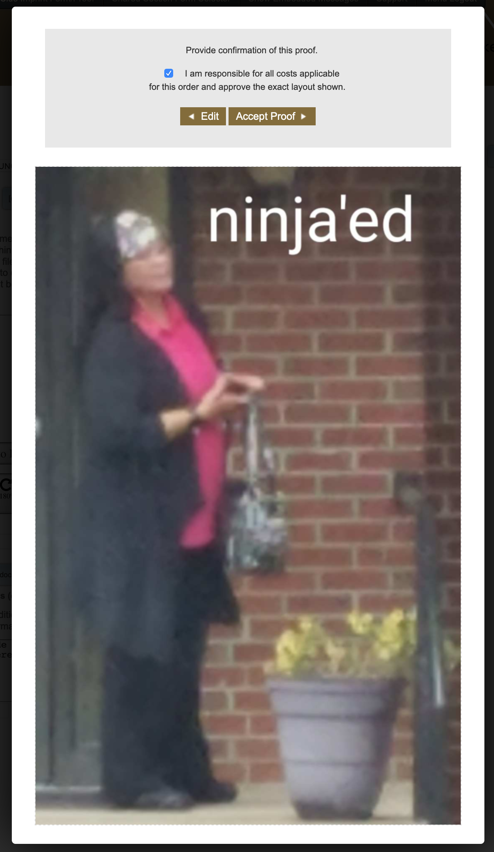
This image is obviously blurred so you may want to choose edit and return to upload another image or upload an edited file of this image. Who is this mystery woman?
If you are satisfied with it check the box indicating that you are responsible for the image content and select Accept Proof

Slide 8
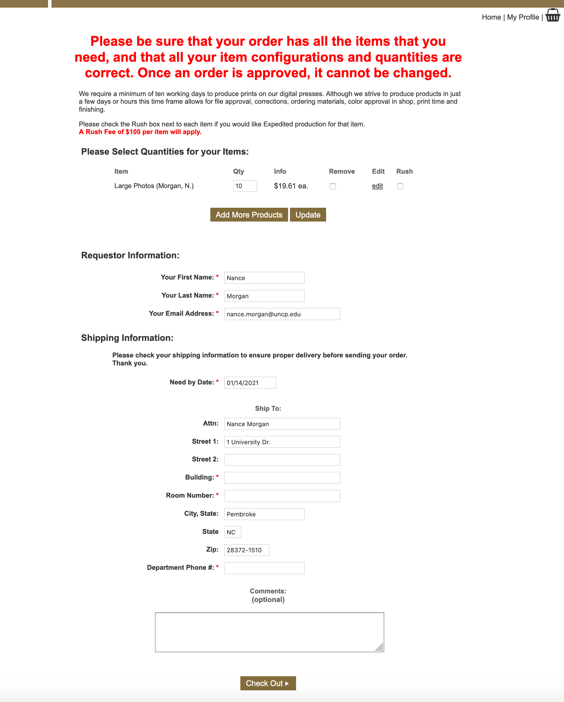
Here you will see the total of your order and what you ordered.
If you have other items to order, click the Add More Items button.
Select rush if you need sooner than 5 business days and click Update.
Fill in requestor (that’s you).
Select a need by date.
We require 5 business days, or a late fee will be added to your total.
Fill in shipping information. Red asterisks indicate required fields.
Include any questions or comments here. This is optional.
Check Out

Slide 9
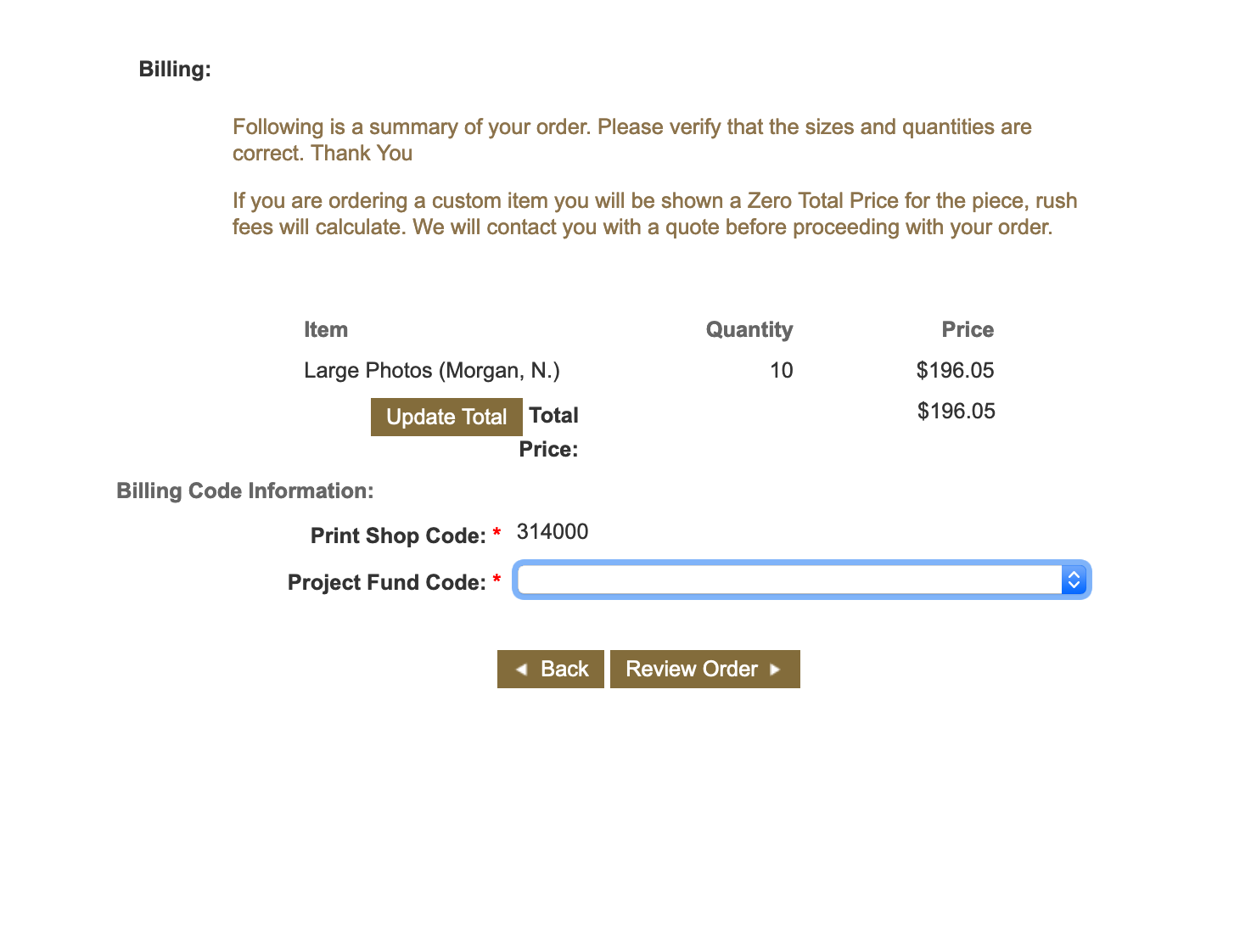
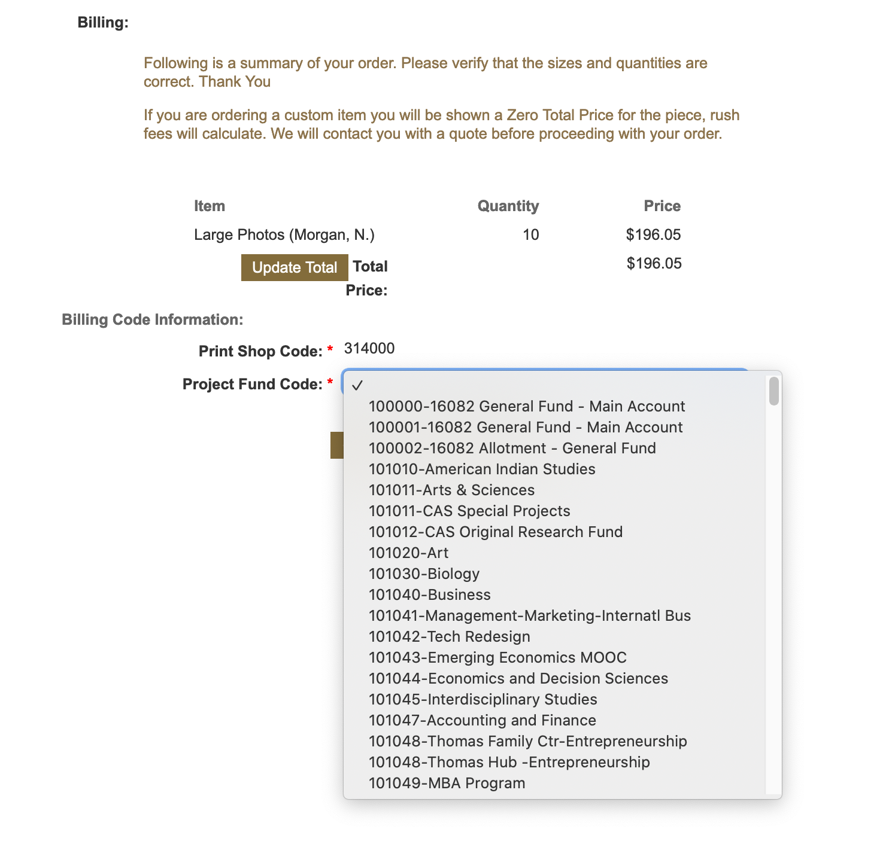
Now you see the total of your order, the Print Shop Fund Code,
and the Project Fund Code.
We cannot print jobs without this information, and you cannot finalize
the order without it.
When splitting the cost between one or more fund please call us.
As you begin to type your fund number a drop down will appear,
you can continue to type or use the drop down.
Once the fund number is entered click Review Order

Slide 10
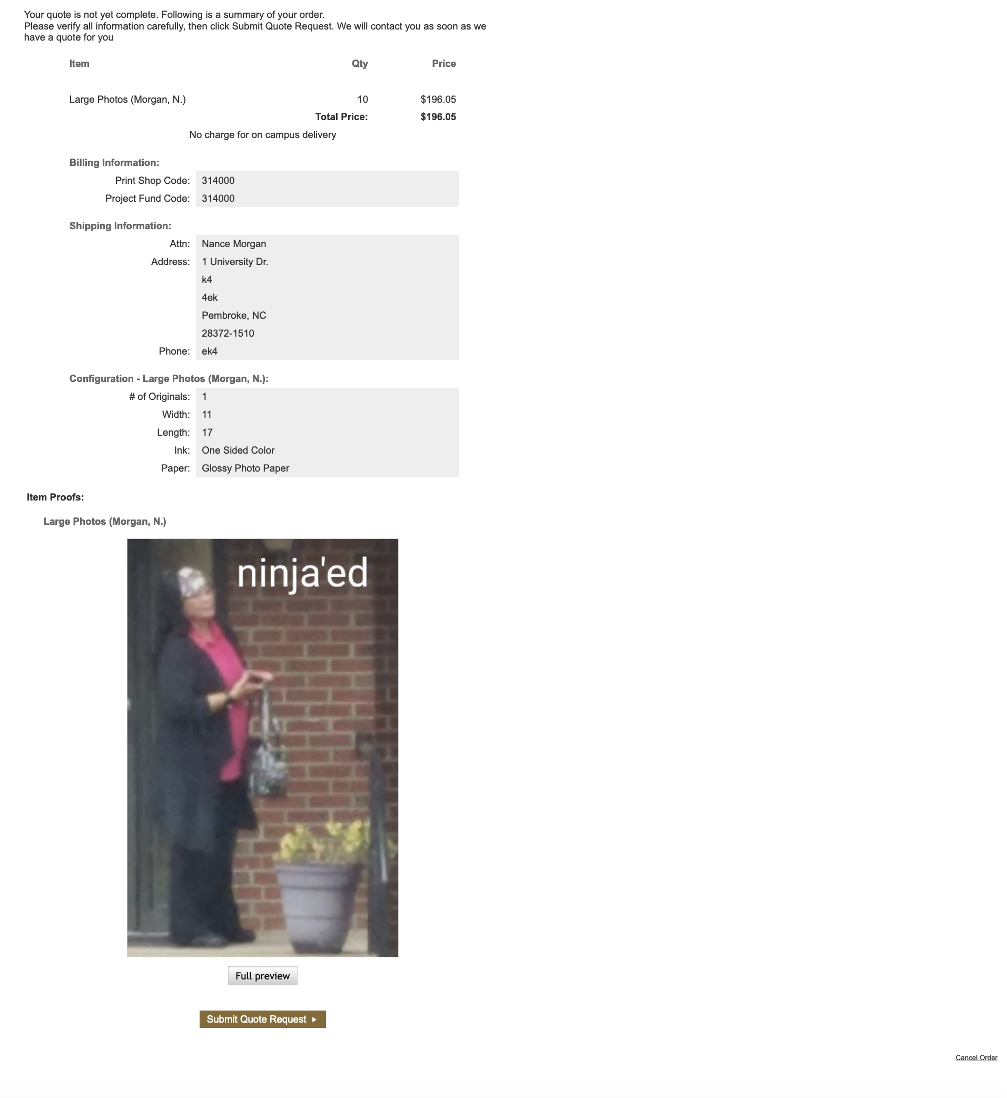
Submitting Your Order
Here you have 1 last chance to review your order for accuracy.
Once you are satisfied click Submit
If you decide its all wrong or you change your mind click cancel in the bottom right- hand corner and you will be returned to the Home Page.

Slide 11
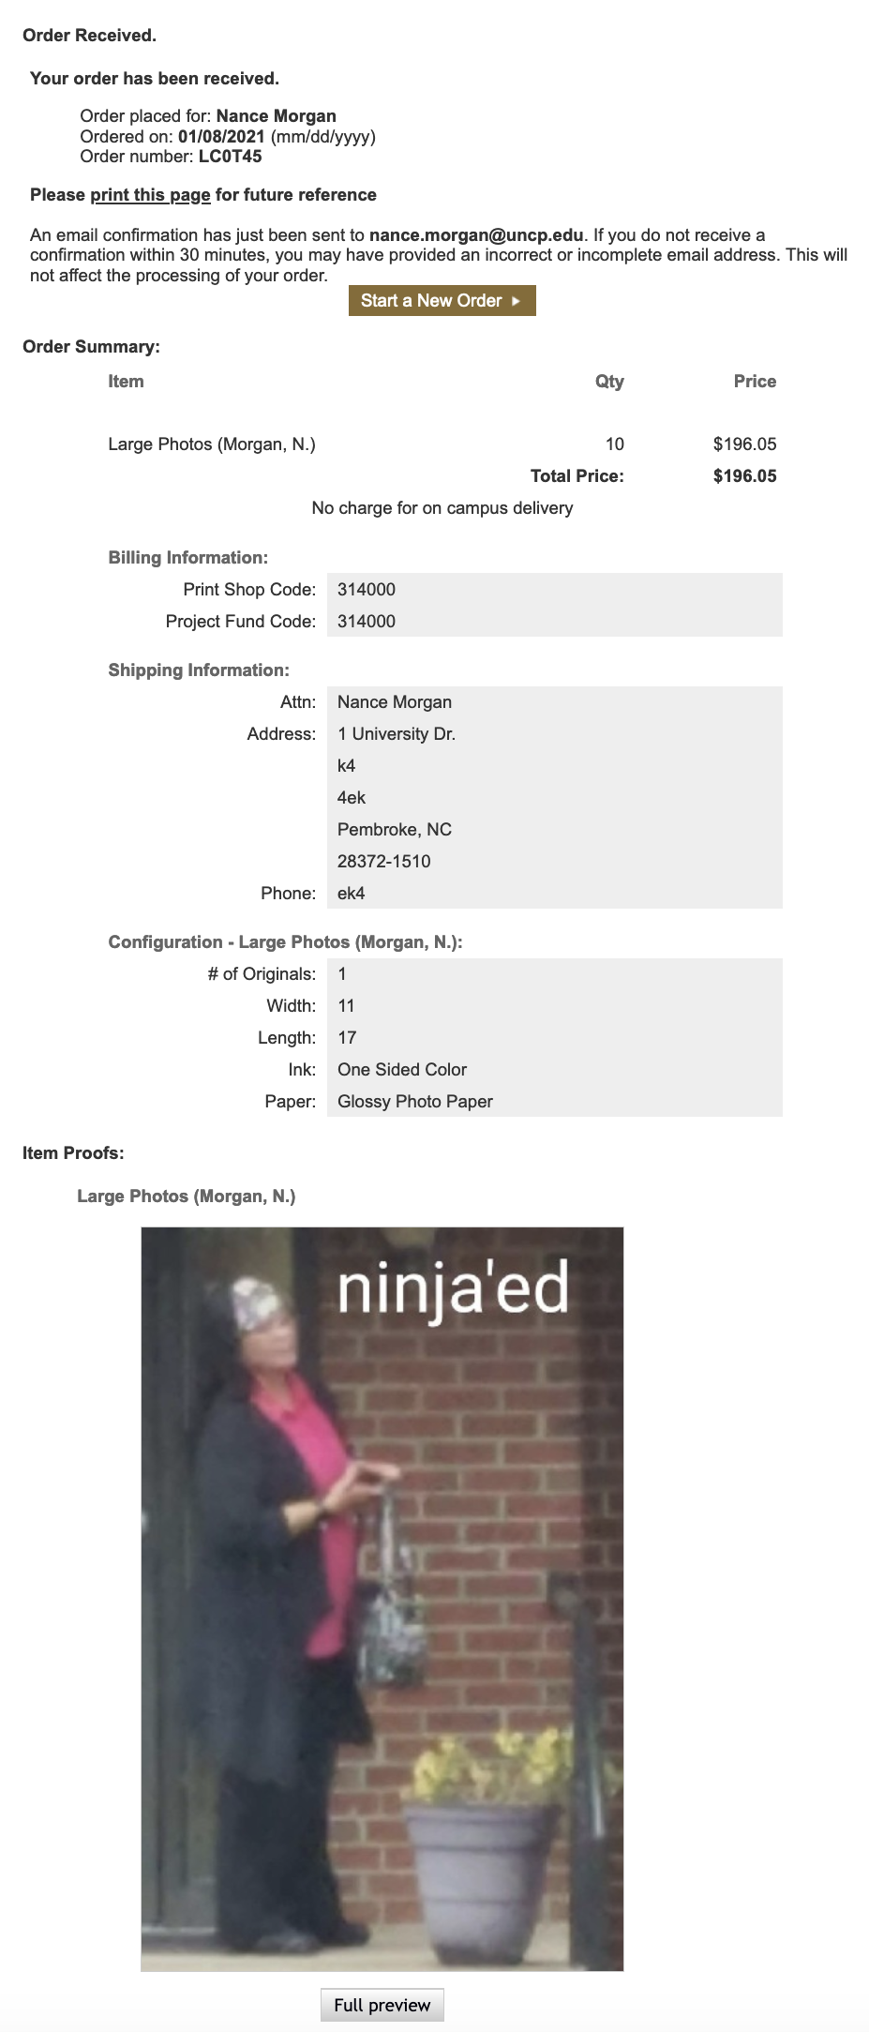
Order Received
Once you see this page you know
that your order has been received by BraveNation Print.
This triggers an email to the fund manager to approve
the funds to produce the job.
Once the fund manager responds to the link in that email and approves,
the job it is automatically moved to our Production Queue.
Waiting for approval will delay your job and end up costing you a rush fee.
We will send a reminder in 2- 3 days, but a reminder from you at the time
is helpful to these very busy fund managers.
As the requestor you will also receive an email to confirm the order
with a link that will let you track the job progress.

Slide 12
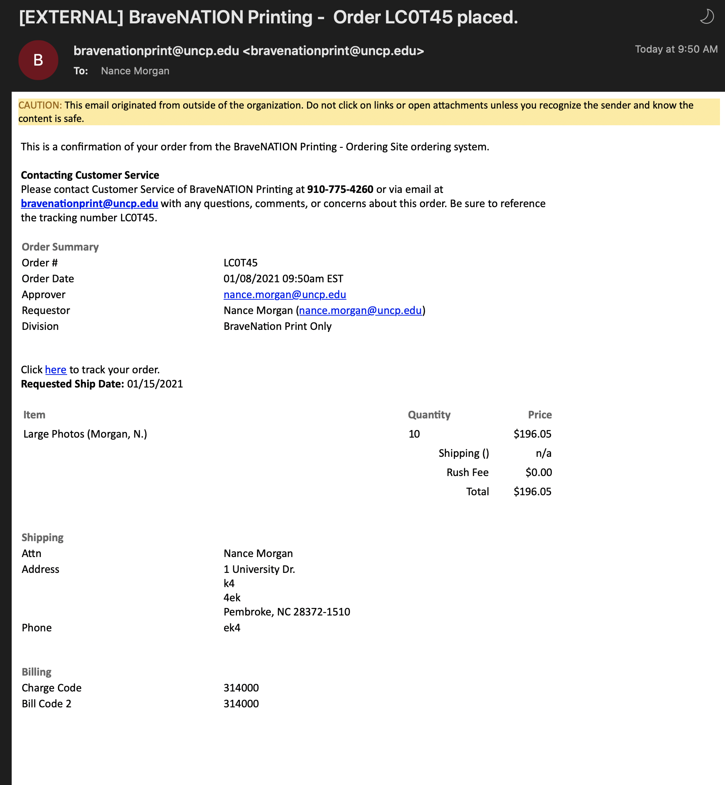
Sample of Requestor’s email

Slide 13
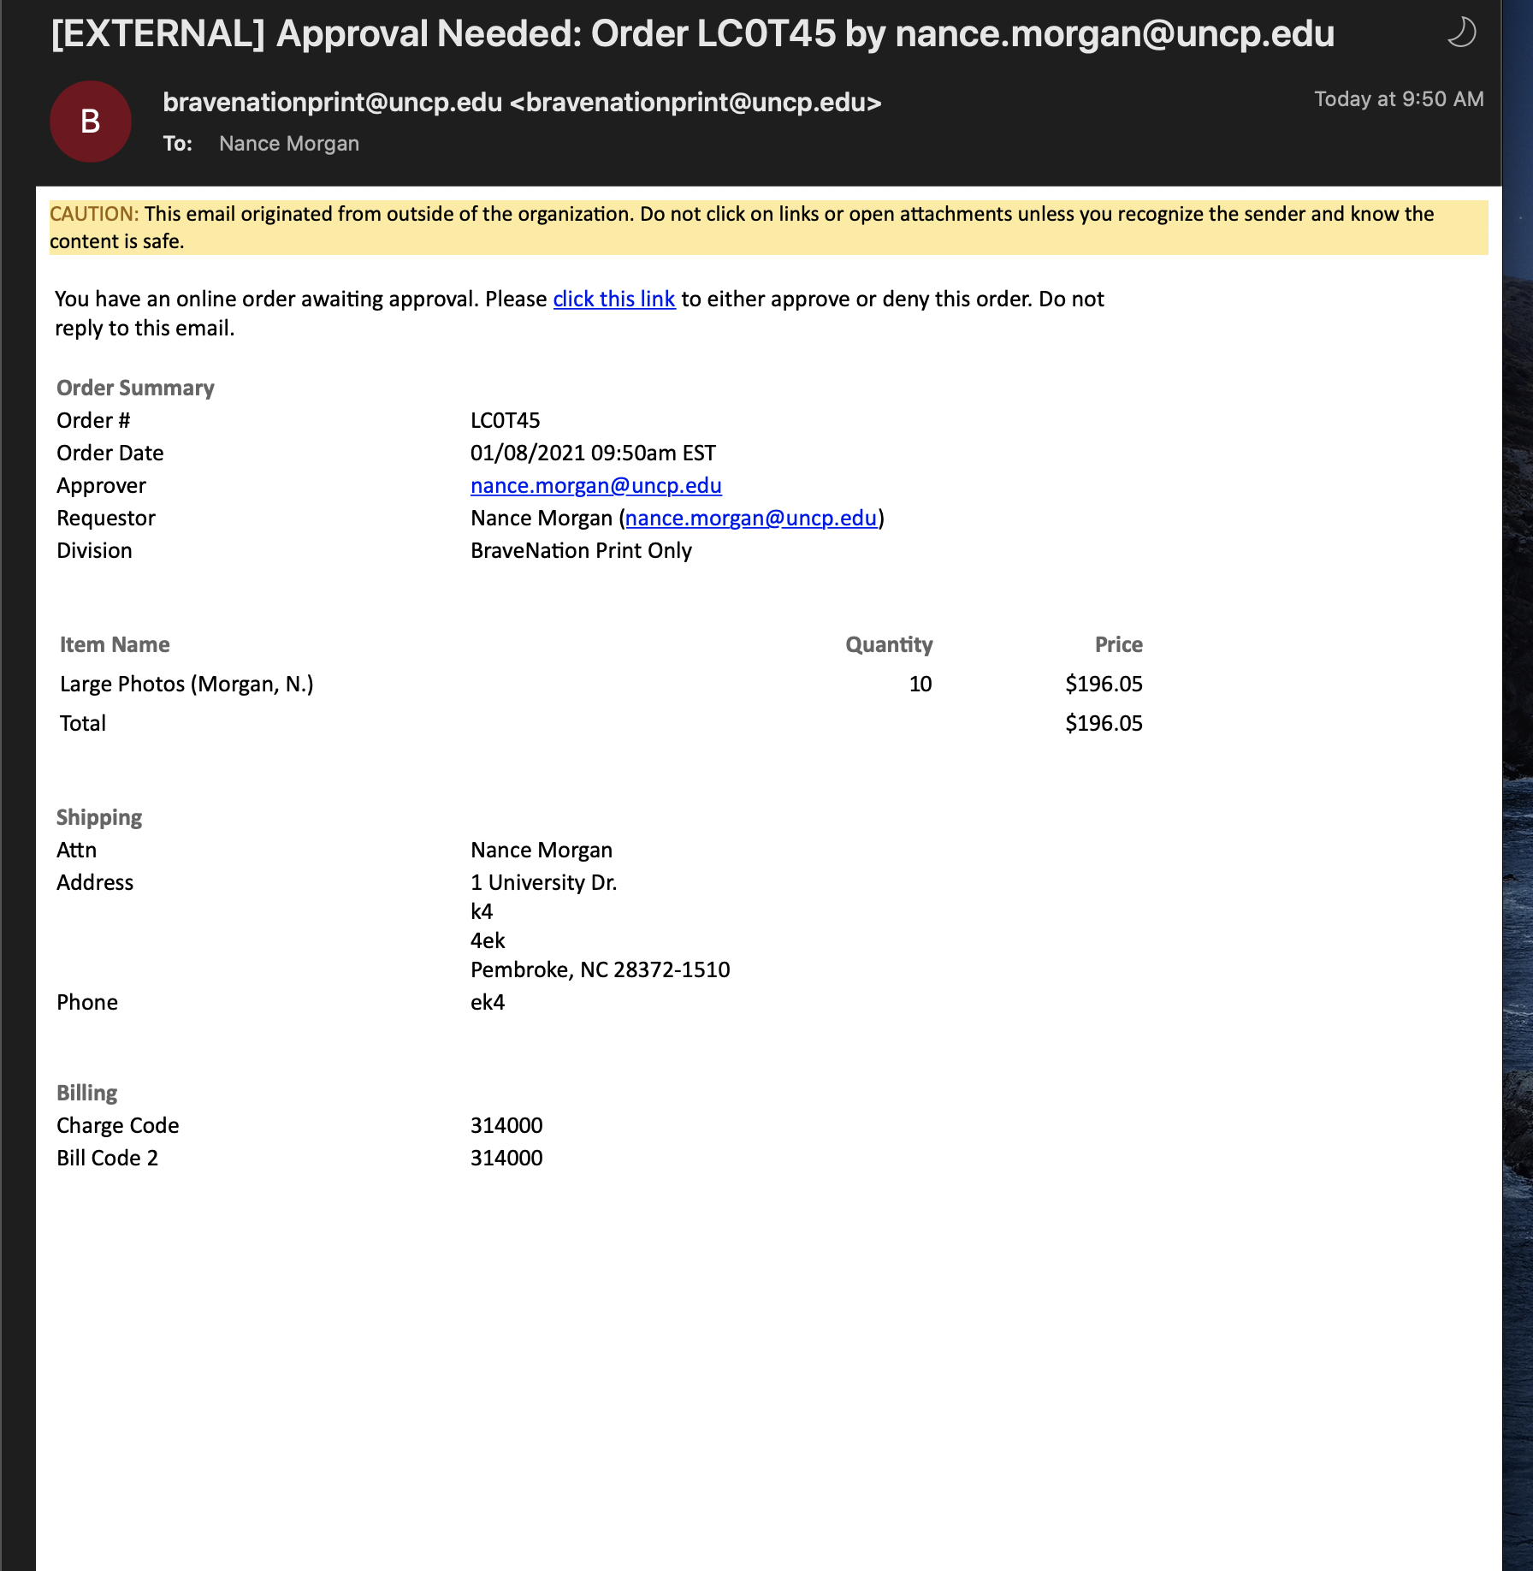
Sample of Fund Manager’s email

Slide 14

We are Here for You
BraveNation Print is here to assist you in anyway that we can.
Contact us if you need assistance with the ordering process.
We can help you to understand how your file needs to be produced before you get to the submittal process
Large Format: ext. 4220, Digital Press: 4260, Business Office: 6331
Thank you for choosing BraveNation Print.
View our How to Order Business Cards and Stationery demo, or
How to Set Up a Profile

