Slide 1
HR Essentials for Leaders
Online Performance Management System (OPMS)

Slide 2

Objective
To improve efficiency for Supervisory Staff
More effectively manage tracking and collection
Eliminate paper process

Slide 3
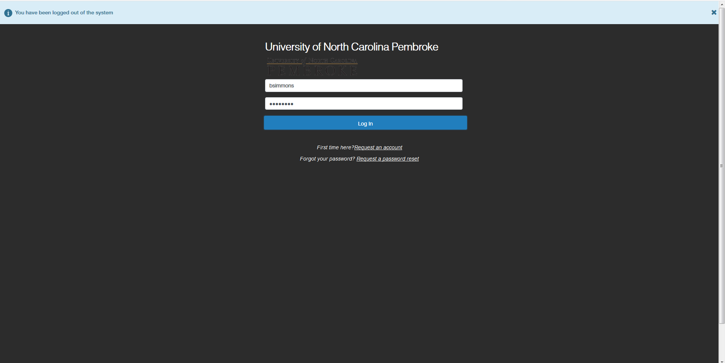
Login Screen
https://jobs.uncp.edu/hr/login

Slide 4
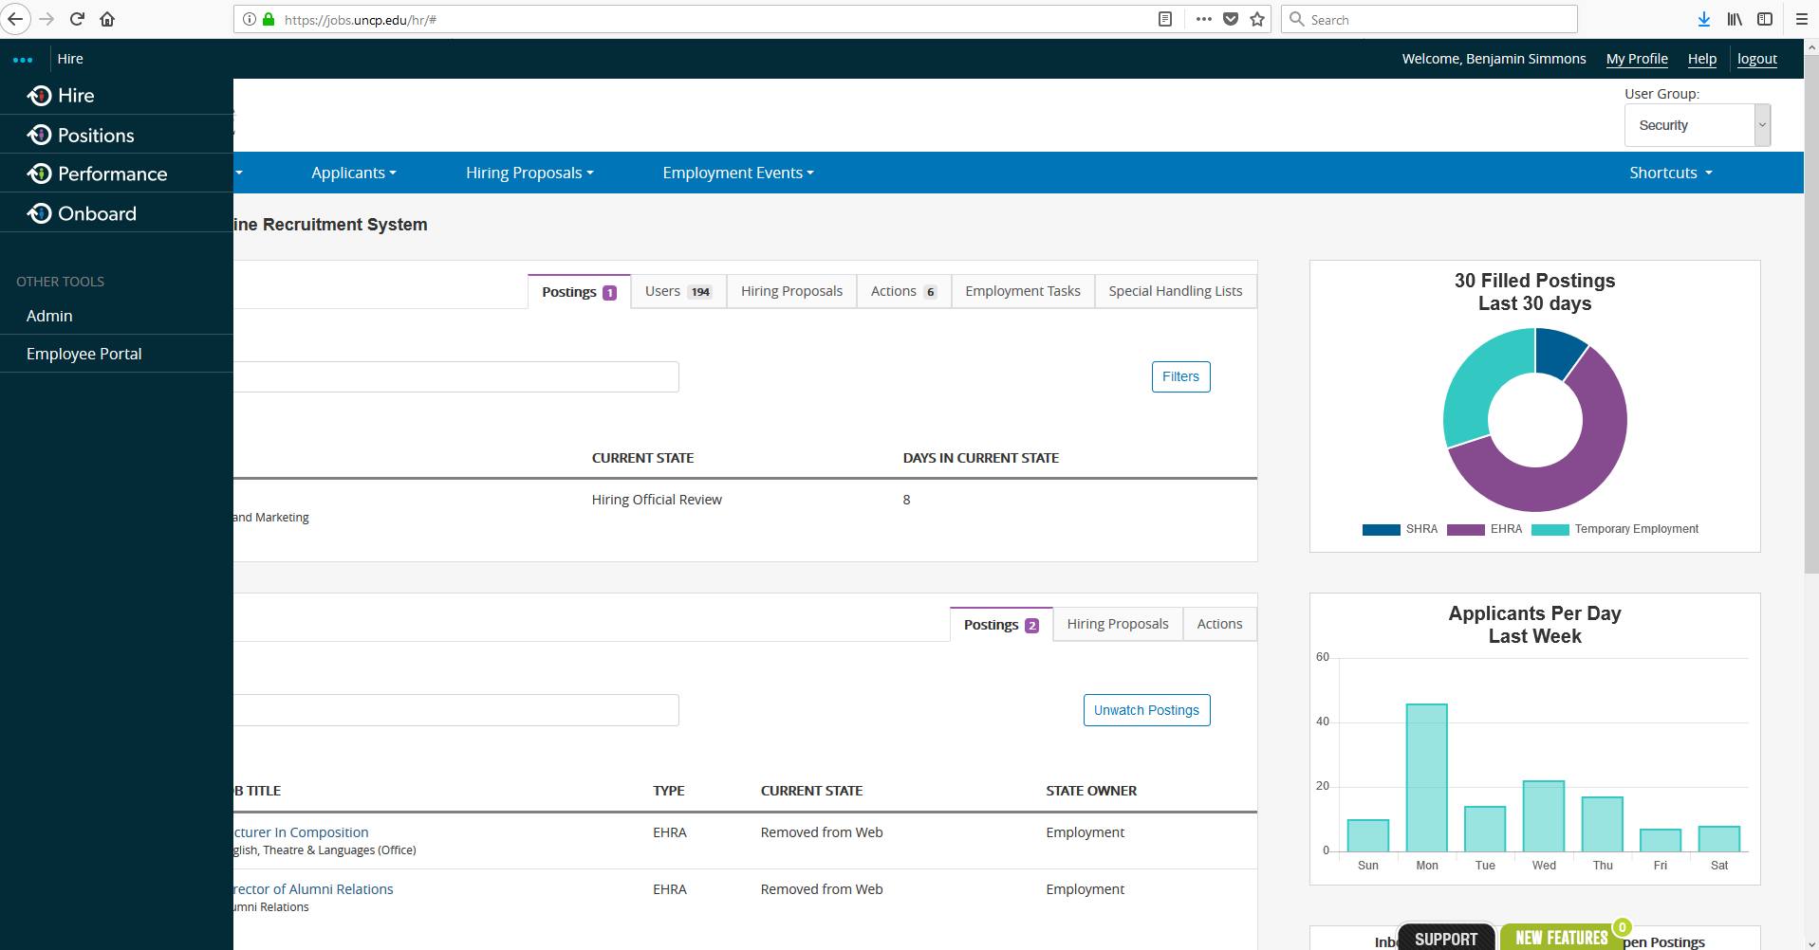
Introduction Screen

Slide 5
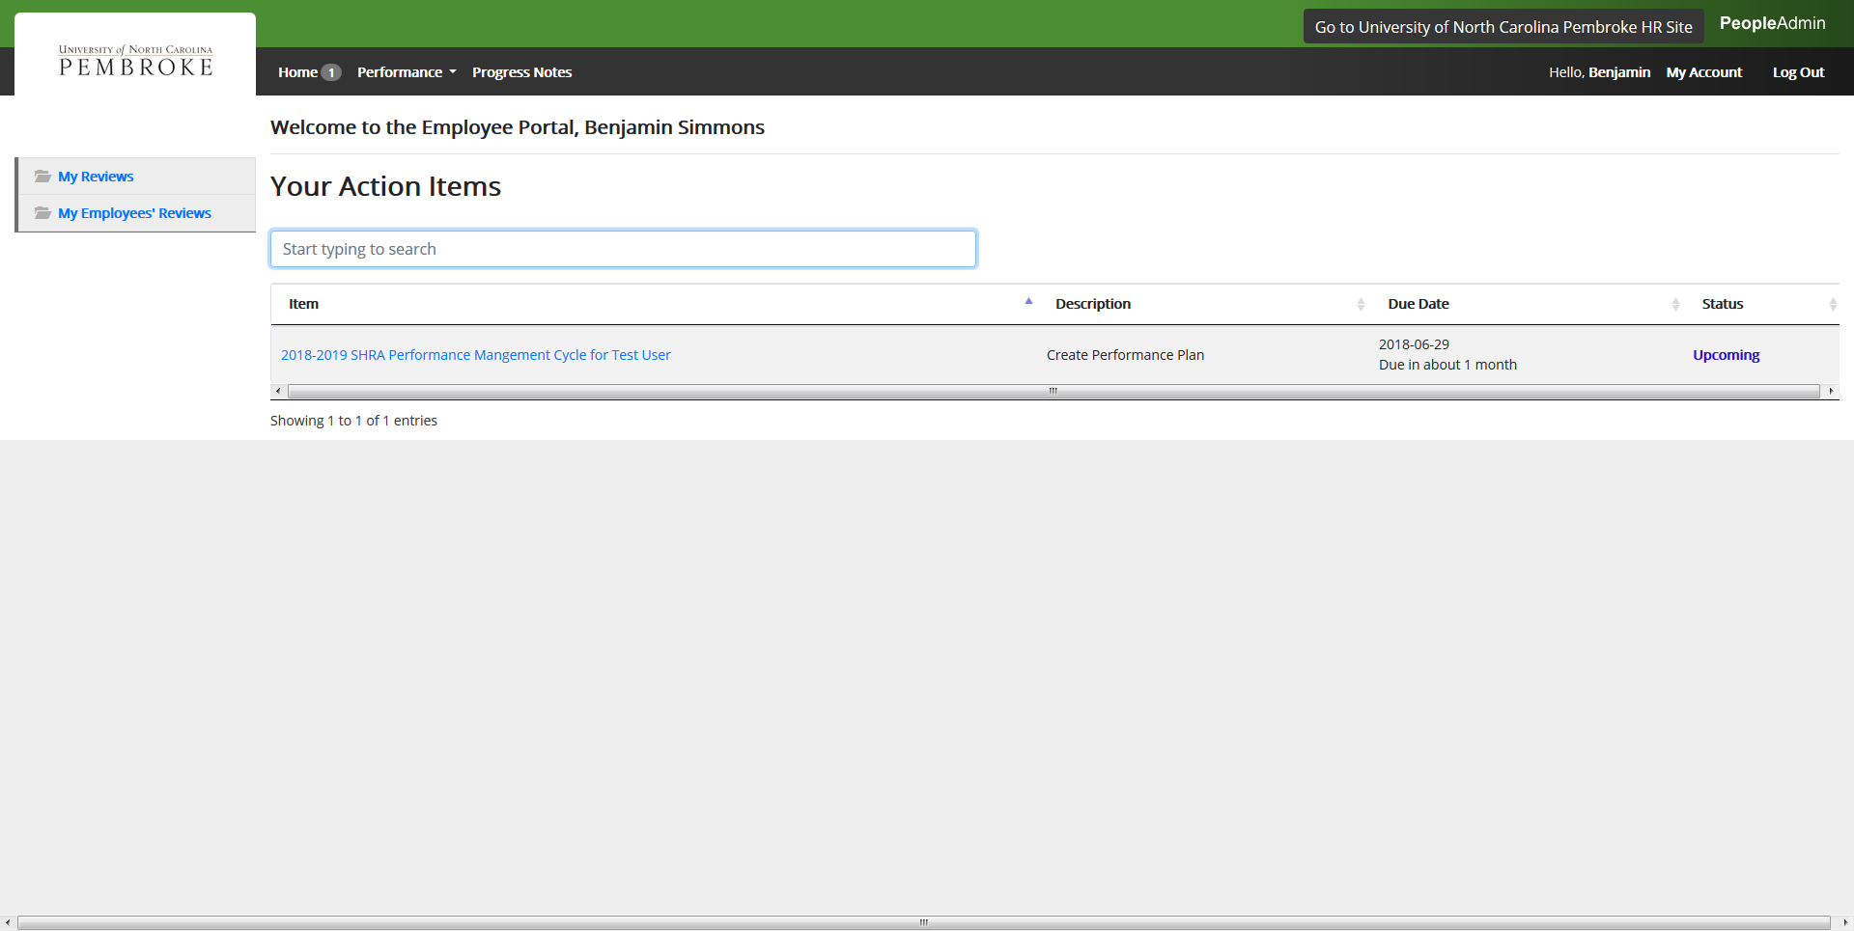
Employee Portal

Slide 6
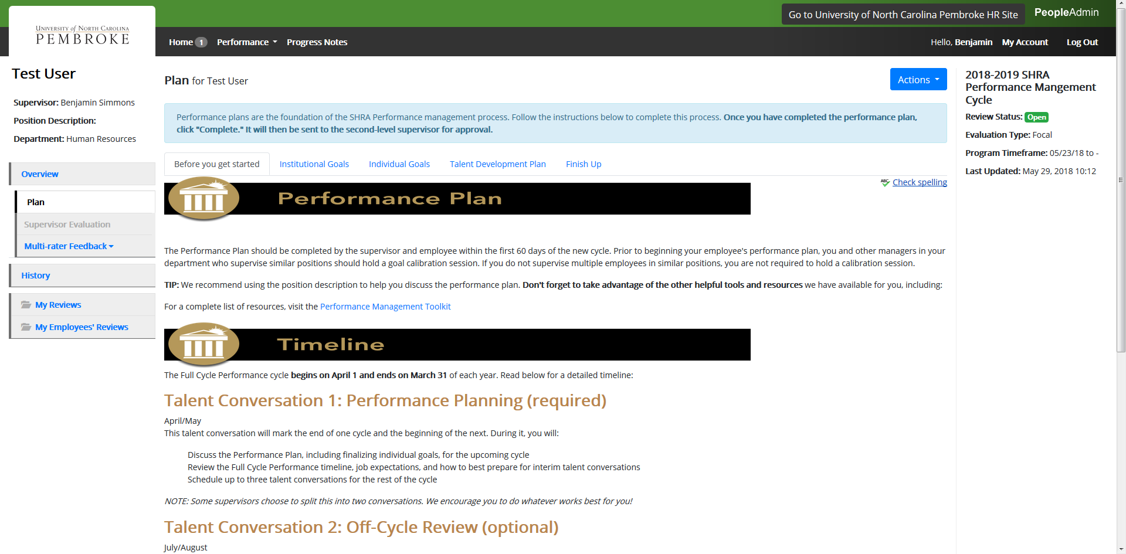
Before You Get Started

Slide 7
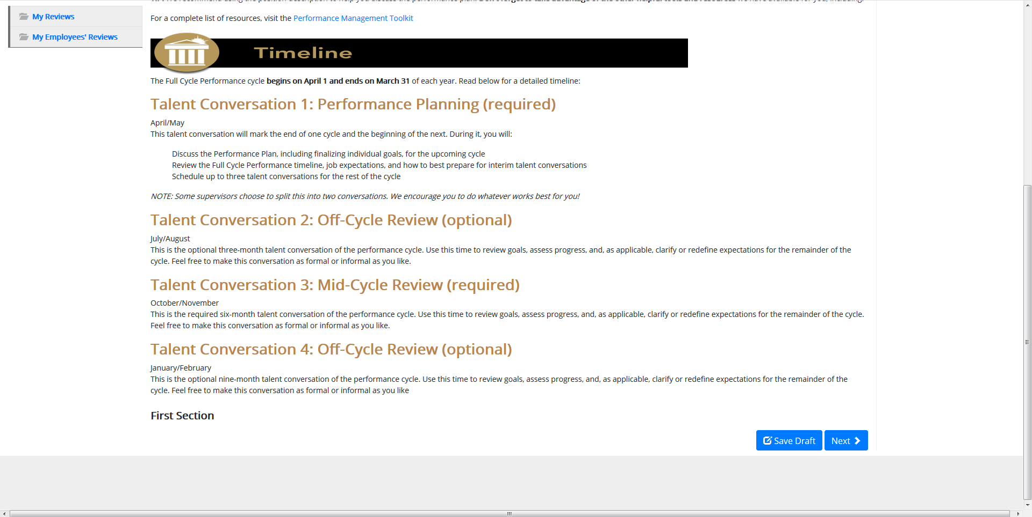
Before You Get Started

Slide 8
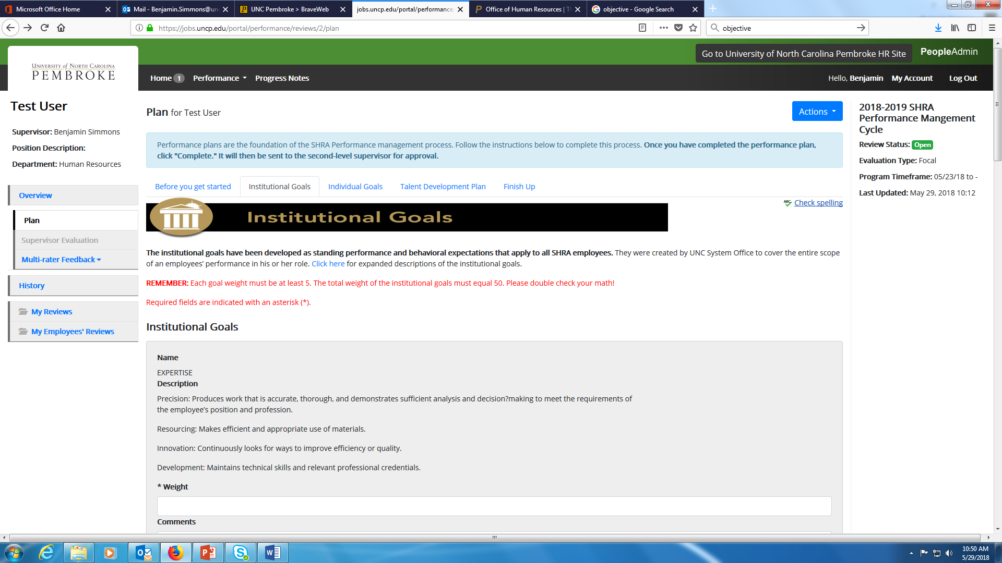
Create Plan-Institutional Goals

Slide 9
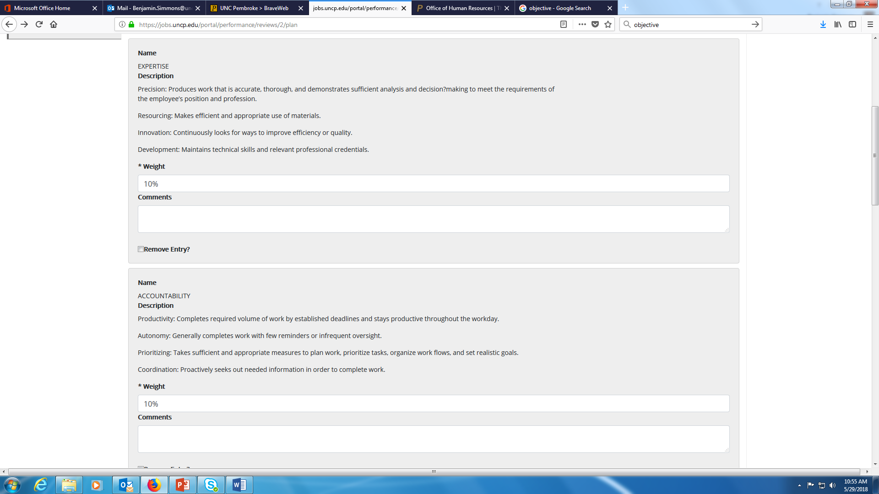
Institutional Goals

Slide 10
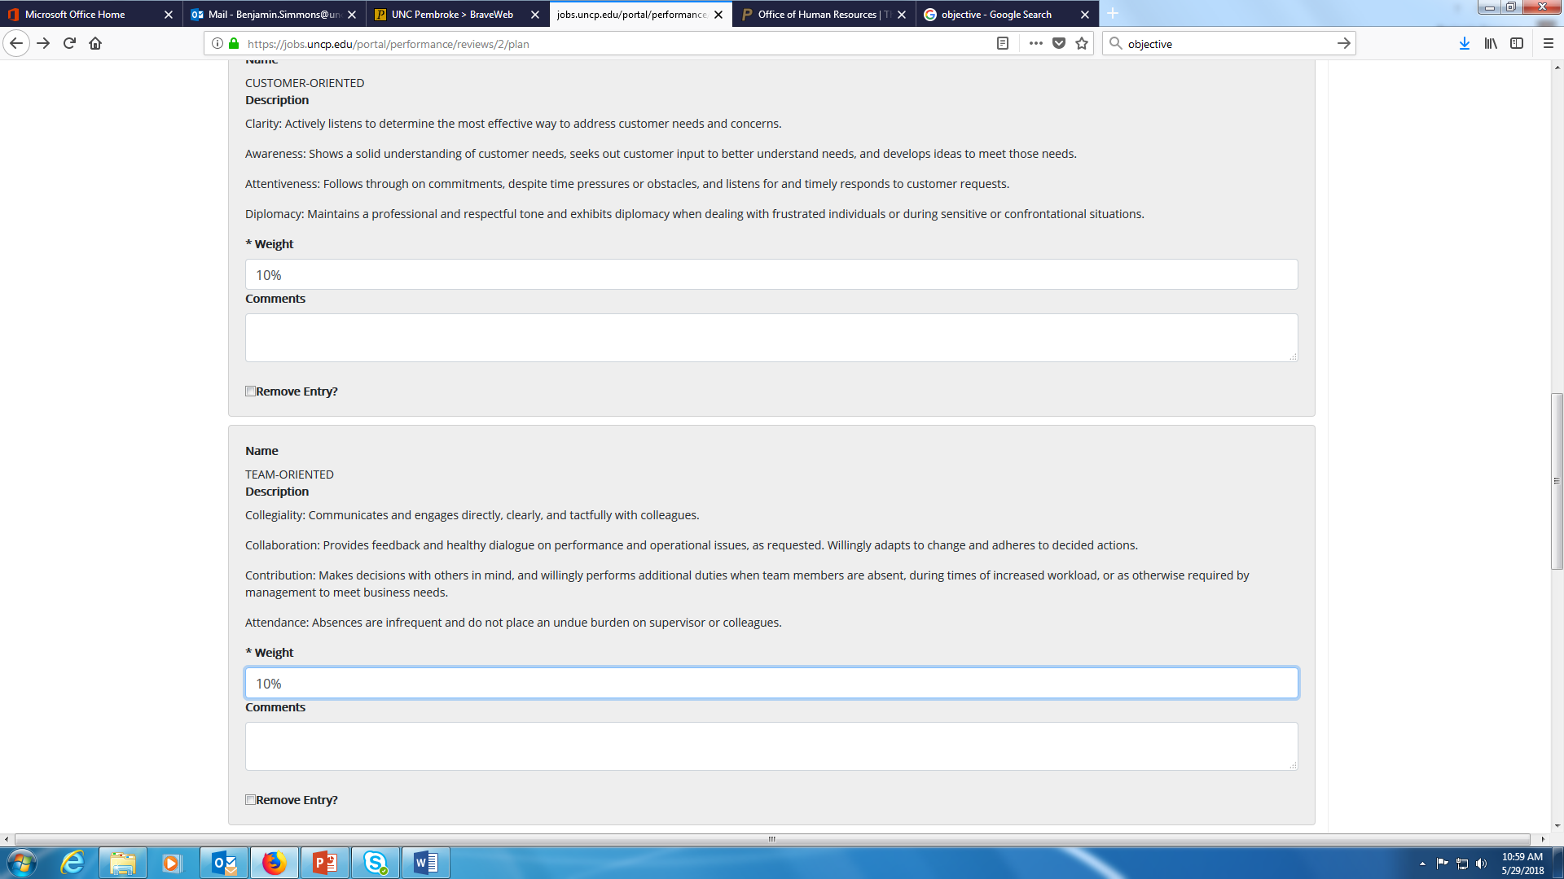
Institutional Goals

Slide 11
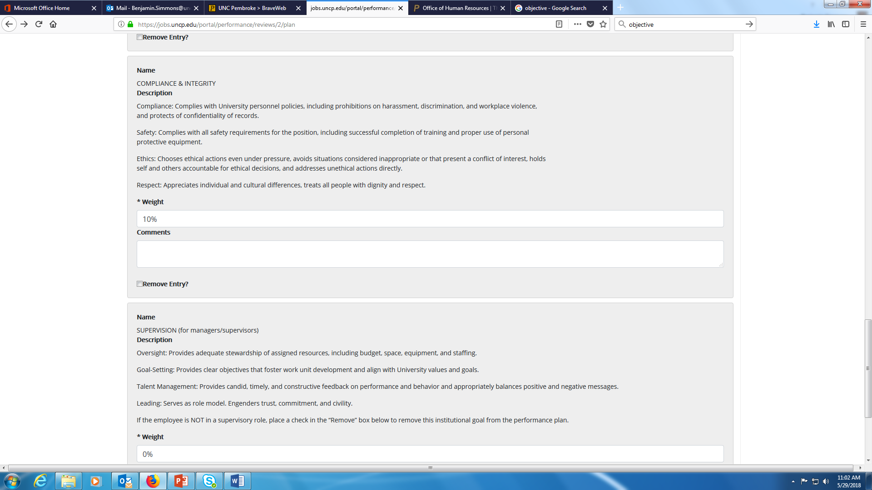
Institutional Goals
**0% for non-supervisors; or remove entry

Slide 12
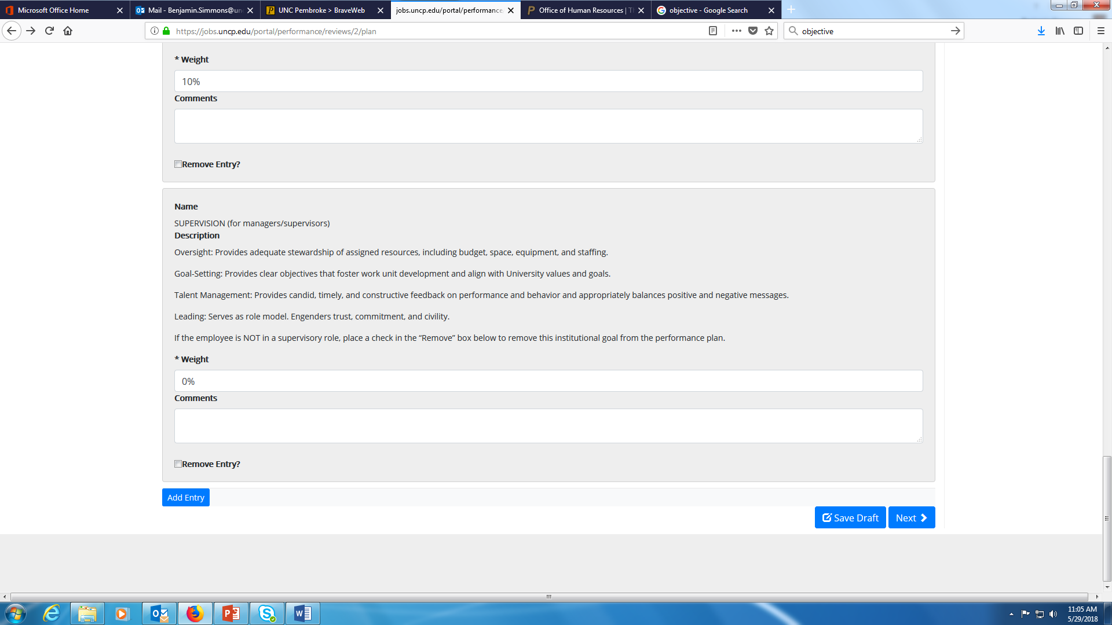
Save and Next

Slide 13
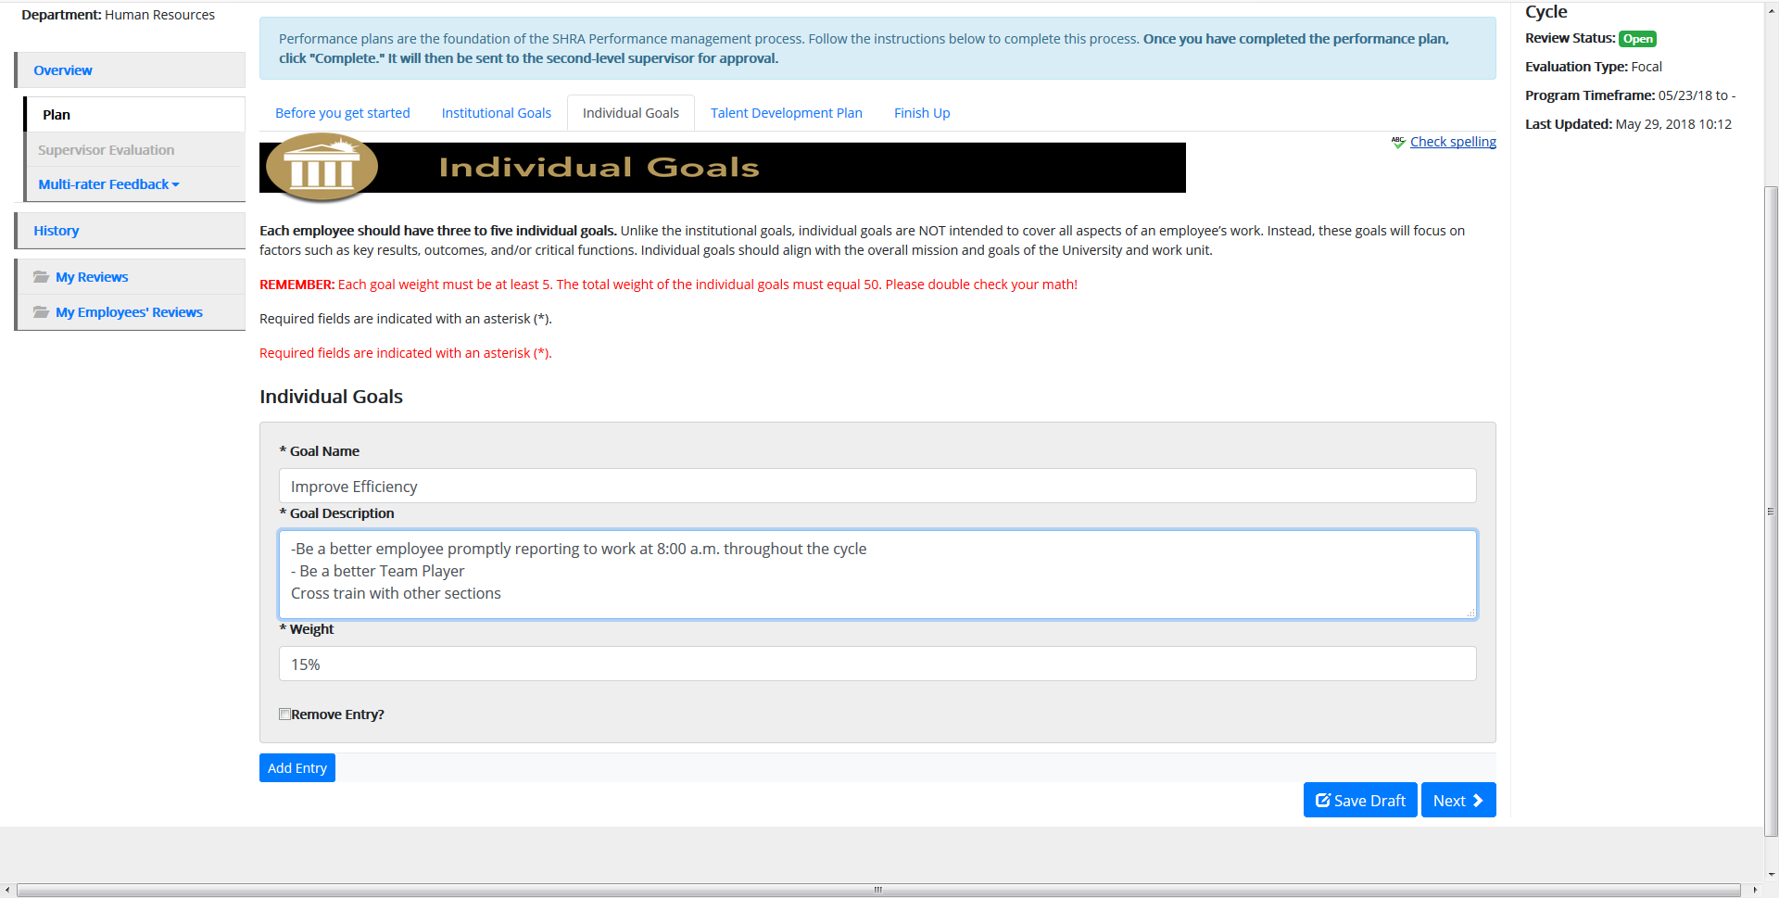
Create Plan-Individual Goals

Slide 14
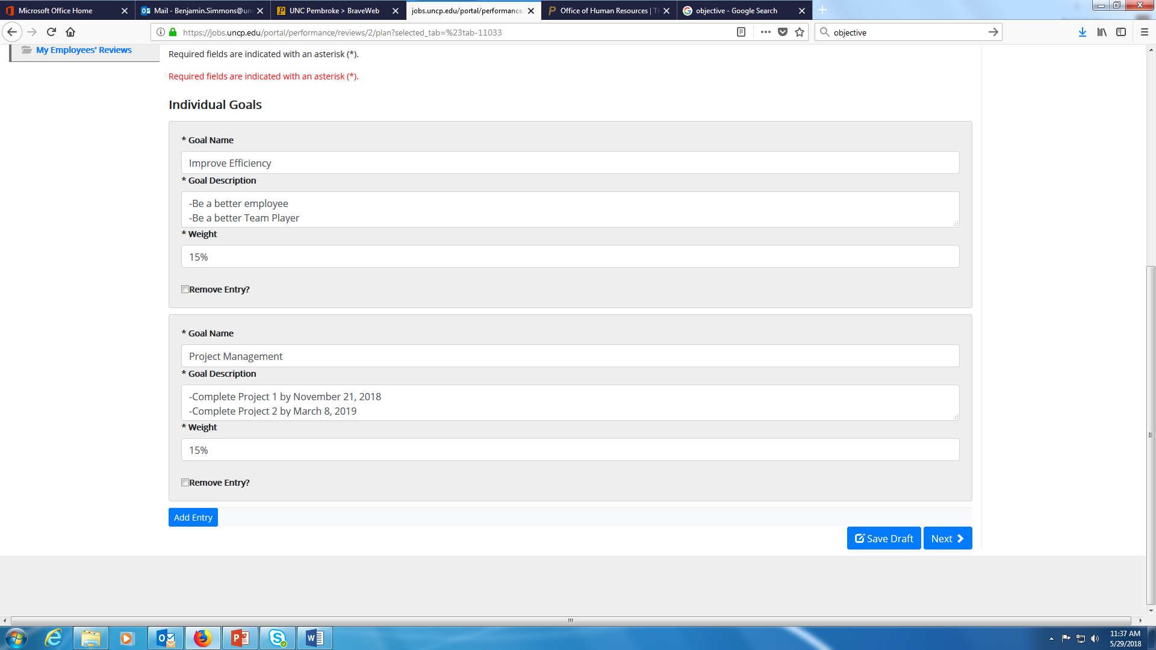
Individual Goals
Only if adding more than 3 Individual Goals

Slide 15
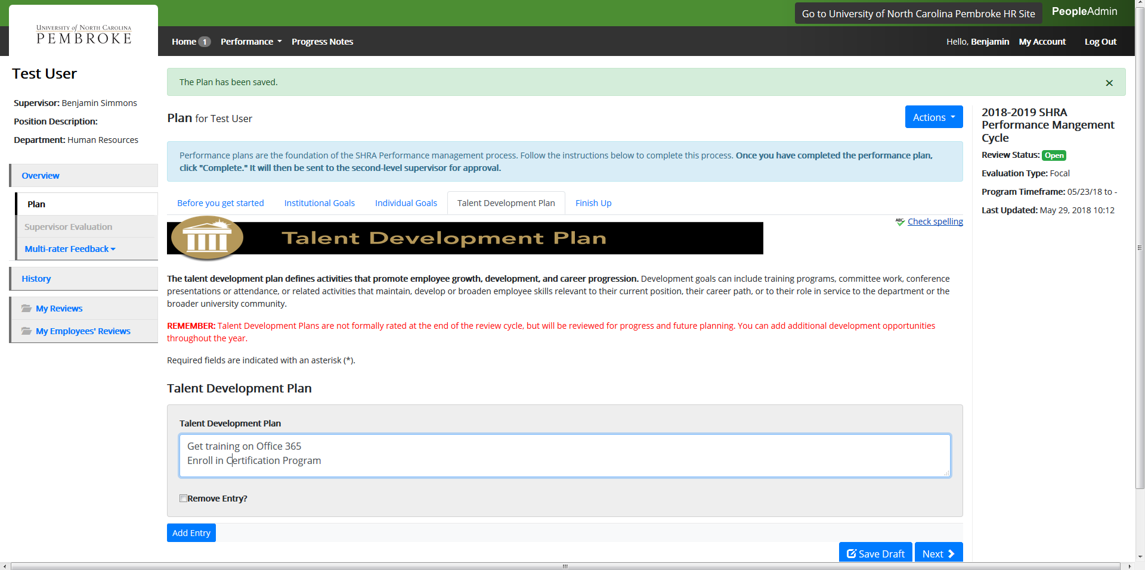
Talent Development Plan

Slide 16
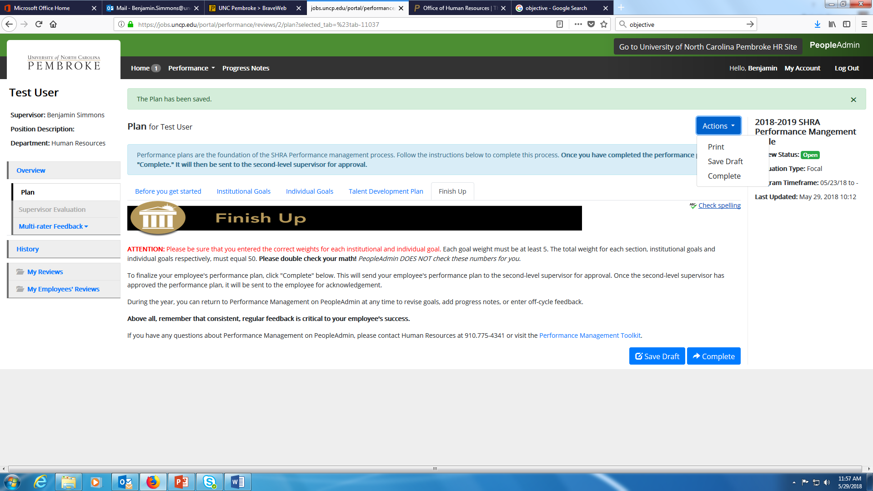
Finish Up

Slide 17
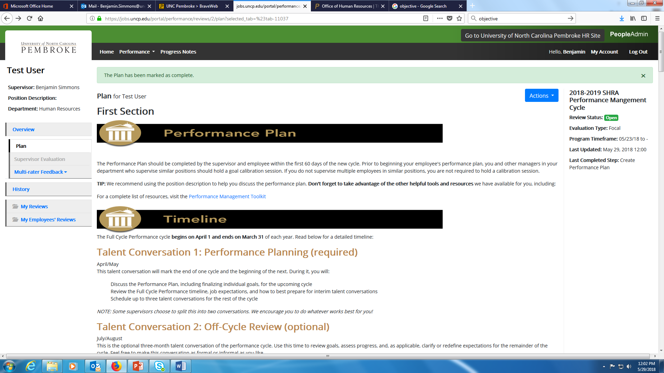
Progress Note Feature

Slide 18
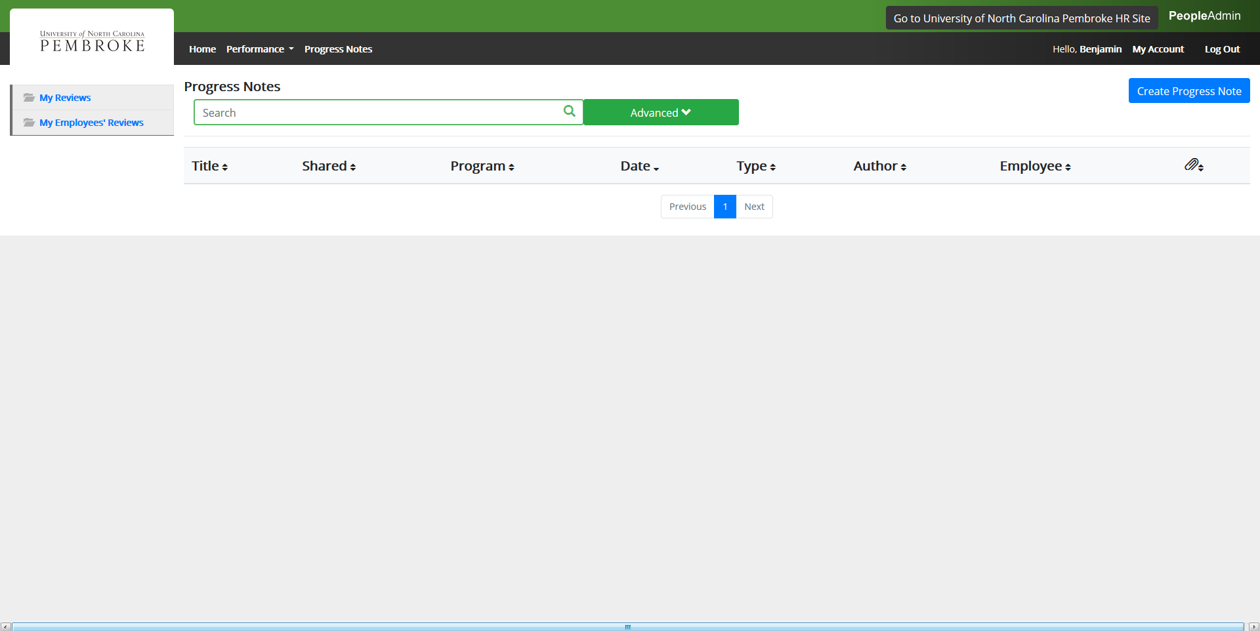
Create Progress Notes

Slide 19
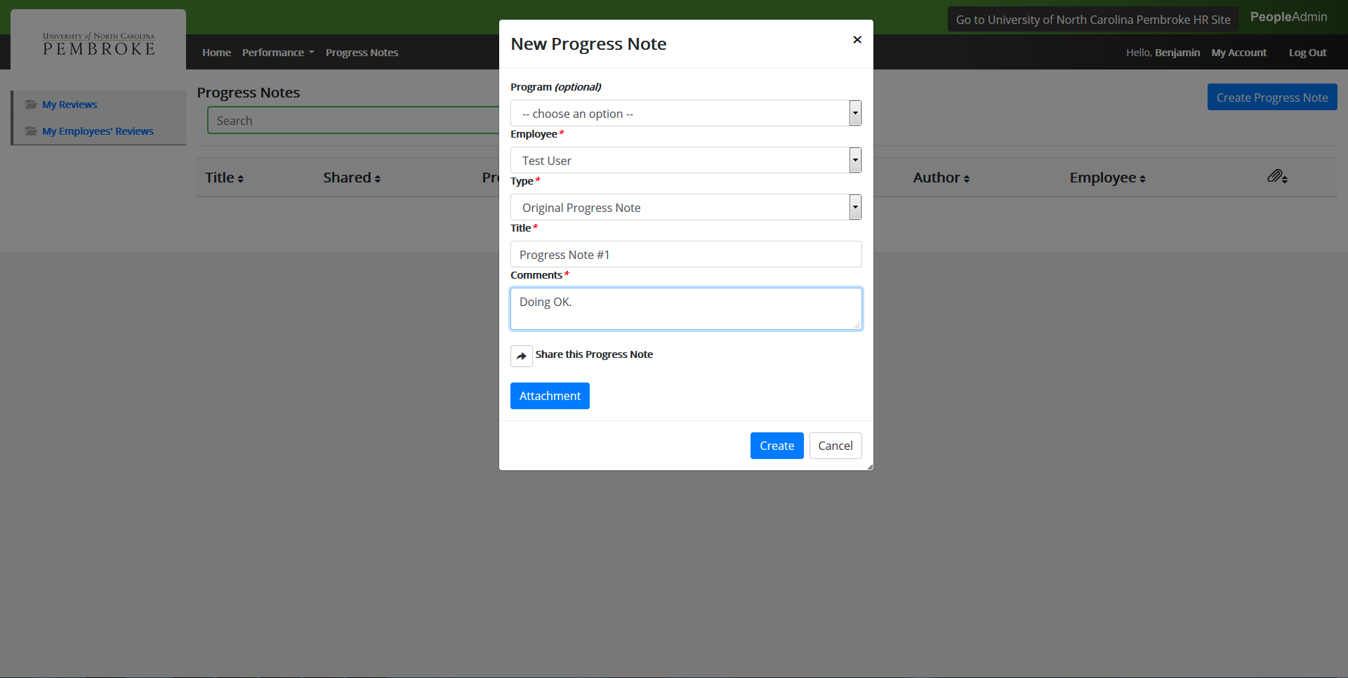
Create Progress Notes

Slide 20
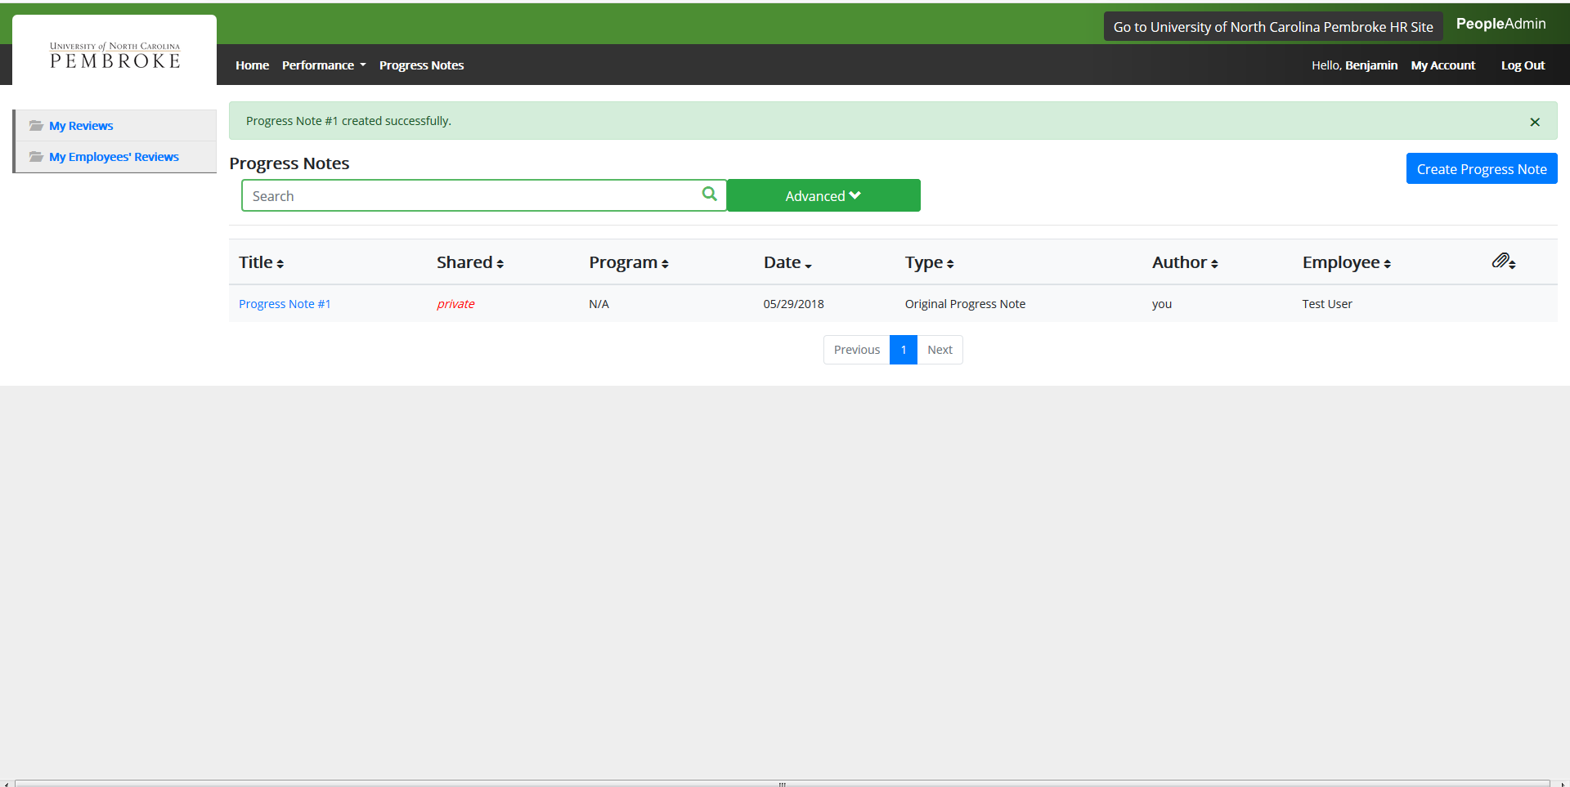
Progress Notes

Slide 22
Questions??

Slide 23

Thank You

