Slide 1
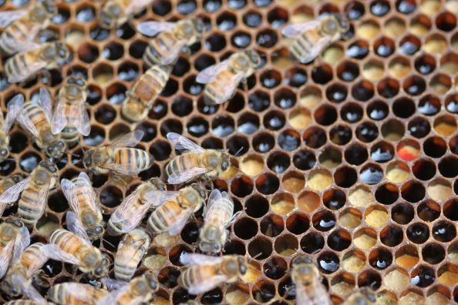
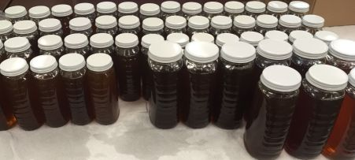
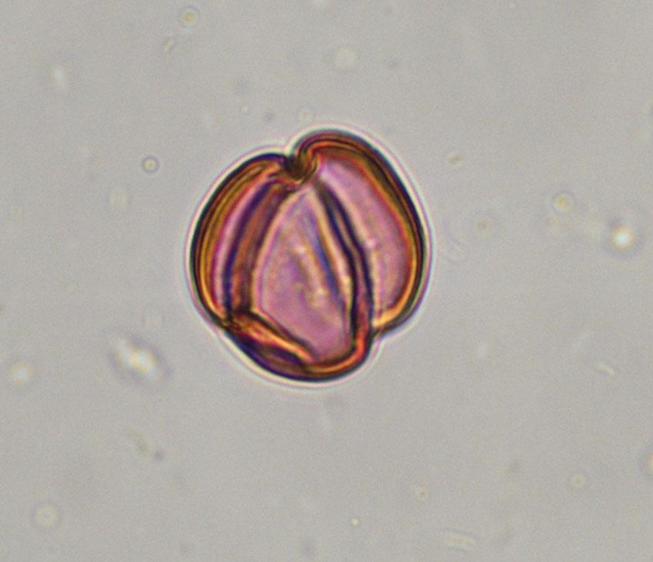
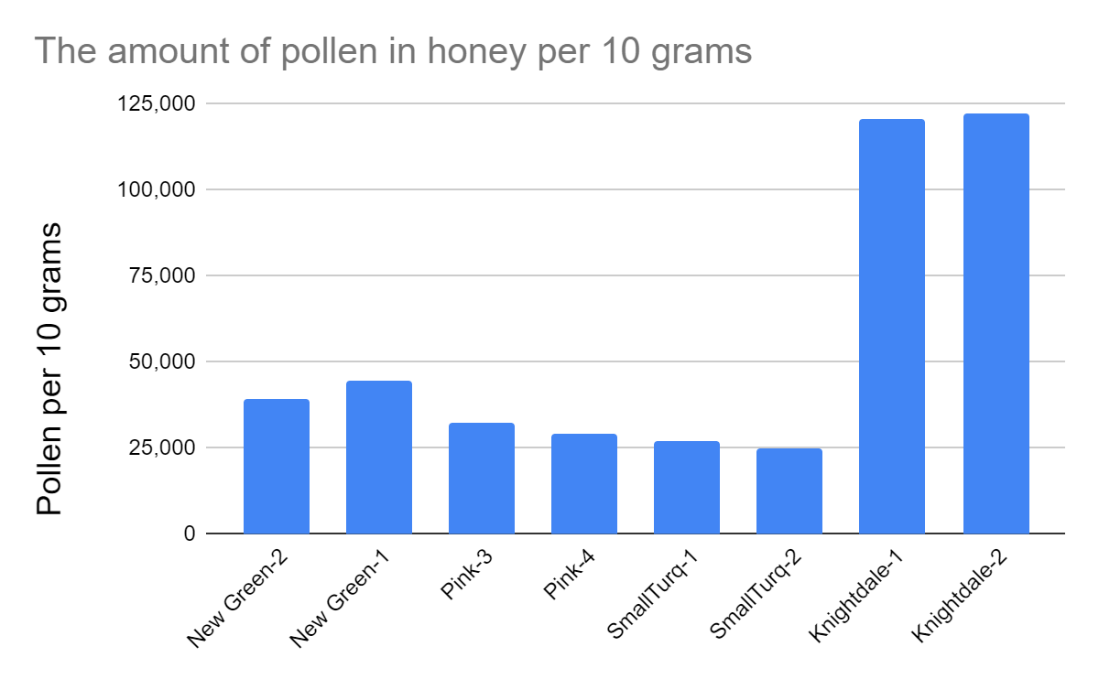
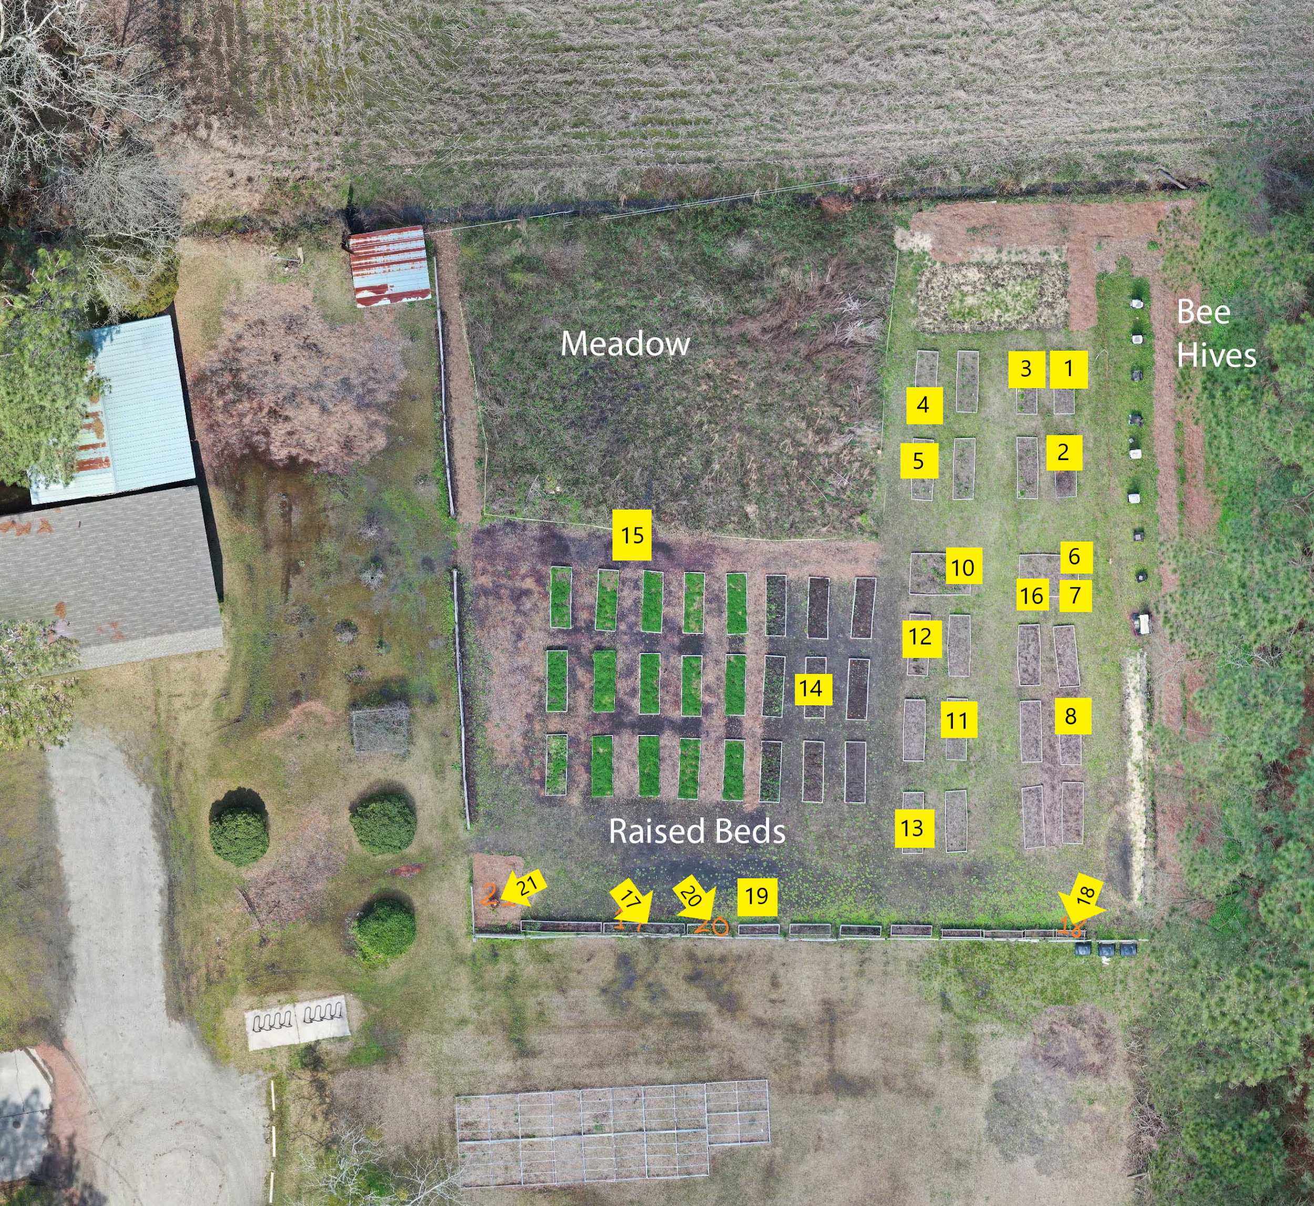
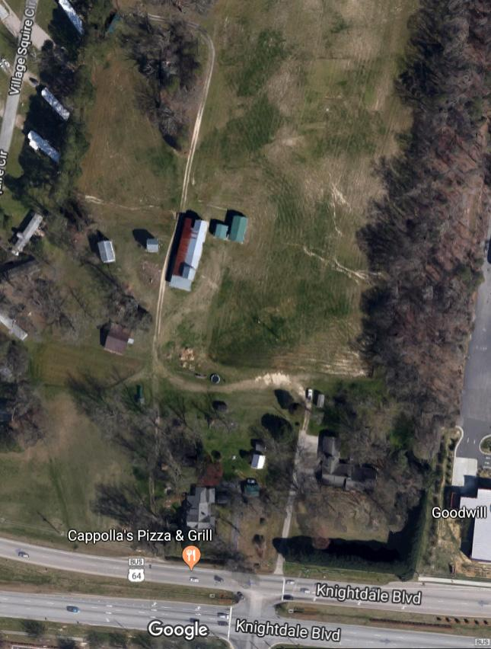
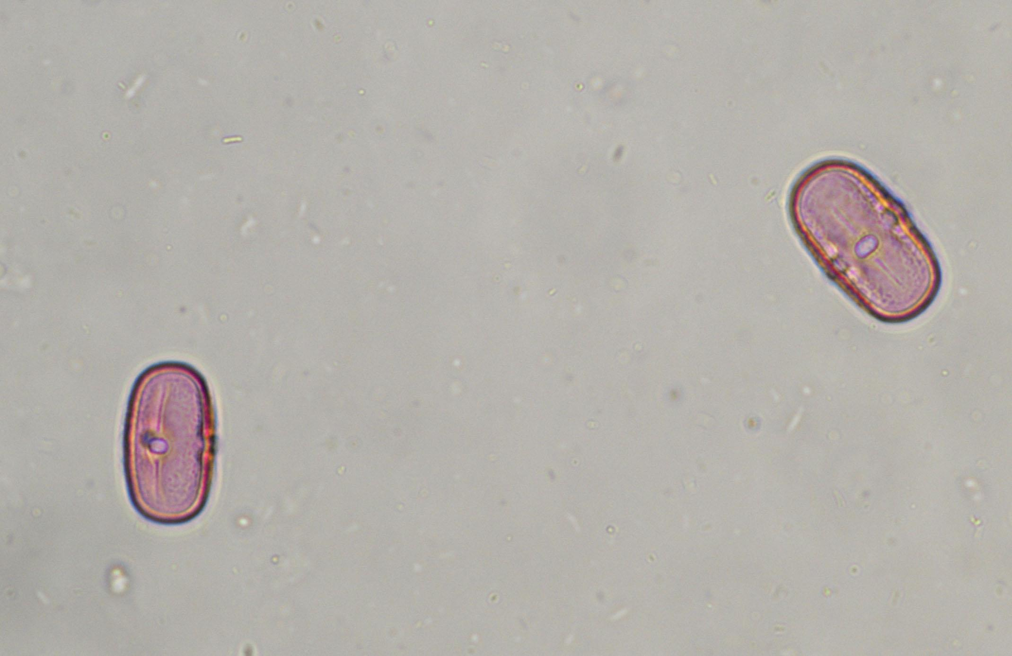
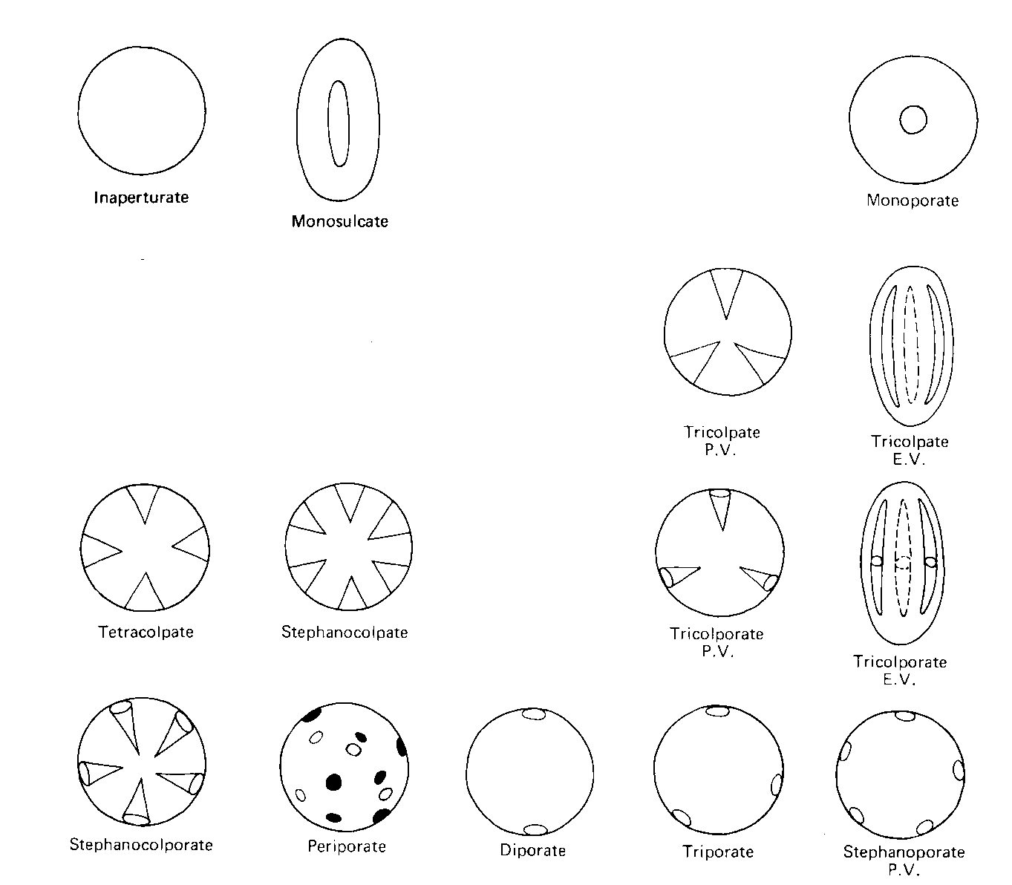
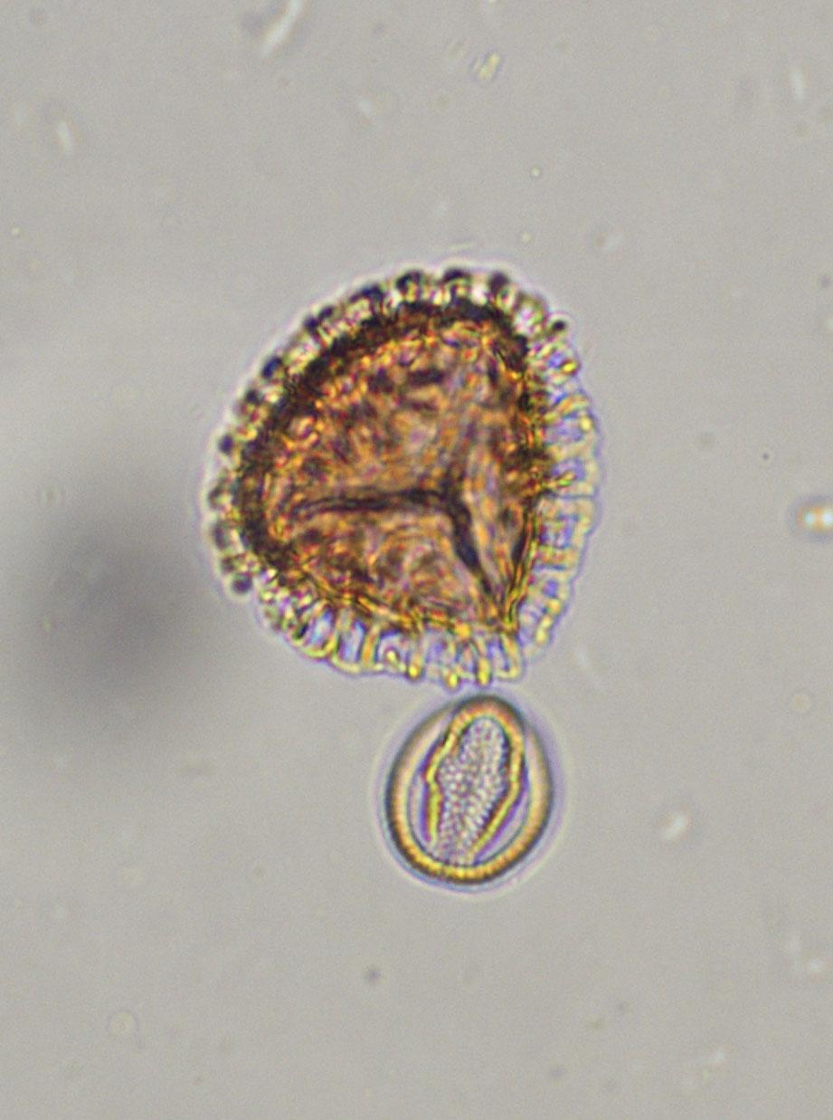
Pollen Abundance in Honey to Tell About Honeybee
Foraging in North Carolina
Eli Hicks¹, Hugo Mundo-Jonsson²
¹ Spring Hill Middle School, ² Southeastern Academy
Photo credit: Kaitlin Campbell
Photo credit: Kaitlin Campbell
d
Methods
Results
Results (Continued)
Summary
d
Pollen Extraction and Slide Making
See the notebook for details of the lab processing.
The samples had marked spores added so that the abundance of pollen per gram of honey can be determined. Lycopodium clavatum, a fern ally, are spores not collected by bees. Spores are processed and pressed into tablets. Lund University (Sweden) produces these tablets and determined that Batch 3862 averages 19332 spores per 2 tablets (standard deviation 4.91%). The formula to determine number of pollen per 10 grams of honey is
(# of pollen grains counted)(# of Lycopodium added) (# of Lycopodium counted)
From all of the data we collected from Knightdale and UNCP hives: The two of us looked at different slides to see if each of us or the slides made a difference in results. The good news is that our results are nearly the same for each honey sample. This means we did similar work.
The table gives the data for all the samples and the graph allows for easy comparison. We found Knightdale had the highest concentration of pollen per 10 grams of honey at 120,825 from slide 1 and 122,033 from slide 2. The lowest number of pollen was from SmallTurq, which was 27,038 from slide 1 and 24,906 from slide 2. The graph (Fig. 3) allows easy comparison. Figures 4-6 shows some pollen.
Bee pollination is vital to about one-third of the food consumed by humans. Honey production for human consumption in the United States is an additional resource amounting to more than 70 million kilograms annually despite colony collapse disorder in recent years (e.g., USDA, 2016). We analyzed pollen in the honey to evaluate how honeybees forage for honeys from UNC-Pembroke (UNCP) and the Raleigh area. Pollen abundance per 10 g in these samples ranges from 25,000 (intermediate by the international standard; Bogdanov and others, 1999) in UNC-Pembroke honey to 122,000 (rich pollen abundance) in the Knightdale honey. We are not sure why the Knightdale honey was higher than the UNC-Pembroke honeys but it could be because the Knightdale was from an urban/suburban environment whereas UNC-Pembroke is rural.
Figure 6: Three-grooved pollen grain
Table: The amount of pollen per 10 grams of honey
Honey sample | Analyst | Pollen Count | Lycopodium | Pollen/10 g
New Green-2 | Eli | 202 | 100 | 39,051
New Green-1 | Hugo | 210 | 91 | 44,612
Pink-3 | Eli | 200 | 120 | 32,220
Pink-4 | Hugo | 205 | 137 | 28,927
SmallTurq-1 | Eli | 200 | 143 | 27,038
SmallTurq-2 | Hugo | 210 | 163 | 24,906
Knightdale-1 | Eli | 200 | 16 | 120,825
Knightdale-2 | Hugo | 202 | 16 | 122,033
Conclusions
Our Procedure
1. We looked into a microscope at the slides.
2. First we looked down the oculars.
3. We adjusted our focus so we could see the pollen and Lycopodium clearly.
4. Once that was done we used the movement knobs on the side of the microscope, which allows us to look in different directions (up, down, left, right).
5. We then proceeded to count our pollen and Lycopodium.
6. When we counted to around 200 pollen grains we stop our counting.
The number of pollen per 10 g of honey is the standard method to analyzing abundance for comparison of different honeys. Our samples came from honeys from three hives in the UNC-Pembroke (UNCP) Campus Garden and a honey from a beekeeper in Knightdale near Raleigh. Abundance per 10 g ranged from about 25,000 pollen/10 g to 122,000/10 g of honey. The Knightdale honey had higher abundance (average 121,000/10 g) than the honeys from UNCP hives (average about 33,000/10 g). On the international abundance scale, the Knightdale is considered “rich”, but the UNCP hives are “intermediate”.
The reason the Knightdale honey is richer in pollen than the UNCP hives is unclear, although perhaps it has something to do with the urban/suburban environment around the Knightdale location. UNCP is very rural. We would have to do more work to understand this.
Research Questions
What is different among honey bee hives at UNC-Pembroke and Raleigh? How variable are they?
What does the concentration of pollen in honey mean about the honey ?
What is different about each area’s pollen concentration?
Location of Honey Samples
General Form of Pollen
Figure 3. Pollen Concentrations in Honey Samples
The figure below shows the usual types of flowering plant pollen.
References
Bogdanov S, and others. (1999) Honey quality, methods of analysis and international regulatory standards: review of the work of the International honey commission. Mitt. Lebensm. Hyg., 90:108-125.
Bryant, V. (2014) The Basics of Honey Identification: Bee Culture (April issue), 59-63.
Bryant, V. (2018) Melissopalynology: Bee Culture (November issue), 41-45.
Jones, G. D & Bryant, V. M (2014) Pollen studies of east Texas honey. Palynology, 38: 242-258.
Tschudy, R.H., 1969, The plant kingdom and its palynological representation: in Tschudy, R.H. and Scott, R.A. (eds.), Aspects of Palynology: Wiley-Interscience, New York, p. 5-34.
USDA. (2016) Honey. Retrieved from http://usda.mannlib.cornell.edu/usda/current/Hone/Hone- 03-22-2016.pdf
Figure 4. Two grains of clover pollen from the Pink- 3.
Figure 1. Location Photos for Honey Samples. UNCP Campus Garden, note bee hives on right side (left, photo from UNCP Kids in the Garden project) and Knightdale (right: photo from Google maps)
UNCP hives are named by color for convenience in identification. We looked at honeys collected in 2018 from New Green, Pink, and SmallTurq (short for Small Turquoise).
Figure 5. Lycopodium with trilete mark next to a pollen grain.
Figure 2: General pollen types (modified from Tschudy, 1969).

