Slide 1
Cart/Utility Vehicle Training

Slide 2
Environmental Health and Safety Office
Who are we?
The University of North Carolina at Pembroke Office of Environmental Health and Safety (EH&S) is dedicated to the protection of human life and our campus environment. EH&S acknowledges the close relationship between the environment, work, and human health and safety.
What we do?
We are committed to preventing the loss of human potential caused by fatalities, injuries, illness, and disabilities on the job and in the campus community.
Where can you find more information about us?
https://www.uncp.edu/campus-life/environmental-health-and-safety

Slide 3
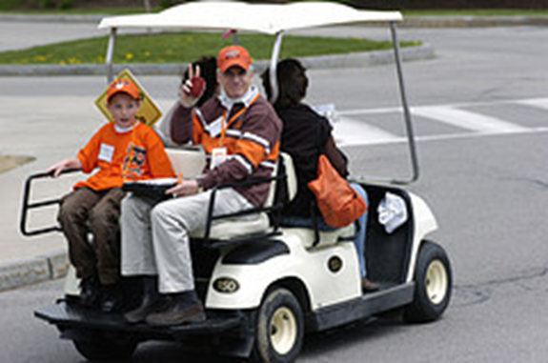
The Purpose of this PowerPoint is to…
Help ensure the safe operation of UNCP owned, leased, or rented motor vehicles
Help ensure the safety of drivers and passengers

Slide 4
To Complete This Training:
Possess a valid divers license
Prior to this training, read the UNCP Cart/Utility Vehicle Safety Policy and sign the statement verifying that you have read and understand the policy
Complete this class and pass the exam
The University Safety Office will maintain training records of cart operators but individual Departments must also maintain a list of certified operators

Slide 5
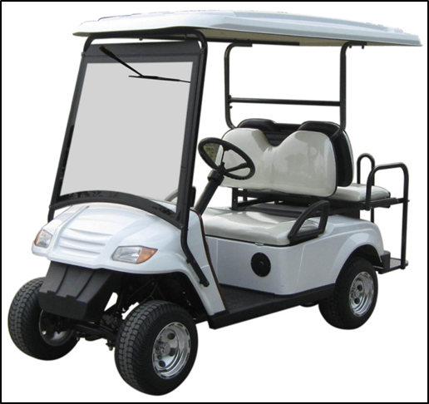
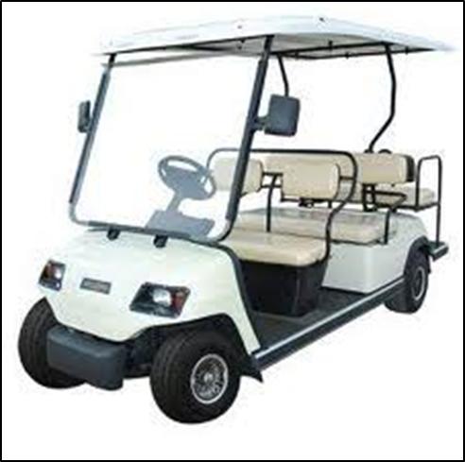
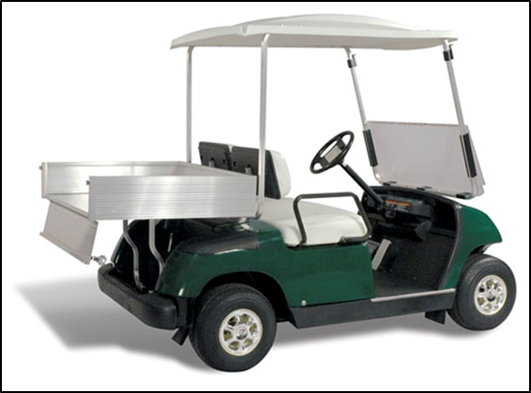
Types of Golf Carts:
4 Seat
6 Seat
Cargo

Slide 6
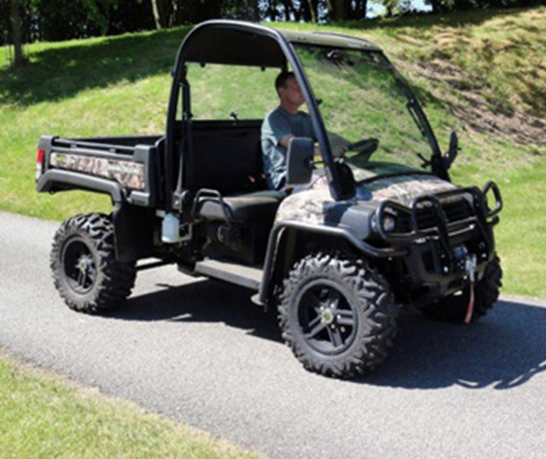
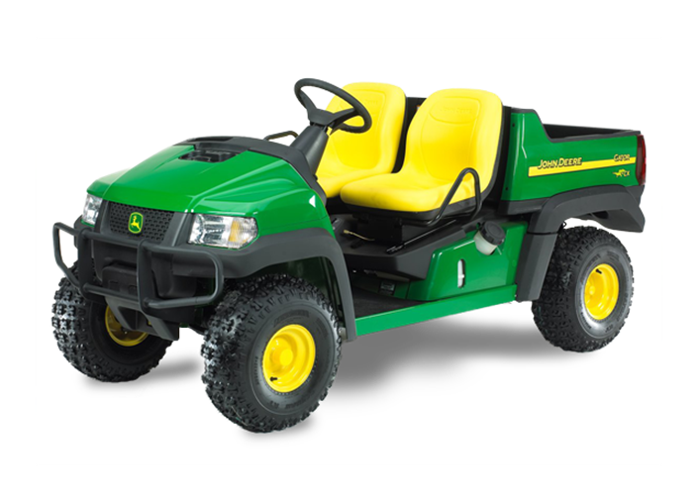
Gas Powered Utility Carts

Slide 7
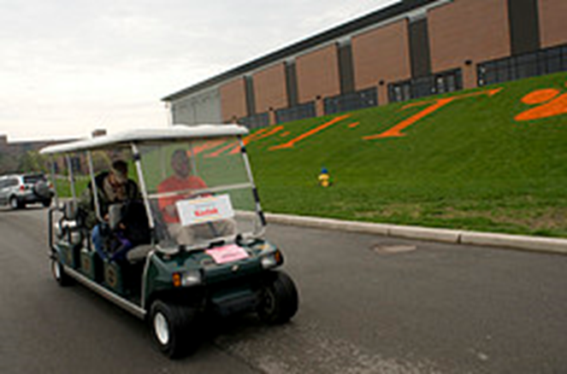
The Difference Between Cars and Carts:
Carts roll easier
Carts almost always operate close to pedestrians
Carts run much more quietly
Other motor vehicles have the right-of-way

Slide 8
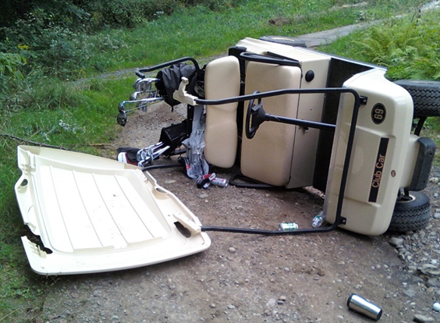


Carts vs. Cars:
Center of gravity is lower
than most vehicles but they
WILL tip over
Speed limit is much lower
Remember, in a collision, the cart will ALWAYS lose

Slide 9
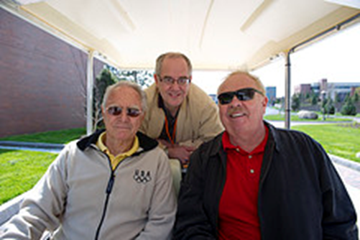
Basic Golf Cart Guidelines:
Golf Carts should only be used for permitted University activities
Joy riding is never permitted
Horseplay endangers passengers and pedestrians and will NOT be tolerated
Golf carts must be operated safely at all times

Slide 10
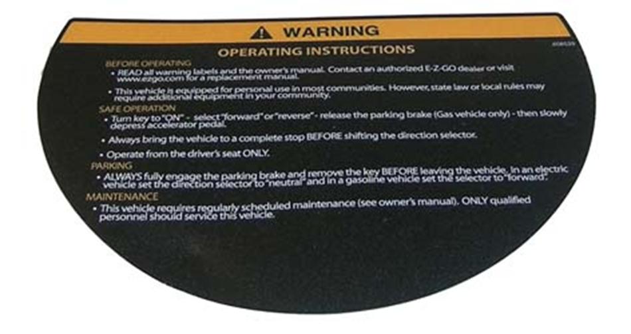
Make Sure to Read all Warning Labels:

Slide 11

Where/When you can Drive:
Golf carts should be driven on paved surfaces only unless authorized for such use
Do not operate across the grass or landscaped areas
Do not park carts in heavily traveled pedestrian areas such as building entrances/exits
Golf carts without headlights shall not be operated after dusk or before dawn
Watch for all pedestrians… they have always have the right of way

Slide 12
Where/When you can Drive:
Carts and utility vehicles are prohibited on roads outside the University boundary
Exceptions are the satellite buildings associated with the University (the West Campus Complex)
Carts are prohibited from operating inside, under, or through the confines of University buildings
Carts are prohibited from driving on the bridge that spans the water feature near the Livermore Library

Slide 13
Speed Limits:
Maintain a safe speed at all times and avoid making sharp turns
Operate the cart at a speed equivalent to a well-paced walk and no faster than 20 mph, where speedometers are present to indicate speed
Maximum speed is subject to:
The terrain over which it is being driven
The weather conditions
The total weight of the utility vehicle, passengers and any other equipment being carried

Slide 14
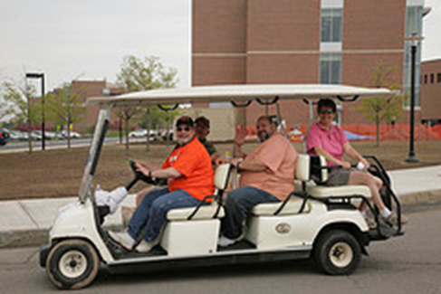
Information for Drivers:
Motorized utility vehicle operators shall observe all UNCP campus rules and North Carolina vehicle traffic laws such as lane travel, stop signs etc.
You must obey traffic signs and symbols
Pedestrians have the right-of-way
You must obey campus speed limits
All utility vehicles will be operated from the driver’s side only

Slide 15
Before you Drive:
Do a pre-trip check
Conduct a visual check of the cart before driving
Review how the vehicle operates before you turn it on
Know your vehicle
If something is broken, don’t use it until it’s fixed!
If you are not familiar with where you are going, check a campus map before you get started

Slide 16
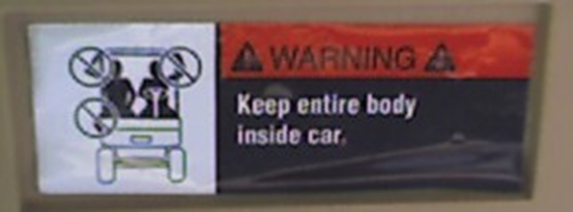
Driving the Vehicle:
Always check behind the vehicle before backing up
Allow no more occupants than the number of seats
Drive with caution
Avoid steep grades
Operators may not use head phones or ear buds when operating carts
Keep hands and feet inside the vehicle when in motion

Slide 17
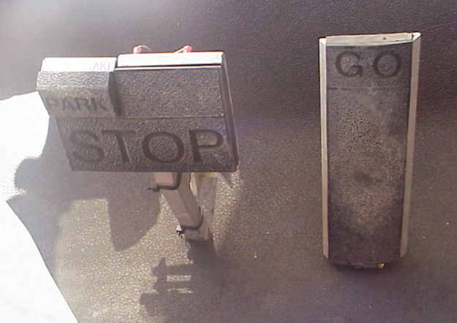



Operating Equipment:
Accelerator Pedal
Brake Pedal
Image from: Lander University
Parking Break

Slide 18
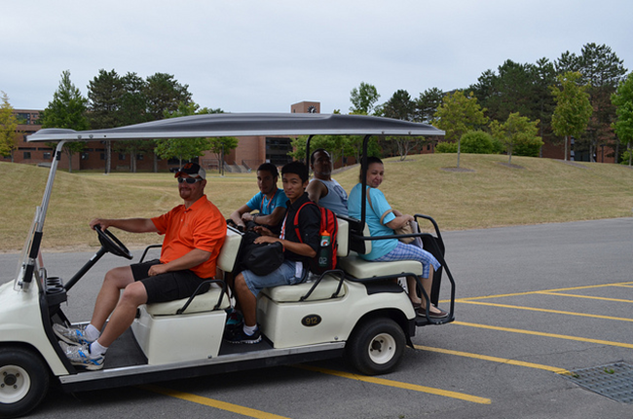
When there are Passengers:
When your cart is occupied with passengers or materials the weight distribution increases and the stopping distance also increases: Go slow!
No utility vehicle is to be operated with more passengers than the seating provided by the manufacturer
Utility boxes on 2 person carts shall not be used to transport additional riders

Slide 19
When there are Passengers:
Passengers are to remain seated at ALL times
Operators and passengers must remain in the vehicle until it comes to a complete stop

Slide 20
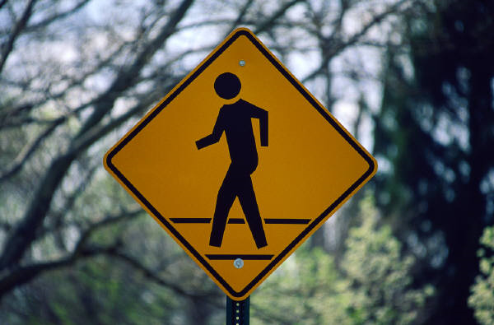
When there are Pedestrians:
Once again, pedestrians have the right of way
If the cart is being operated on a sidewalk:
The operator shall ensure that pedestrians are aware of their approaching cart and use minimal speed to pass pedestrians
Stop the unit until approaching pedestrians have passed
Do not block or impede pedestrian access to walkways or sidewalks

Slide 21

Make sure to…
Always secure your load
Always set your brake once you get to your destination
Operators are responsible for ignition keys. Keys are NOT to be left in the cart when unattended

Slide 22
Malfunctions:
Vehicle Malfunctions should be reported immediately to the department owning/renting the vehicle
Vehicle shall not be used until malfunction or problem has been corrected
Students shall not repair vehicles
Departments are responsible for keeping all original equipment and safety features in good working order

Slide 23
Modifications
Carts and utility vehicles shall NOT be modified in any manner that affects the recommended mode of operation, speed, and safety of the vehicle

Slide 24
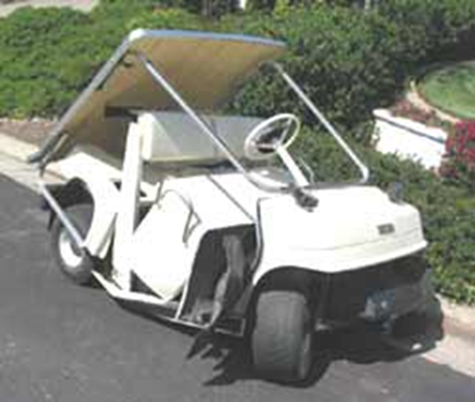
Accidents:
If you are involved in an accident, immediately report it to the University Police, EHS and your supervisor. You will be required to complete an employee accident report

Slide 25
Review:
Get familiar with the vehicle you are driving
Know where you’re going
Always drive at a safe speed
Be aware of your surroundings
Use the golf cart properly (absolutely no horse play!)

Slide 26
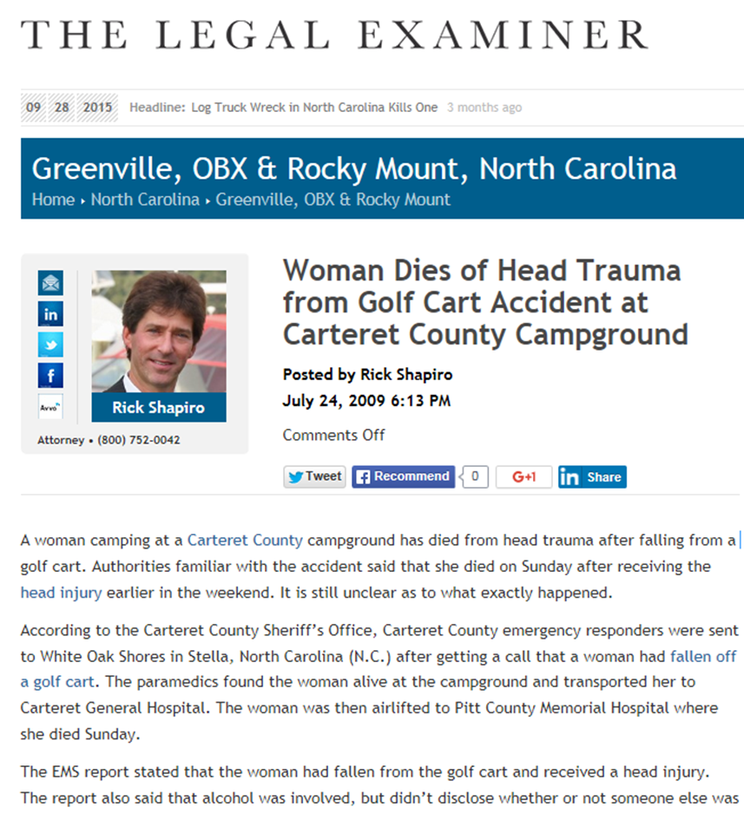
Headlines we never want to make…

Slide 27
Test Time
After passing the test please email: safety@uncp.edu
to set up a time to complete the driving section of the class.
Golf Cart Test

Slide 28
Remember…
Make sure to follow the rules and stay safe!!

Slide 29

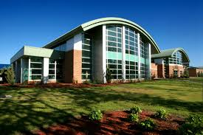
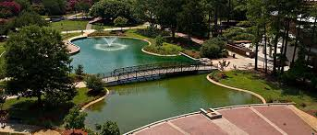
Questions, Comments, Concerns
Michael Bullard
Environmental, Health, and Safety Officer
O: 910.521.6792 C: 910.620.9553
Charles Chavis
Environmental, Health, and Safety Professional
O: 910.775.4772 C: 910.316.6356
Email: safety@uncp.edu

