Slide 1
Intro to SPIN Database
Search engine for faculty and staff to locate funding opportunities across all disciplines including federal, state, and foundation sources
http://infoedglobal.com/solutions/grants-contracts/spin-funding-opportunities/

Slide 2
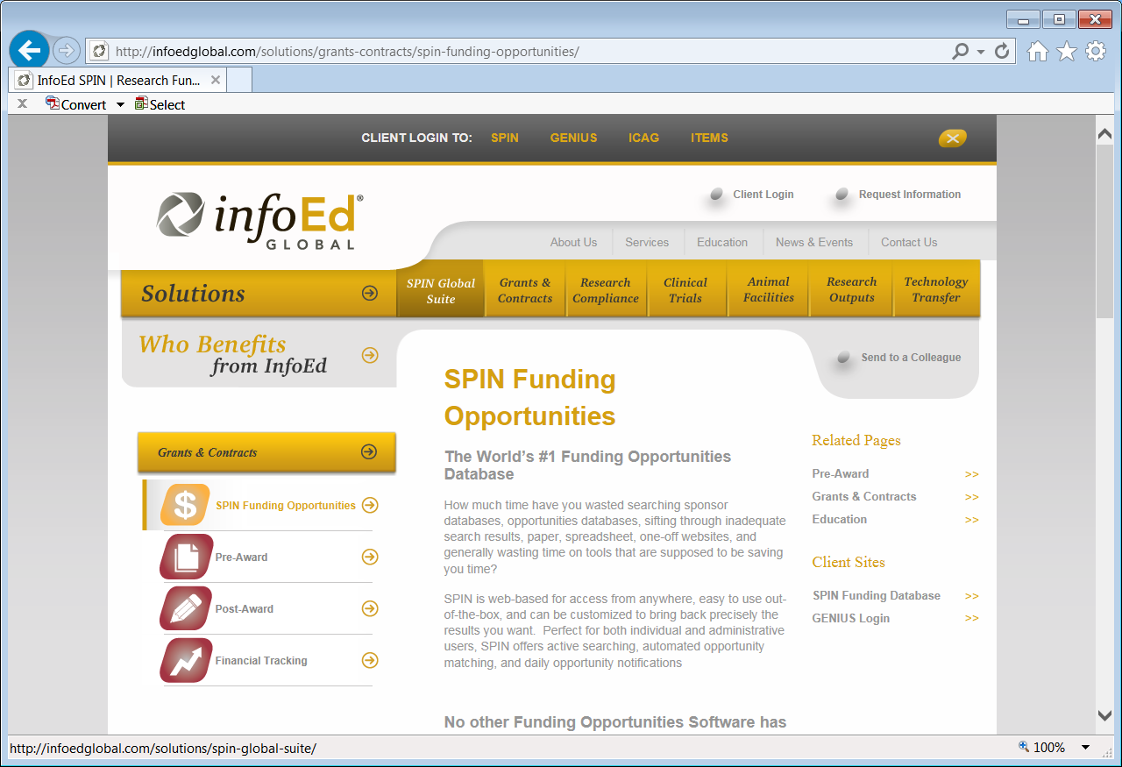
Home Page
Click SPIN

Slide 3
Keyword-Based Search
Click Help for
assistance
Insert search key words in box

Slide 4
Use of Operands

Slide 5
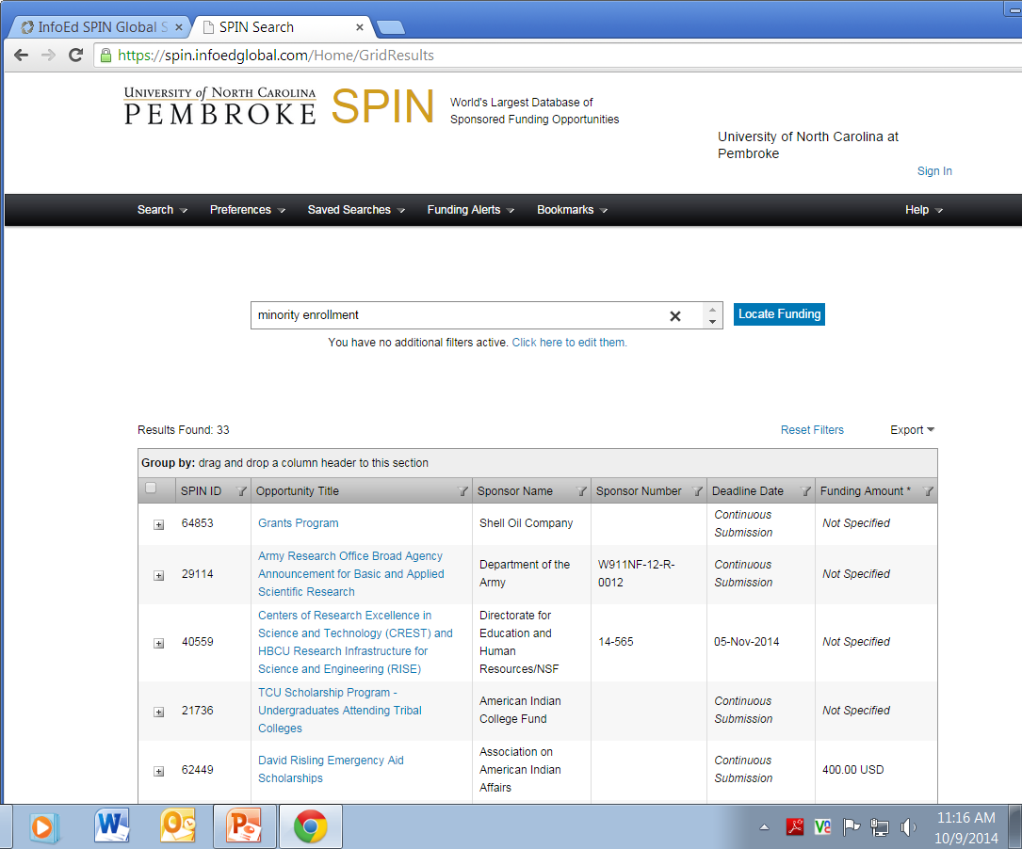
Search Results

