Slide 1
Proposal Routing
Research Administration Management and electronic Submission (RAMSeS) is UNCP’s proposal tracking and award mgt. system
PI’s are required to use RAMSeS to route and receive supervisor approval in proposal submission.
RAMSeS e-records contain basic Grant info, financial or compliance data necessary for UNCP approval and agency submission

Slide 2
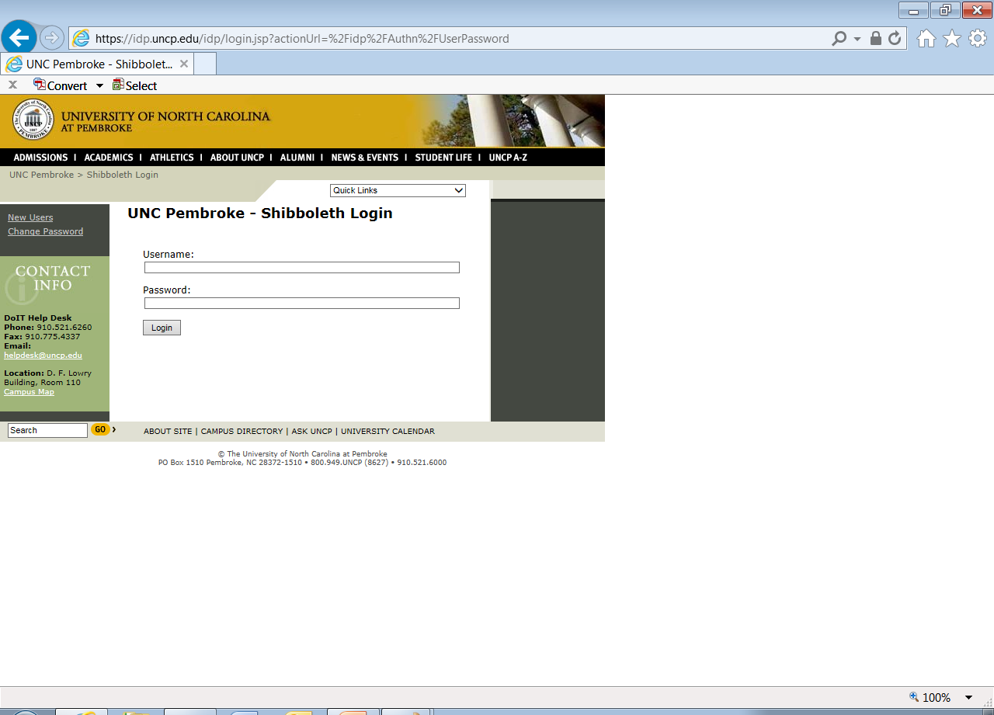
Logging into RAMSeS
Go to: https://uncp.myresearchonline.org/ramses
Enter usual UNCP user name and password

Slide 3
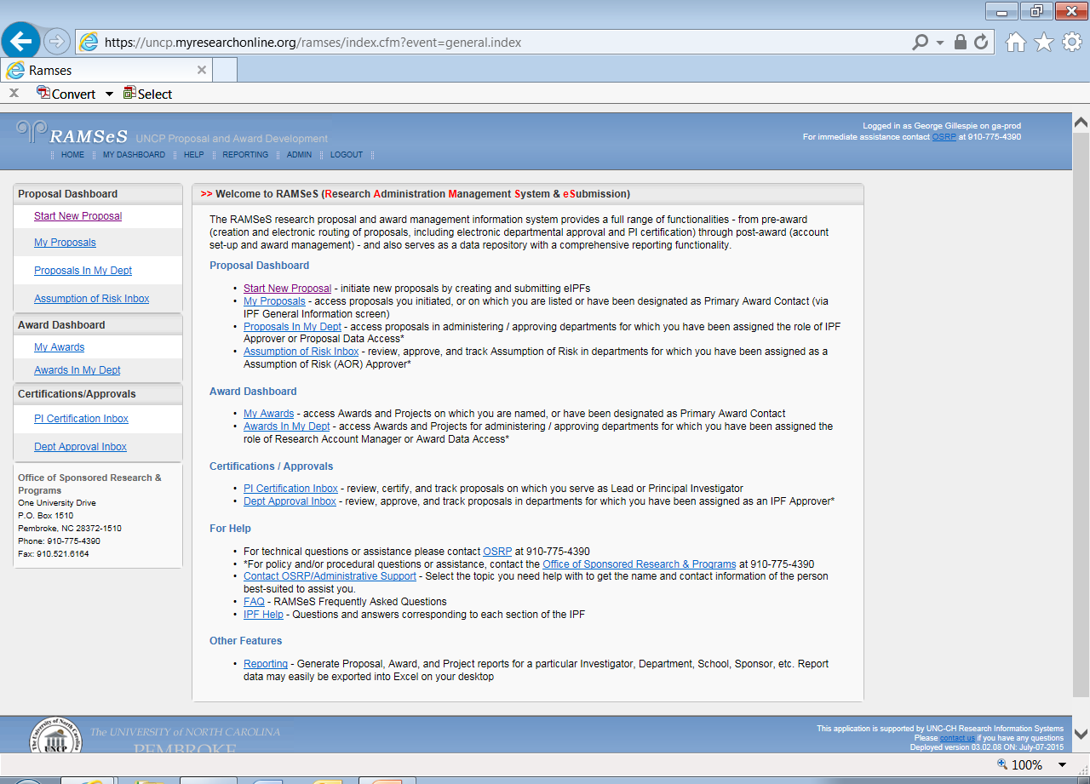
Once logged in the screen will look like:
Click New Proposal

Slide 4
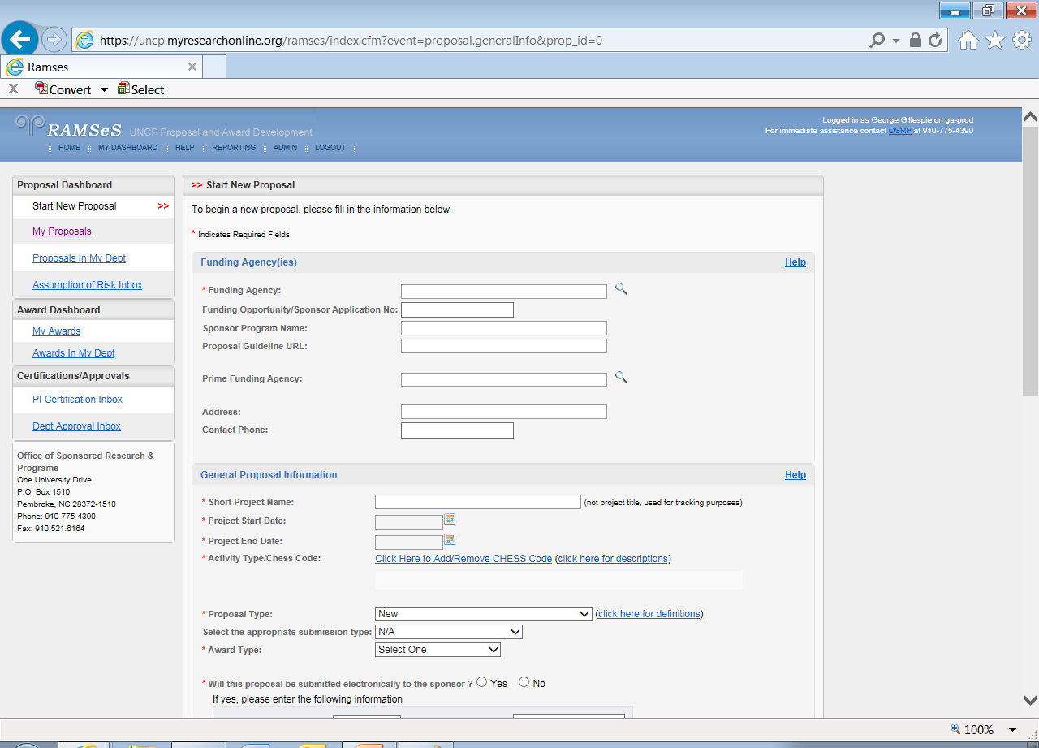
Start New Proposal Data
Please fill in Grant Data

Slide 5
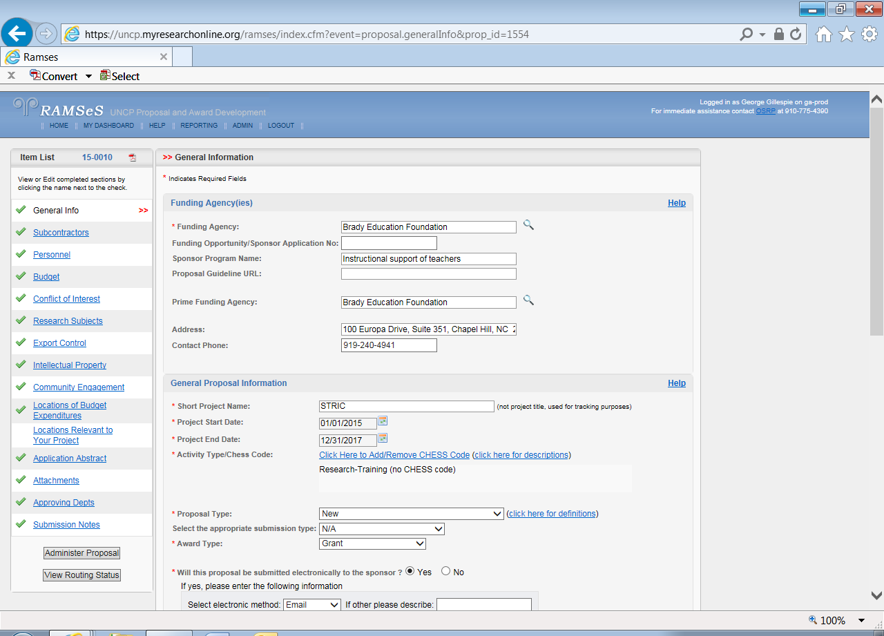
Start New Proposal Data
Please complete data for all categories. Successful completion will result in a green check

Slide 6
Questions??
If you have difficulty or questions with RAMSeS please call the OSRP staff at ext. 4249 or contact email us at: osrp@uncp.edu

