Slide 1
3MT Competition

Slide 2
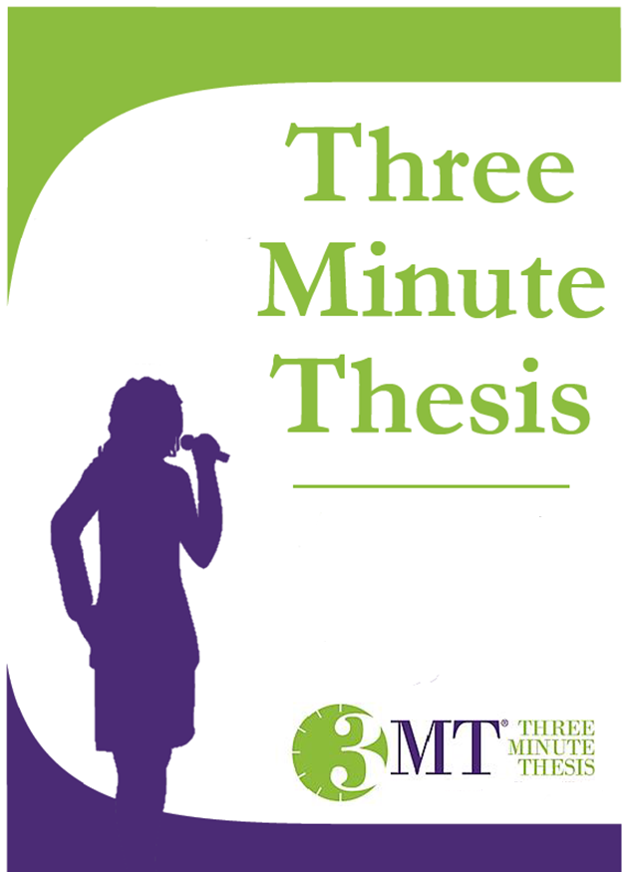
The Three Minute Thesis (3MT) is a research communication competition that challenges graduate students to present their research in a compelling, three-minute speech, relaying the significance and relevance to a non-specialist audience.
The time limitations force the presenter to consolidate their work and ideas.
The first 3MT was held at the University of Queensland in 2008 with 160 graduate students competing.
Today, the 3MT competition has grown to over 170 universities across more than 17 countries worldwide. UNCP is excited to host its first annual 3MT event in April 2017.

Slide 3
3mt rules
Each presentation will be judged on comprehension, content, engagement and communication.
Each presentation is limited to 3 minutes maximum and competitors exceeding 3 minutes will be disqualified. Presentations are considered to have commenced when a presenter starts their presentation through movement or speech.
A presenter is allowed to have a single static PowerPoint slide (no slide transitions, animations or 'movement' of any type are allowed), no additional electronic media (e.g., sound and video files) or props (e.g., costumes, musical instruments, laboratory equipment) are permitted.
All presentations are required to be spoken word (e.g., no poems, raps or songs) and commence from the stage.

Slide 4
Example of 3MT Scoring criteria
Comprehension & Content Score
(Out of 10)
Did the presentation provide an understanding of the background to the research question being addressed and its significance?
Did the presentation clearly describe the key results of the research including conclusions and outcomes?
Did the presentation follow a clear and logical sequence?
Was the thesis topic, key results and research significance and outcomes communicated in language appropriate to a non-specialist audience?
Did the speaker avoid scientific jargon, explain terminology and provide adequate background information to illustrate points?
Did the presenter spend adequate time on each element of their presentation?
Engagement & Communication
Score (Out of 10)
Did the oration make the audience want to know more?
Was the presenter careful not to trivialize or generalize their research?
Did the presenter convey enthusiasm for their research?
Did the presenter capture and maintain their audience's attention?
Did the speaker have sufficient stage presence, eye contact and vocal range; maintain a steady pace, and have a confident stance?
Did the PowerPoint slide enhance the presentation - was it clear, legible, and concise?
Did the speaker avoid scientific jargon, explain terminology and provide adequate background information to illustrate points?
Did the speaker have sufficient stage presence, eye contact and vocal range; maintain a steady pace, and have a confident stance?

Slide 5
3mt Examples

