Slide 1
How to Submit a New Protocol on IRB.net
UNCP
Internal Review Board

Slide 2
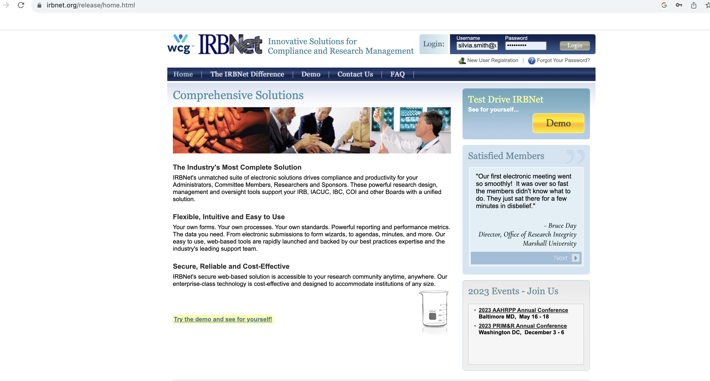
Log in with UNCP credentials

Slide 3
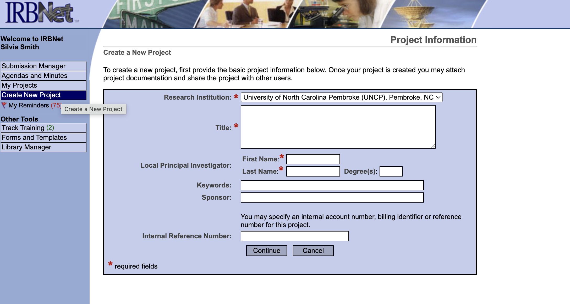
Create a new project

Slide 4
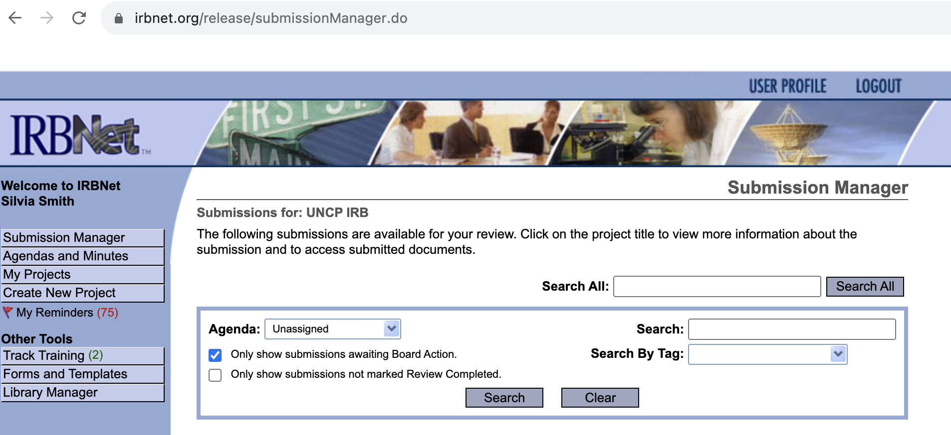
Navigate to submission manager

Slide 5
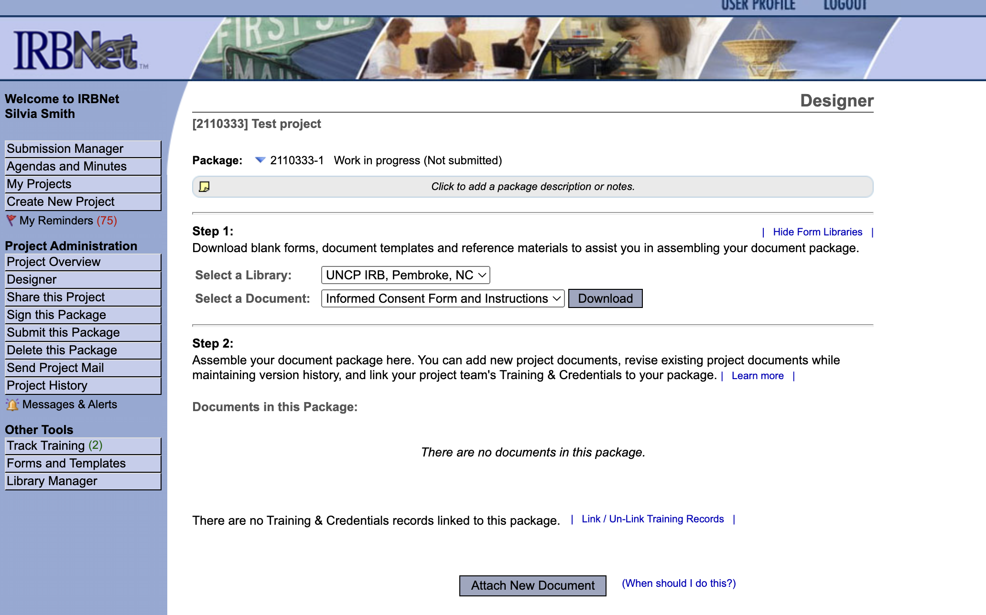
Download templates: ICF or Protocol Application

Slide 6
Click “Attach New Document” and upload CITI or other pertinent training

Slide 7
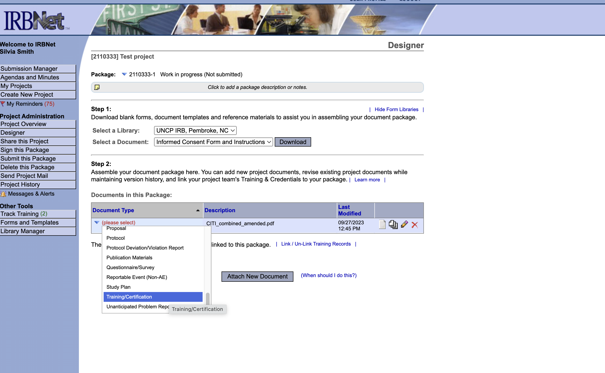
Specify “Document Type” selecting from the list

Slide 8
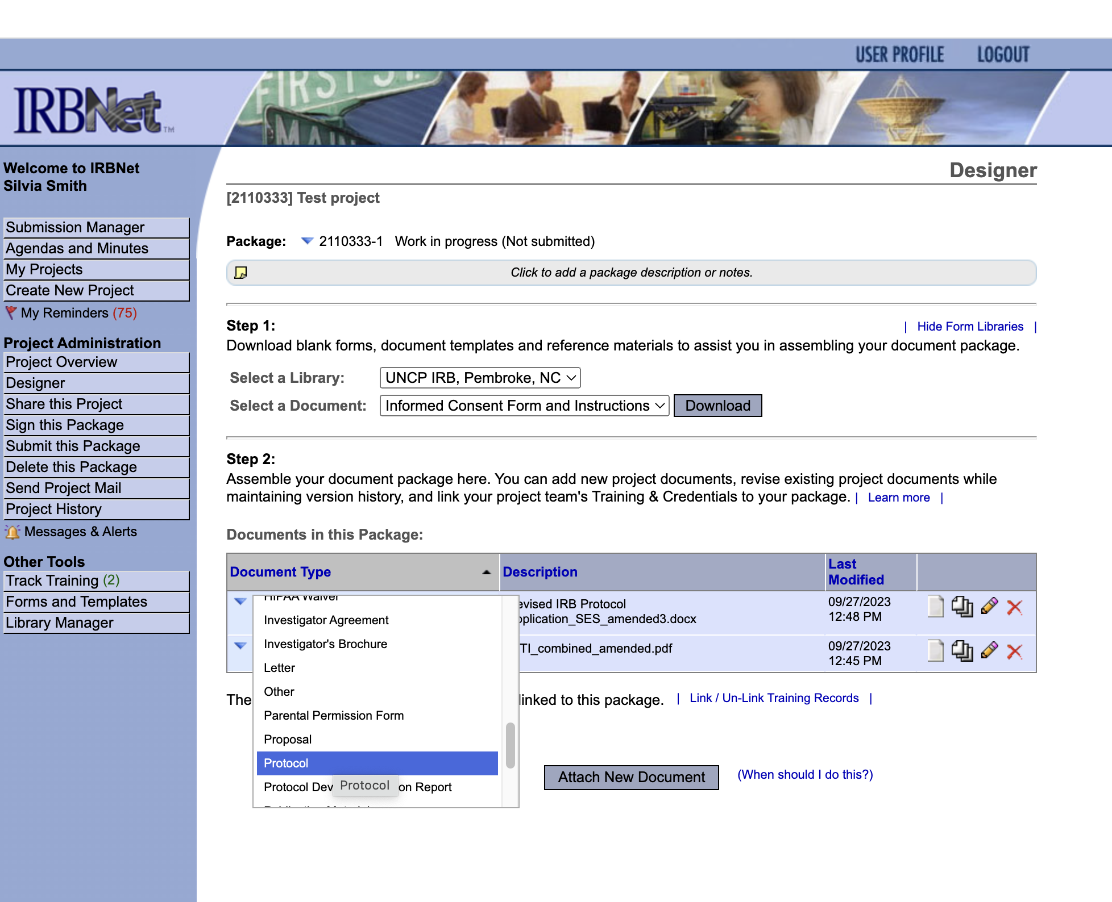
Click “Add New Document” and select “Document Type”

Slide 9
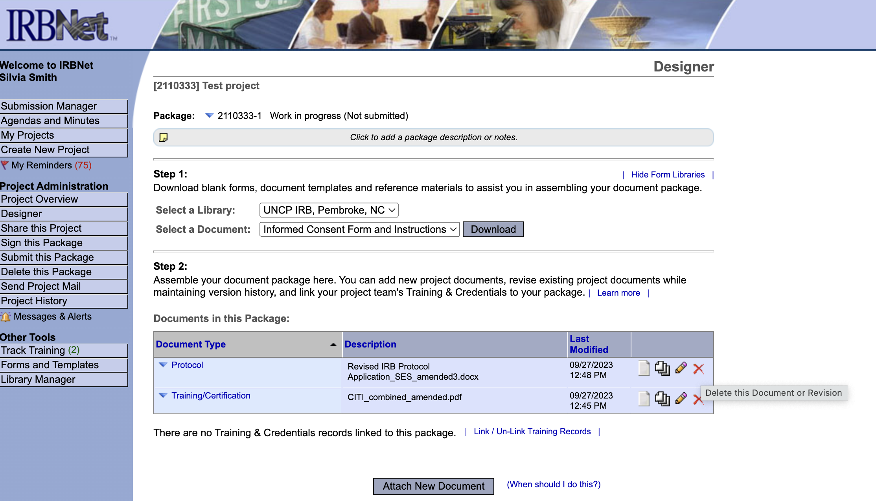
To delete an uploaded document click on the X

Slide 10
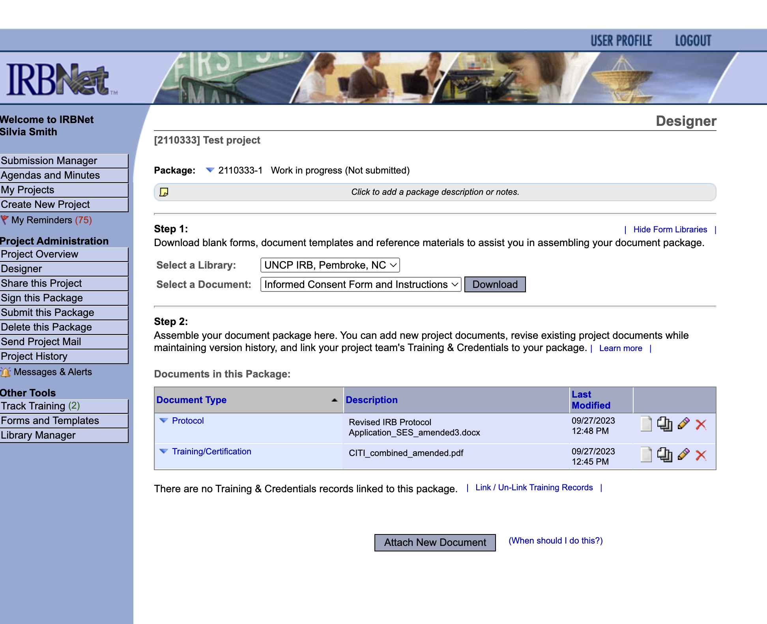
When all documents are uploaded, click on “Sign This Package” (1) and then “Submit this Package” (2)
1
2

