Slide 1
Procedures to Certify Effort

Slide 2
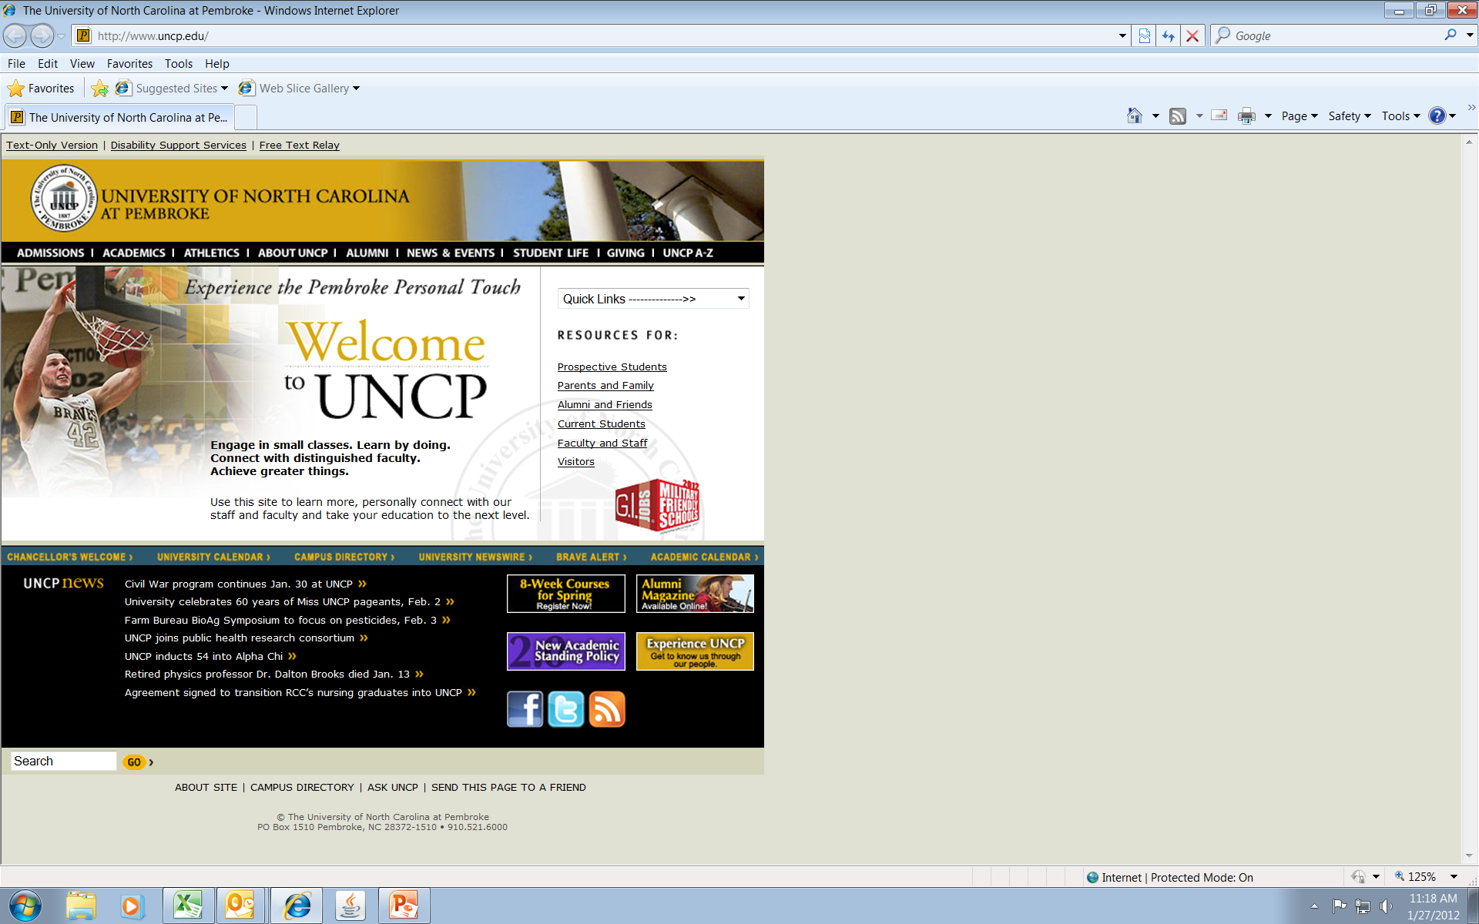
Go to UNCP home page
Notes:
Go to UNCP home page

Slide 3
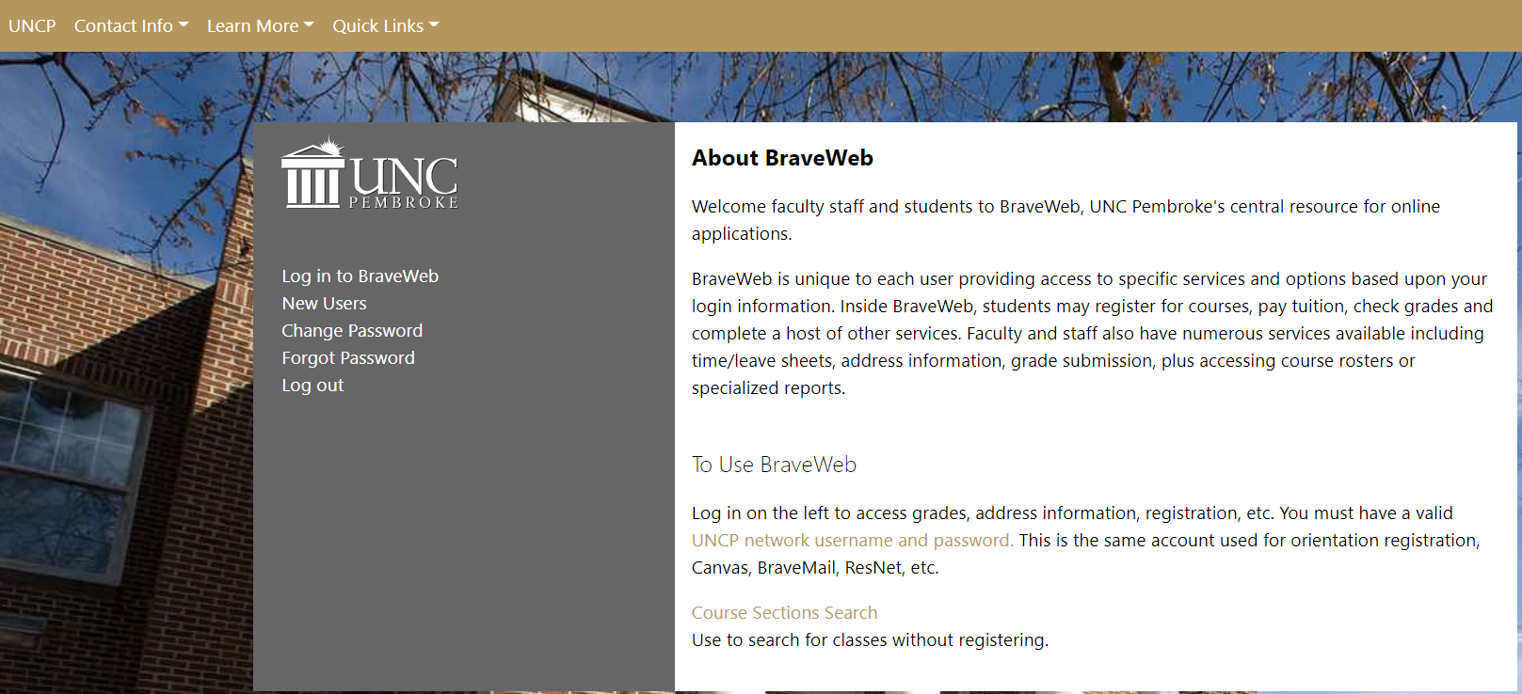
Go to
Go to Braveweb and login with your network ID and password.
Notes:
Go to Braveweb and login with your network ID and password.

Slide 4
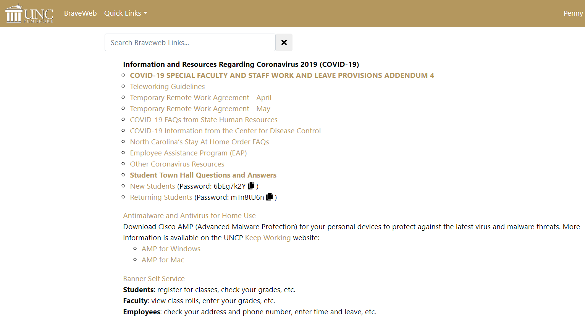
Click on Banner Self Service
Click on Banner Self Service
Notes:
Click on Banner Self Service

Slide 5
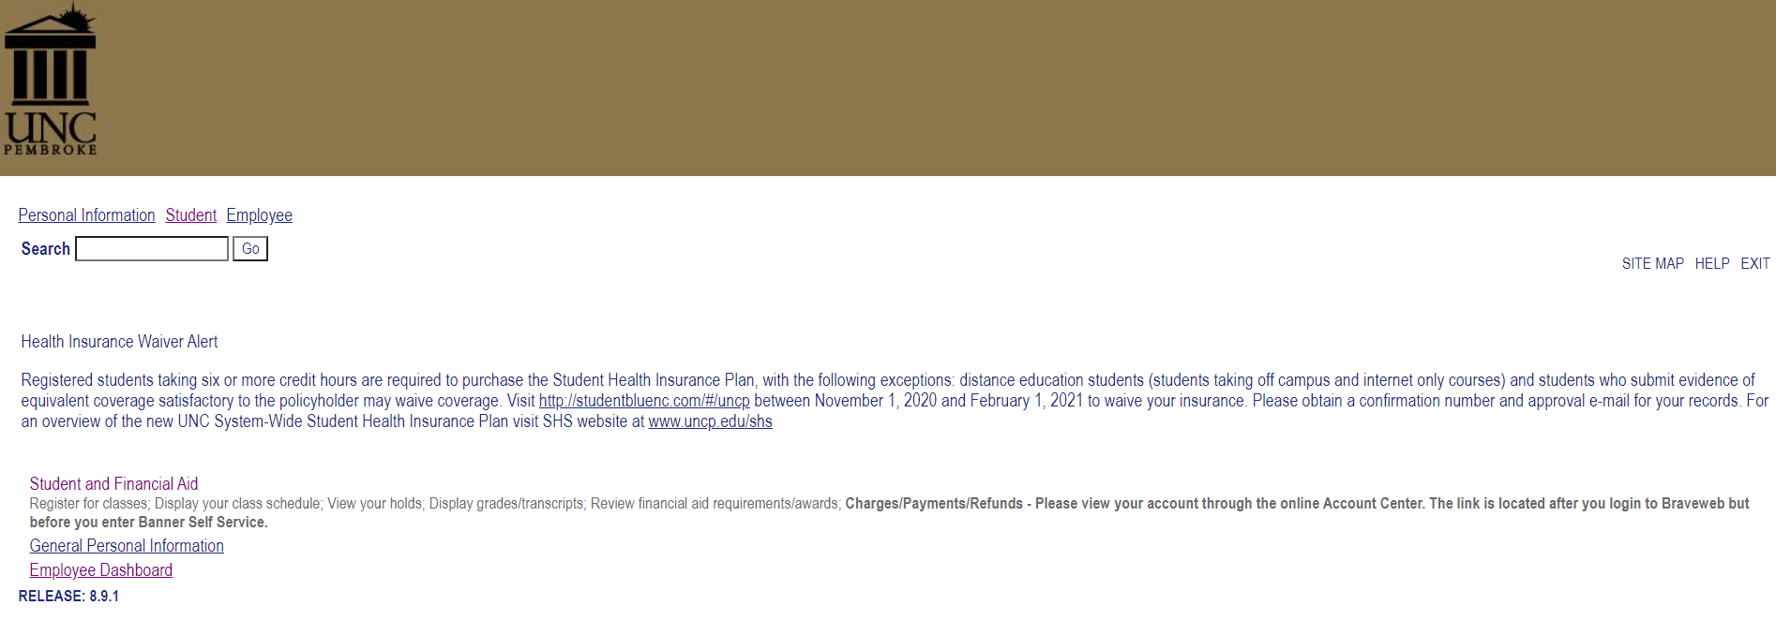
Click on Employee Dashboard
Notes:
Click on Employee

Slide 6
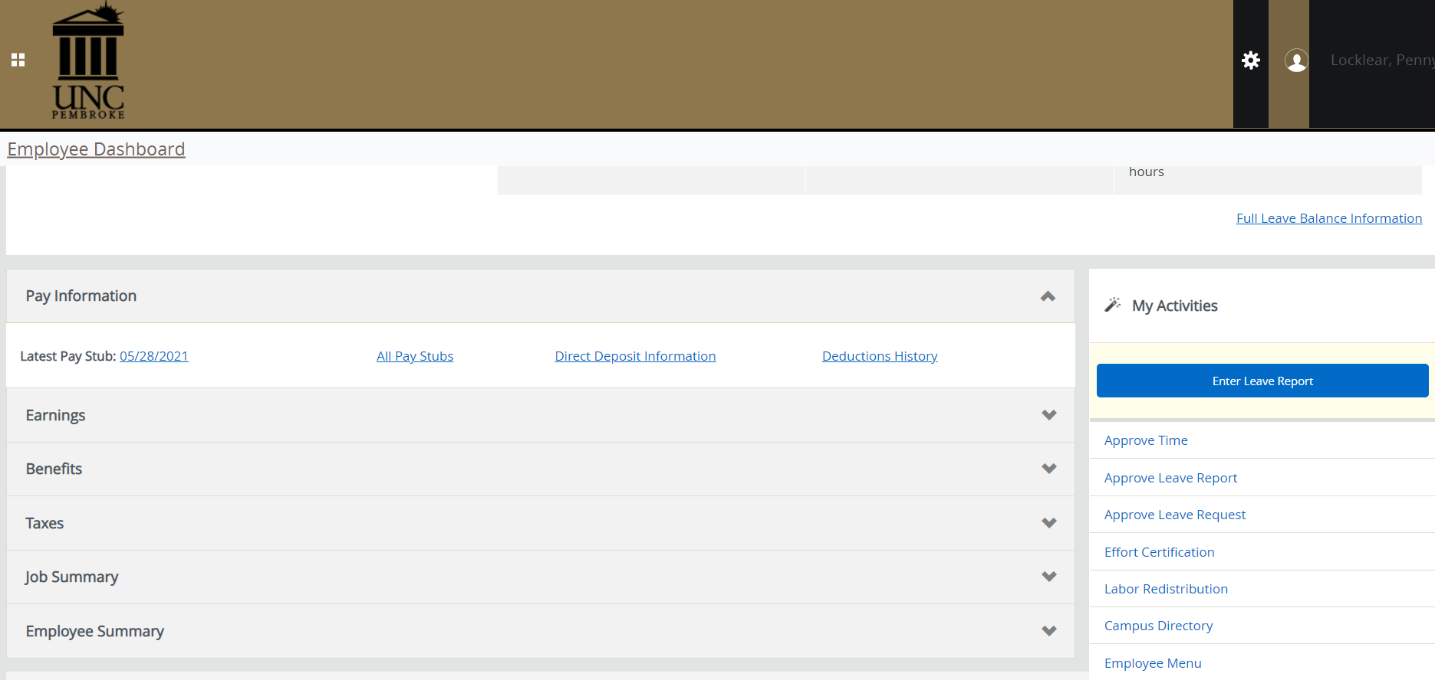
Click of Effort Certification
Notes:
Click of Effort Certification

Slide 7
Screen should look like this, click on Review of Certify Reports if your effort doesn’t show up on this screen
Notes:
Screen should look like this.

Slide 8
Your next screen should look like this.
Notes:
When Click on Review or Certify my Effort screen should look like this.

Slide 9
At Chart of Account Code – Click Drop down arrow and select P, UNCP. At Effort Period Code – Click Drop down arrow and select the semester you are certifying for. Then click go! At this point if your effort report did not show up earlier it should at this point.

Slide 10
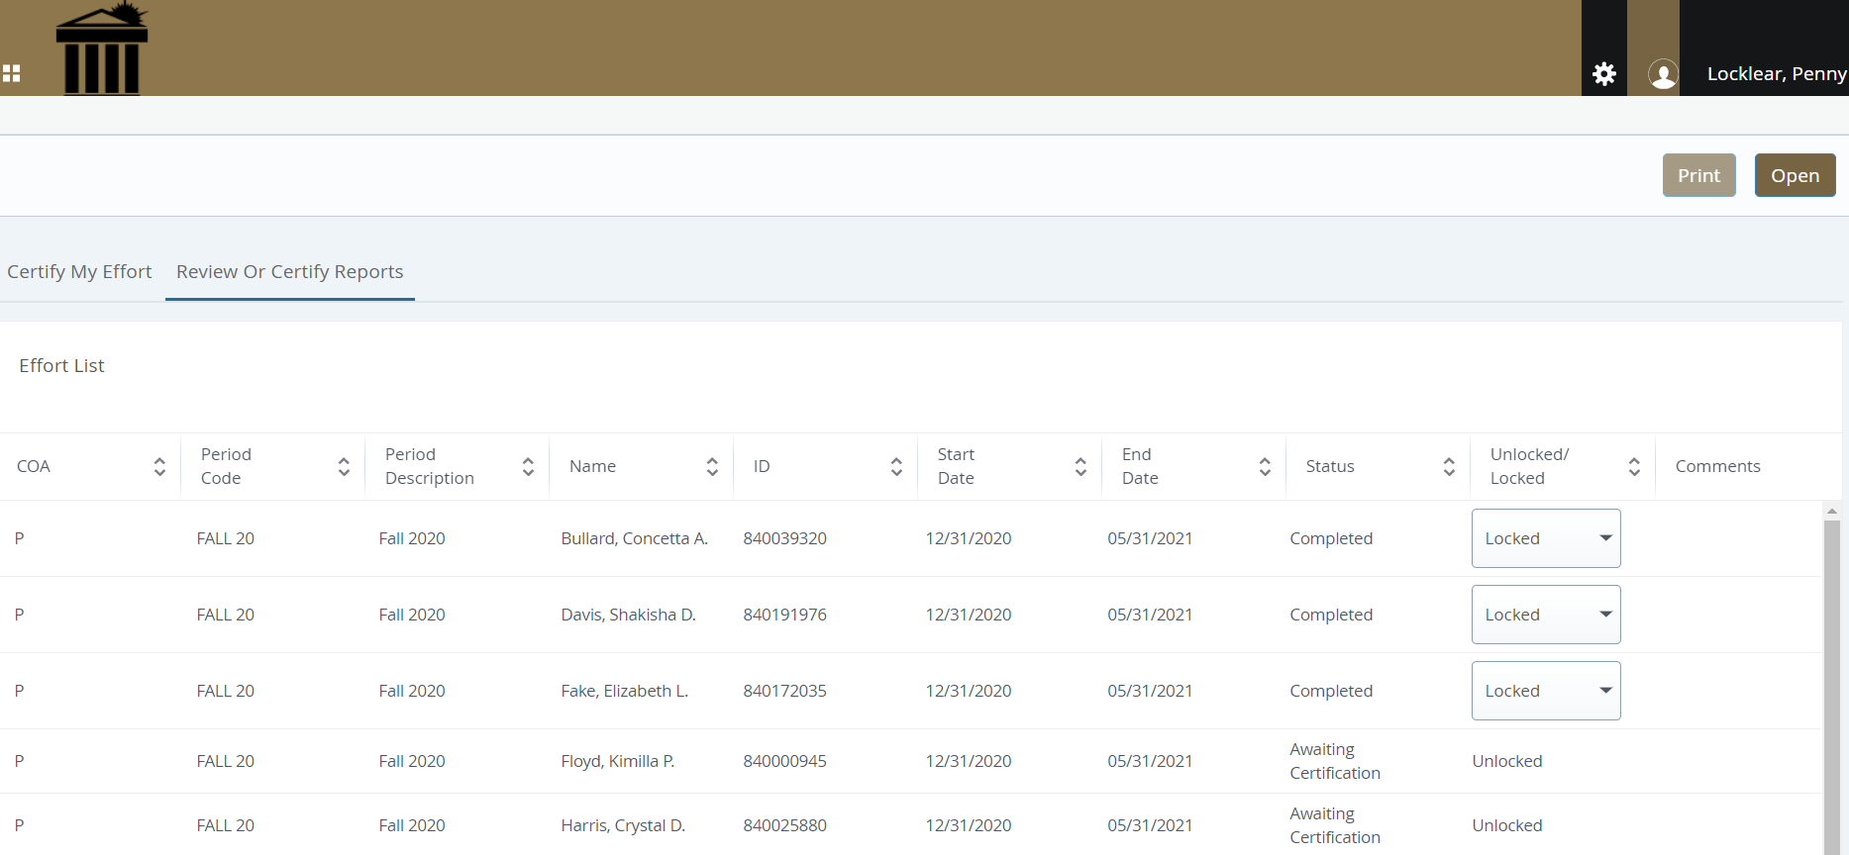
Fall 11.
Your screen should be similar to this – but will only have your information.

Slide 11
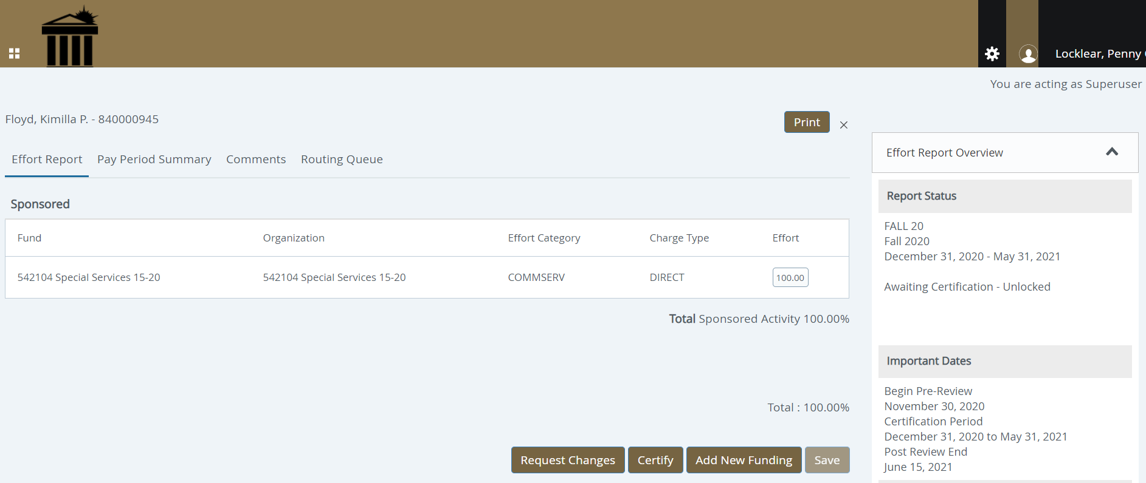
This is an example: Your information should appear and look similar to this screen. If the information is correct, please click certify. If the information is not correct, please click request changes and the Grants Office will make corrections, either electronically or on a manually one.
Notes:
.

