Slide 1
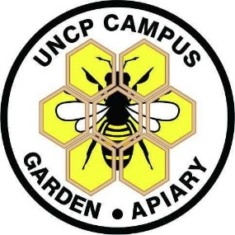
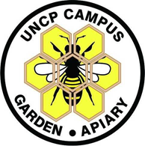
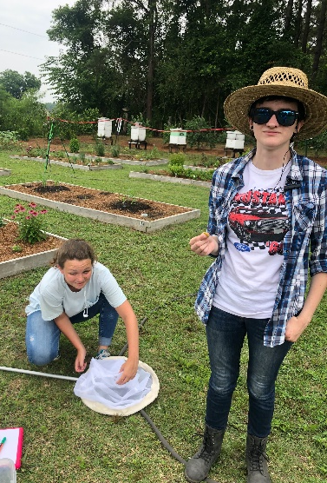
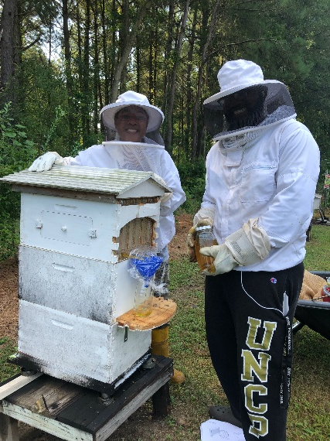
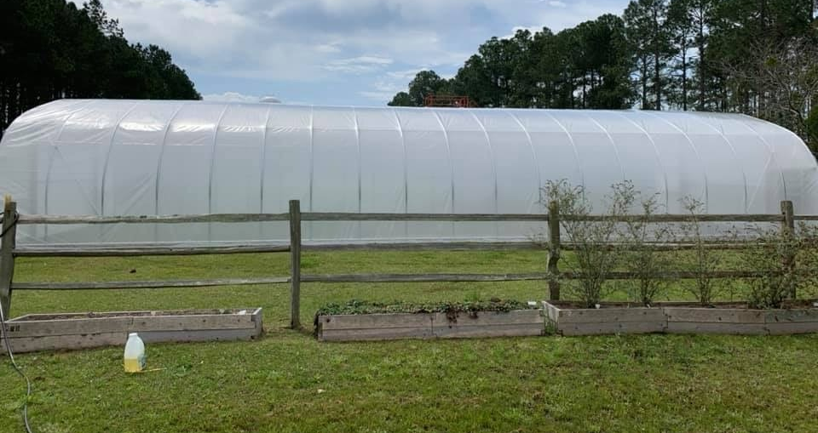
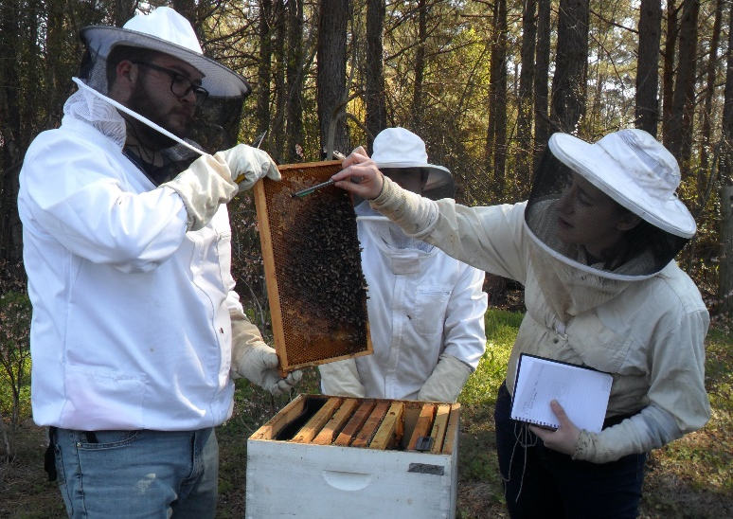
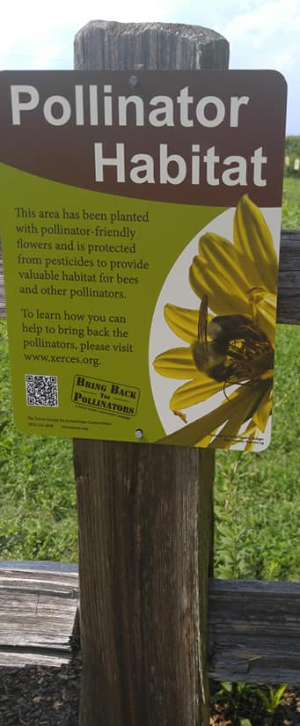
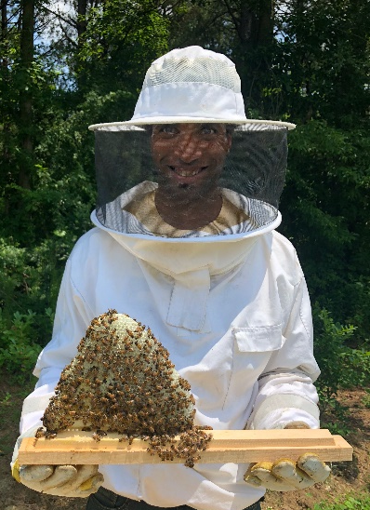
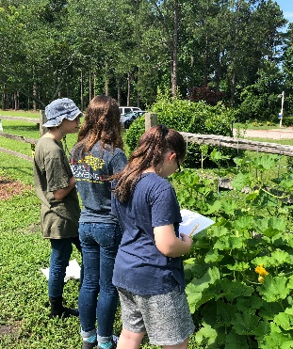
Campus Garden & Apiary, UNC-Pembroke
Campus Garden
UNCP Campus Garden consists of 1/3 acre of…
Undergraduate & Graduate Science Research
(Pollination Ecology and Insect Conservation Lab)
Apiary
Nine honeybee hives are managed at the UNCP apiary:
Pollinator Gardens & Educational Meadow
Herbs, Fruit, & Vegetables
Sunflower Patch
Compost Bins
Blueberry bushes
Apiary & Native Bees
High tunnel for horticulture
Hive Styles
Langstroth hives
Top bar hive
Flow hive I & II
Honey Sales:
Late summer/ early fall
Contact Dr. Campbell
Secondary School Student Research
Location:
Adjacent to Pine Cottage on the north end of UNCP at Ernest Lowery Rd, Pembroke, NC 28372
Dashed line outlines garden parameter
Star denotes apiary
Native Pollinators
The campus garden has several native bee houses and over 100 floral varieties to promote pollinators
Ongoing Projects
Pollen in Honey
Documenting and comparing pollen flora in local and commercialized honey, DNA metabarcoding
Bee Health
Observing and analyzing bee health factors through apiary maintenance, parasite management, and pollen collection
K-12 STEM School Programs
Kids in the Garden Program
Sustainable gardens in schools
Summer Camps
Field Trips, Science Competitions, Science Conferences
Tracking Honeybees
Designing tracking devices for bees and mapping foraging habitats
Native Pollinators
Surveying biodiversity in natural and urban habitats
Crown Bees Native Bees Community Garden Project:
- Raising mason and leafcutter bees to protect food supply and native populations
Research in Biodiversity of:
Native bees
Butterflies
Hoverflies
Educational Meadow & Citizen Science
The Educational Meadow - native wildflowers, grown in a natural habitat, as food for both native and honey bees!
Citizen Science projects connect non-scientists to real data collection and the scientific method.
Contacts
Dr. Rita Hagevik, rita.hagevik@uncp.edu Professor, Biology Director of Graduate Studies in Science Education
UNCP Office: Oxendine 2244A | 919-741-9523
Dr. Kaitlin Campbell, kaitlin.campbell@uncp.edu Assistant Professor, Biology
UNCP Office: Oxendine 2240 | 910-521-6421
Dr. Martin Farley, martin.farley@uncp.edu Chair of Geology and Geography, Professor
UNCP Office: Old Main 231 | 910-521-6478
The Great Pumpkin Project:
Surveying gourds and squash for pests, pollinators and pathogens
The Great Sunflower Project
- Observing pollinator visits and preferences
Bumblebee Watch & Bumblebee Boosters
Documenting bumblebees for pollinator conservation
Constructing bee homes

