Slide 1
Online Self Study -
Laser Safety Training

Slide 2
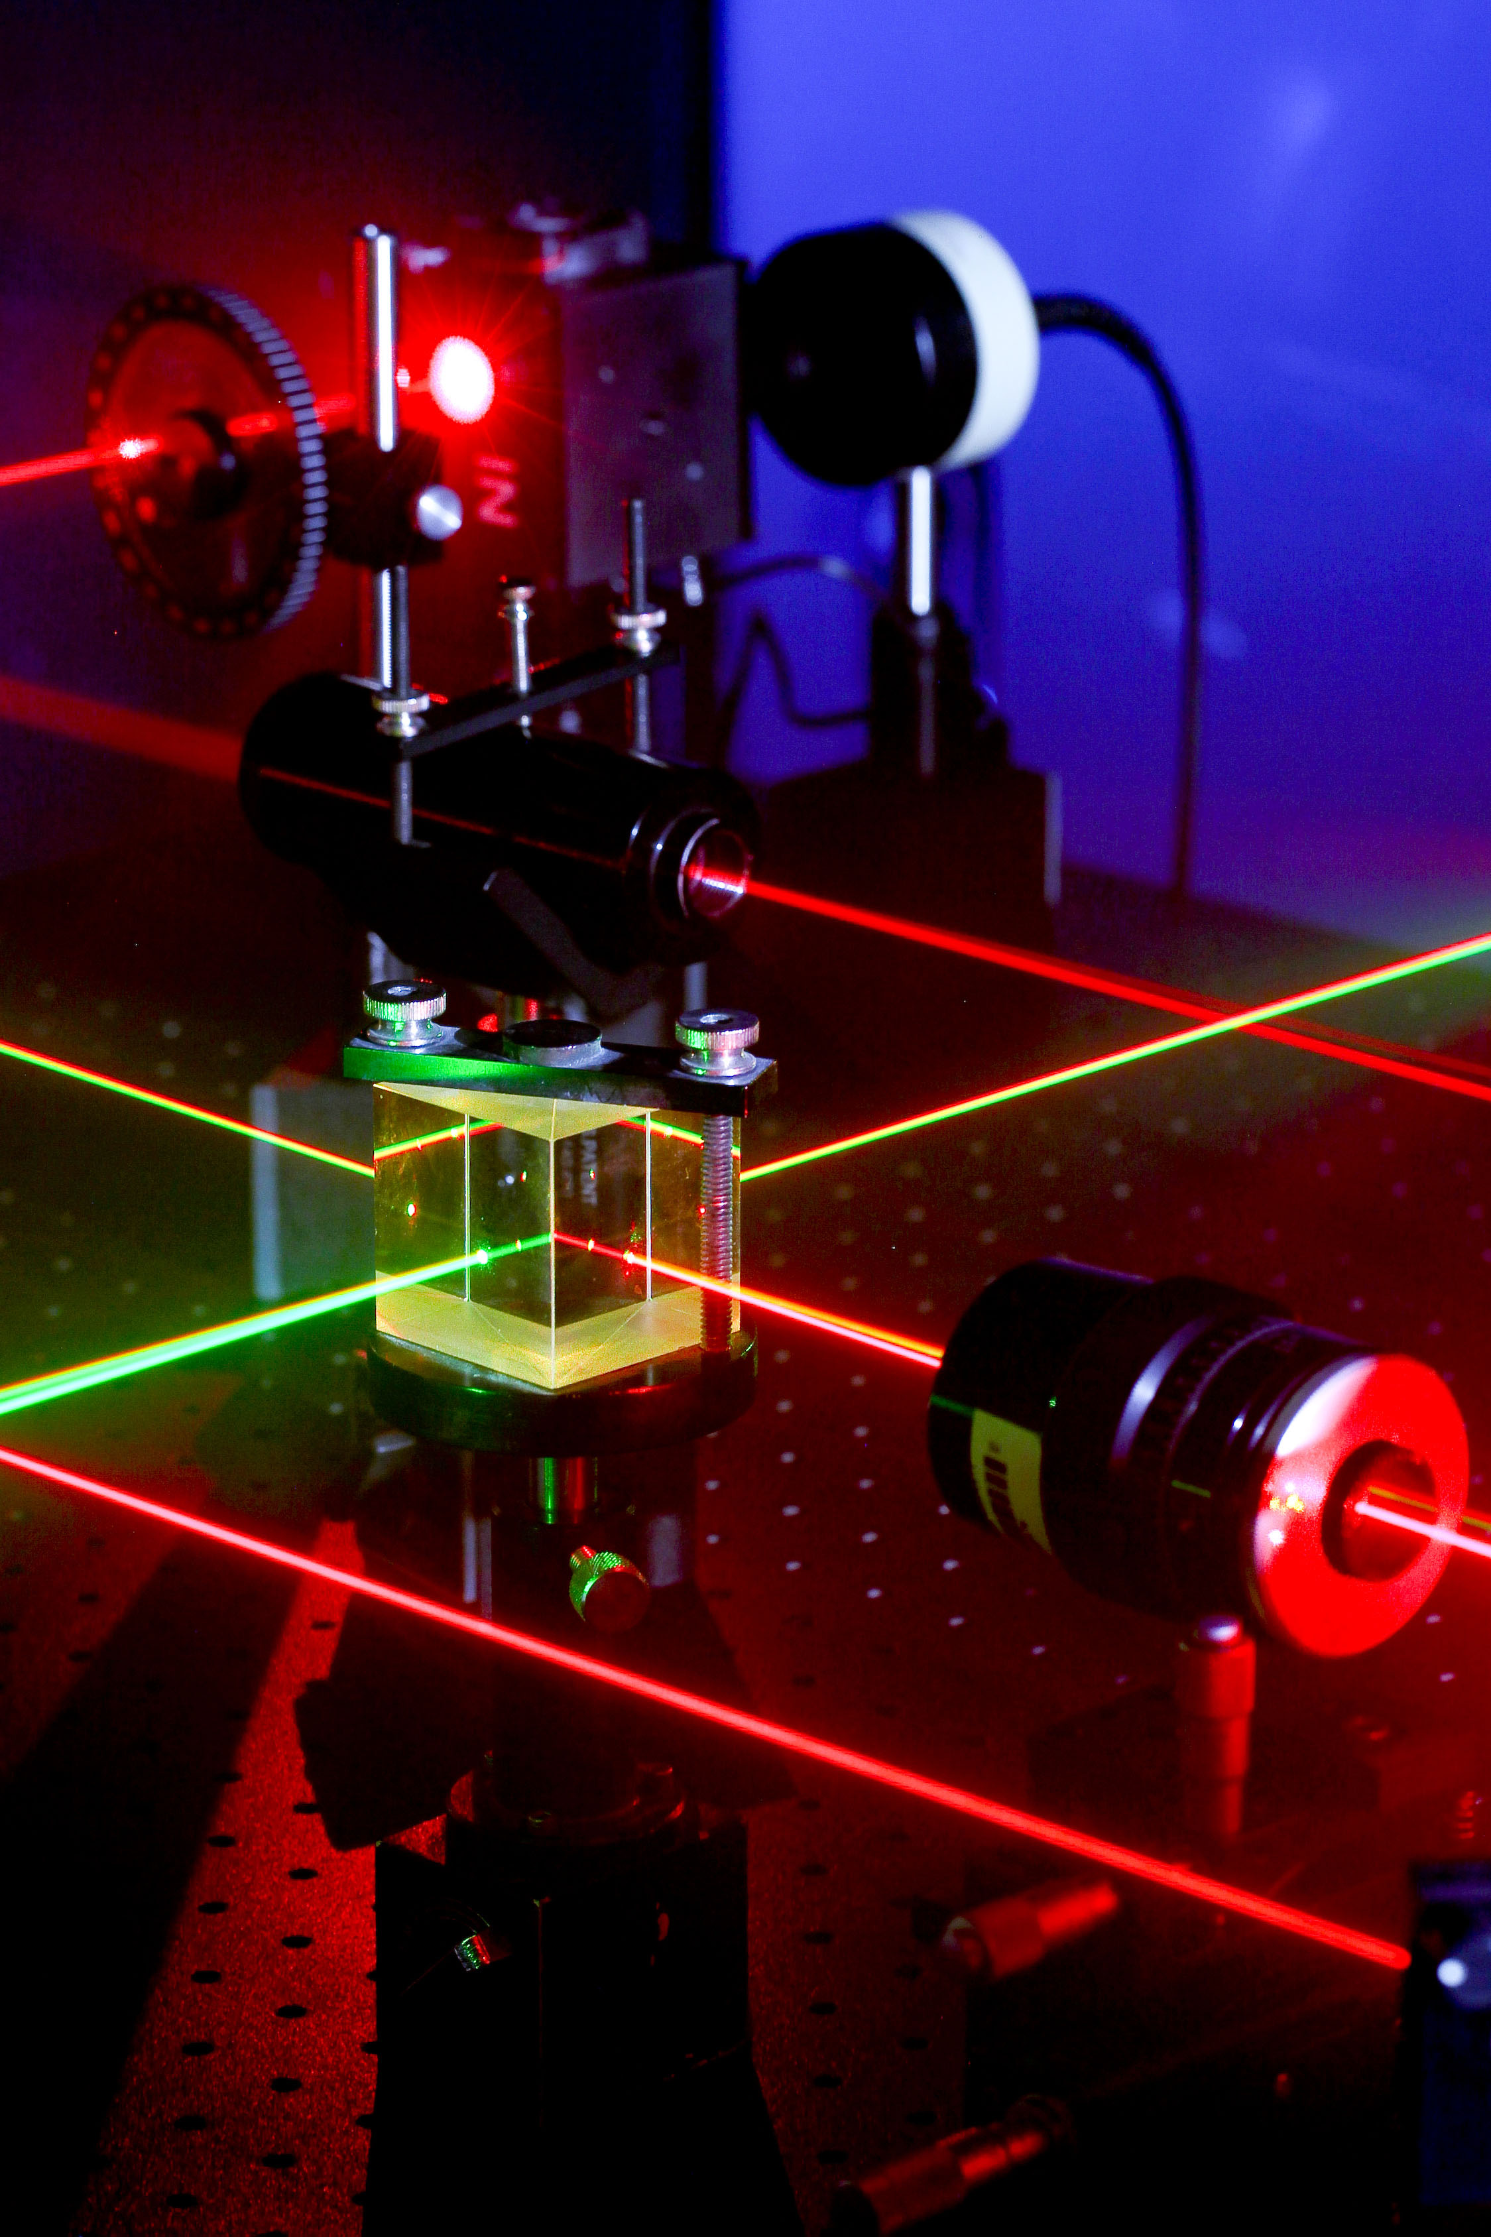
Introduction
The term "LASER" is an acronym for:
  Light
  Amplification by
  Stimulated
  Emission of
  Radiation
The laser is a device that emits a collimated (pencil-like) beam of either visible or invisible electromagnetic radiation (light).

Slide 3
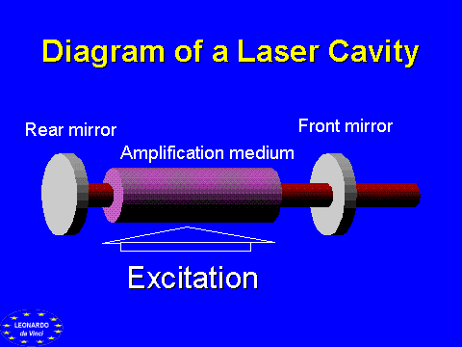
Laser Components
All Lasers are comprised of these essential elements:
  Active medium
  Excitation
  High reflectance mirror and the partially transmissive mirror (output coupler)

Slide 4
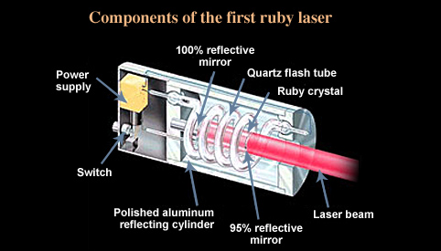
Laser Components
The active medium can be any substance that, when stimulated, emits or "gives off" light energy and are made from gaseous, liquid, or crystalline solid substances. Often lasers are named for the specific element or substance, such as the helium, neon or ruby, which emits the light.
The excitation mechanism in a laser causes electrons in the active medium to jump to higher energy levels. When the electrons drop back to a lower level energy, the energy difference between the two levels is released in the form of light, which is emitted from the medium. Light passing through the medium stimulates this emission in such a way as to amplify the light.

Slide 5
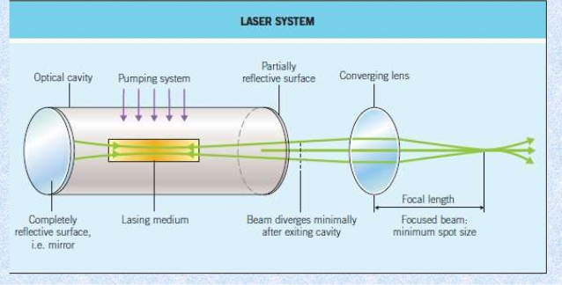
Laser Components
It takes more than an active medium and an excitation mechanism to produce laser light. Such a system could produce light, but it would be emitted in all directions and would behave like ordinary monochromatic light.
In order to produce a laser beam, a feedback mechanism is needed to amplify and to direct the output energy. The feedback mechanism consists of two mirrors placed at opposite ends of the active medium.

Slide 6
Laser Components
The mirrors reflect laser light back and forth through the medium. On each pass through the medium, the intensity of the laser light is amplified. One mirror reflects essentially 100 percent of the light hitting it, while the other mirror, called partially transmissive mirror (output coupler) reflects only part of the light, transmitting the remainder. In this way some of the laser light is emitted from the laser.
Sometimes the output coupler is blocked from the inside by a special material that can be "switched" from a transparent state to an opaque state. This special material enables the laser to be turned on and off so that it can produce pulses instead of continuous output.

Slide 7
Characteristics of Lasers
Laser light has three unique characteristics, that make it different than "ordinary" light. It is:
  Monochromatic
  Directional
  Coherent
Monochromatic means that it consists of one single color or wavelength. Even through some lasers can generate more than one wavelength, the light is extremely pure and consists of a very narrow spectral range.
Directional means that the beam is well collimated (very parallel) and travels over long distances with very little spread.
Coherent means that all the individual waves of light are moving precisely together through time and space, i.e. they are in phase.

Slide 8
Types of Lasers
There are many types of lasers available for research, medical, industrial and commercial uses. The major types of lasers are:
  Gas
  Pumped solid state
  Dye
  Diode
Gas lasers use a gas as the active medium. Common gas lasers are HeNe, CO2, N2, ion, and excimer. Solid state lasers, such as Nd:YAG, Nd:glass, and ruby, use crystal doped with heavy multi-electron atoms as the active media.
Tunable dye lasers use a dye in a liquid active medium.
Diode lasers use semiconductor materials as the active media.

Slide 9
Electromagnetic Spectrum
Regions of the optical radiation spectrum

Slide 10
Electromagnetic Spectrum
Region Wavelength
Ultraviolet (UV) 100 to 400 nm
UV-C 100 to 280 nm
UV-B 280 to 320 nm
UV-A 320 to 400 nm
Visible (Light) 400 to 700 nm
Near Infrared 700 to 1400 nm
Far Infrared 1400 nmto 1 mm

Slide 11
Laser Classifications
Lasers and laser systems are assigned one of the four broad classes (1 to 4) depending on the potential for causing potential damage.
  Class 1: "safe" if not disassembled. Example: Laser printers, CD-Rom players/drives
  Class 2: may exceed class 1 exposure limits if viewed more than 0.25 seconds [aversion respond time], but still not pose a significant eye hazards. Example: Supermarket scanners
  Class 3a: eye hazard if viewed using collecting optics, e.g., telescopes, microscopes, or binoculars.
  Class 3b: eye hazards if beams are viewed directly or specular reflections are viewed. Example: research
  Class 4: eye hazards if beams are viewed directly or specular reflections and sometimes even from diffuse reflections are viewed. Also skin burns from direct beam exposure. Example: research, manufacturing.

Slide 12
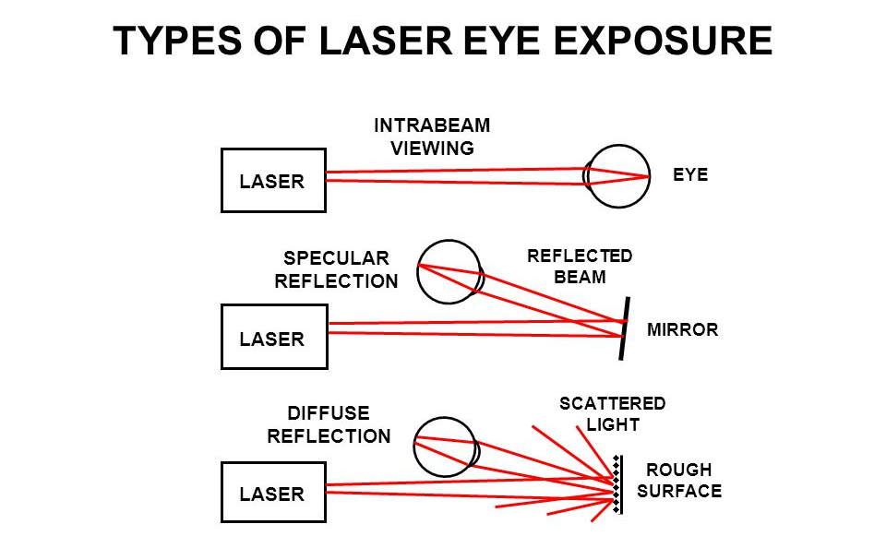
Viewing Laser Radiation
Figures 1, 2, and 3 illustrate the different ways laser radiation can be viewed and therefore the different types of exposures an individual may encounter.
Figure 1. Intrabeam viewing of direct (primary) beam. This type of viewing is most hazardous. Note that the diagram also illustrates that a laser beam may diverge as it propagates.
Figure 2. Intrabeam viewing of a specularly reflected (secondary) beam from a flat surface reflector.
Figure 3. Diffuse viewing of a diffusely reflected (secondary) beam from a rough surface in which a collimated beam is reflected in all directions.

Slide 13
Laser Exposure Limits
Maximum Permissible Exposure(MPE) is defined as the level of laser radiation to which a person may be exposed without hazardous effect or adverse biological changes in the eye or skin. The MPE of a specific laser is determined based on the wavelength and exposure duration.
Nominal Hazard Zone(NHZ) is the space within which level of the direct, reflected, or scattered radiation during normal operation exceeds the applicable MPE. Exposure levels beyond the boundary of the NHZ are below the appropriate MPE level.

Slide 14
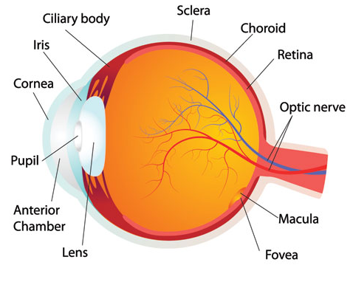
The Structure of the Eye
The eye is a complex optical instrument consisting of several parts.
The CORNEA is exposed to the outside environment and therefore must repair itself rapidly because it is constantly faced with abrasion. It is transparent to all visible and near infrared wavelengths. The pupil is the opening that allows light into the eye. Its size is controlled by the light sensitive iris.
The LENS is transparent to visible and near infrared light. Together with the cornea, the lens focuses light to the back of the eye. The shape of the lens changes to accommodate near or distant viewing.

Slide 15
The Structure of the Eye
The RETINA is the layer of nerve cells that receives the image and sends signals to the brain. The FOVEA is the most sensitive area of the retina because it has the greatest concentration of cones. Rods and cones are the photoreceptors.
The nerves leading from the rods and cones exit at the back of the eye through the OPTIC NERVE. The pigment epithelium is a layer at the back of the retina that absorbs light. The heat generated by the absorption of even environmental light in the pigment epithelium is removed by the blood flow in the choroid located just behind the retina.

Slide 16
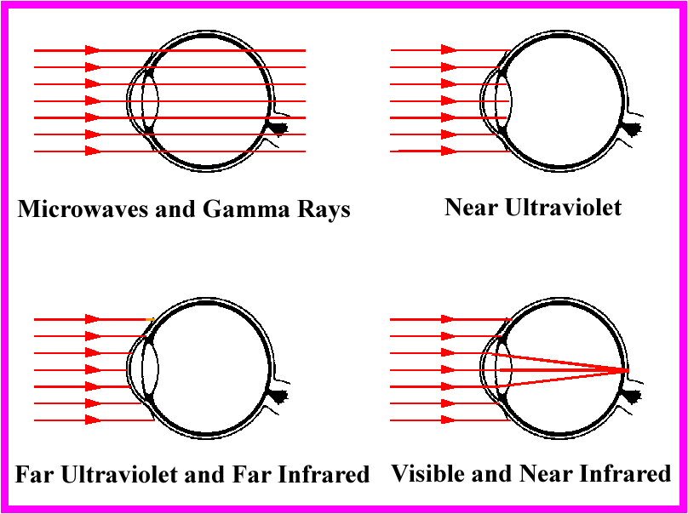
Eye Hazards
The site of damage depends on the wavelength of the incident or reflected laser beam as shown below:

Slide 17
Eye Hazards
Visible (400 -700 nm) and Near-Infrared wavelengths (700 -1400 nm) are focused by the cornea and lens and are absorbed by the retina. This may result in a fovea burn which may be considered one of the more serious types of laser injuries.
Mid-Infrared and Far-Infrared (1400 nm -1mm) wavelengths and Mid-Ultraviolet (180 -315 nm) are absorbed by water on the surface of the eye.
Near-Ultraviolet (315 -390 nm) wavelengths are absorbed in the cornea and lens structures.

Slide 18
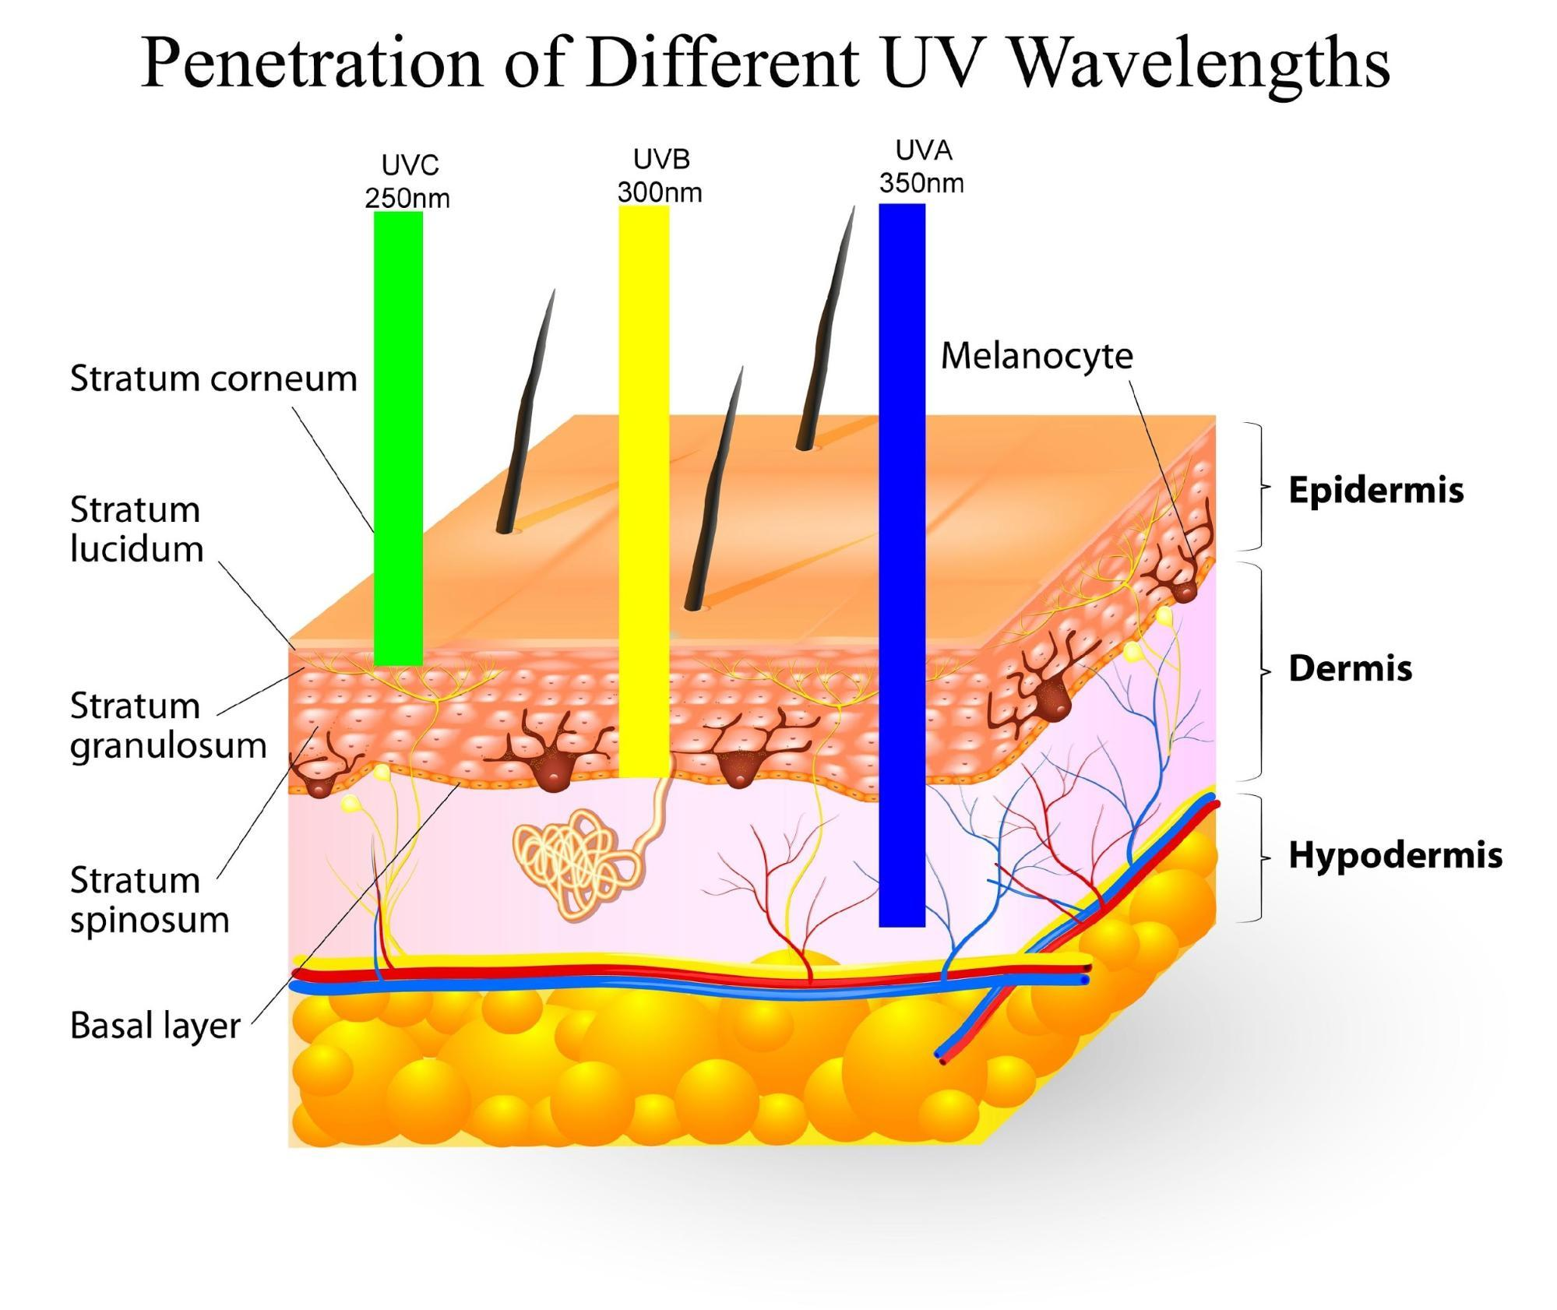
Skin Hazards
UV-C (200 -280 nm): erythema (sunburn), skin cancer
UV-B (280 -315 nm): accelerated skin aging, increased pigmentation
UV-A (315 -400 nm): pigment darkening, photosensitive reactions
Visible (400 -780 nm): photosensitive reactions, skin burn
Infrared (900 nm -1 mm): skin burn

Slide 19
Non Beam Hazards -Electrical
Lasers may contain high voltage power supplies and large capacitors or capacitor banks that store large amounts of charge. In general, systems that permit access to components with large charges must be interlocked; however, during maintenance and alignment procedures such components often become exposed or accessible. The proper high voltage electrical safety precautions should be utilized in these situations.

Slide 20
Non Beam Hazards -Electrical
As a reminder, the following electrical safety precautions should be followed to help prevent electrical injury when working around laser equipment:
  Use one hand when working around power supplies, capacitors or other electrical equipment.
  Avoid wearing metallic items.
  Never handle electrical equipment when hands are wet or when standing on wet ground.
  With high voltages, regard all floors as conductive and grounded for high voltages unless they are covered with well-maintained dry rubber matting of a type suitable for electrical work.
  Be familiar with the following rescue procedures for application to apparent victims of electrocution:
    Kill the circuit.
    Remove the victim with a non-conductor if he is still in contact with an energized circuit.
    Initiate Cardio Pulmonary Resuscitation and continue until relieved by a physician.

Slide 21
Non Beam Hazards -Chemical
One of the major sources of chemical hazards from lasers is from the organic dyes used in dye lasers.
Other chemical hazards include toxic gases from excimer lasers, coolant such as liquid nitrogen, and gases that are formed by the interaction of the laser light with target materials.
Please refer to the UNC Laboratory Safety Manual and your Laboratory Safety Plan in controlling or reducing your risk of exposure to these chemicals

Slide 22
Non Beam Hazards -Fire
Class 4 lasers represent a fire hazard. Depending on the construction material, beam enclosures, barriers and beam stops are potentially flammable if exposed to high beam irradiance (>10 W/cm2) or beam powers in excess of 0.5 W for more than a few seconds.
To prevent fire hazard:
  Beam enclosures should be constructed of flammable resistant materials.
  Electrical circuitry shall be evaluated for the potential to cause fire.

Slide 23
Non Beam Hazards -Explosion
High-pressure arc lamps, filament lamps, and capacitors may explode violently if they fail during operation.
Laser targets and some optical components also may shatter if heat can not be dissipated quickly enough.
Care must be used to provide adequate mechanical shielding when exposing brittle materials to high intensity lasers.

Slide 24
Control Measures -Engineering
Engineering controls are design features or devices that are applied to a laser or its environment for the purpose of reducing laser hazards. Engineering controls are considered to be the most effective types of control:
  Protective housing
  Interlocks
  Key control
  Beam stop or attenuator
  Activation warning systems: audible sound, warning light

Slide 25
Control Measures -Administrative
Administrative controls consist of procedures and information provided to personnel for the purpose of reducing laser hazards. They are:
  Warning signs and labels
  Standard Operating Procedures (SOP)
  Training

Slide 26
Eye Protection
Laser safety eyewear is required for class 3b and 4 lasers.
The amount of attenuation is measured by optical density (OD). For instance, OD 5 means that the incident beam is attenuated by a factor of 100,000. The greater the OD, the greater the attenuation.
Eyewear is very wavelength dependent. Safety eyewear for one type of laser will not work for another type of laser. Eyewear stamped OD 5 for 488 & 514 nm [Argon] may be OD 0 for 633 nm [HeNe].
All laser safety eyewear should be stamped with the OD at a particular wavelength.

Slide 27
Skin Protection
Designation of protective clothing for UV lasers should be considered, even if not class 3b or 4.
Fire resistant material should be considered when class 4 lasers are being used.
Remote firing and monitoring should also be considered as a method of skin protection.

Slide 28
Common Causes of Laser Accidents
According to ANSI(American National Standard) Z136.1-2000. Ninety five percentage of laser accidents occurs due to the following:
  Unanticipated eye exposure during alignment
  Misaligned optics and upwardly directed beams
  Available laser eye protection not used
  Equipment malfunction
  Improper methods of handling high voltage
  Intentional exposure of protected personnel
  Operators unfamiliar with laser equipment
  Lack of protection for ancillary hazards

Slide 29
Common Causes of Laser Accidents
Common Causes (Continued):
  Improper restoration of equipment
  Eyewear worn not appropriate for laser in use
  Unanticipated eye/skin exposure during laser usage
  Inhalation of laser-generated air contaminants and/or viewing laser-generated plasma
  Ignition of fires of both a facility or personal nature
  Eye or skin injury or photochemical origin
  Failure to follow standard operating procedures (SOP)

Slide 30
Administrative Safety Practices
Supervisors are responsible for training users on any laser-specific safety procedures for the laser they are operating.
Standard Operating Procedures shall be developed for class 4 lasers.
Only authorized personnel allow in vicinity of laser.

Slide 31
General Laser Safety Precautions
Always consult with your laser manufacturer's guidelines for laser safety
Always use proper laser eye protection
Operate within a controlled area or secured enclosure only, unless the beam path is totally enclosed
Keep the beam path well above or below the eye level
Remove all unnecessary reflective surfaces from the area of the beam path
Permit only properly trained & authorized personnel to operate the laser
Enclose the entire beam path if possible
Use the entire beam path if possible
Use remote viewing methods where feasible (e.g. video monitoring) to accomplish any necessary view of the beam

Slide 32

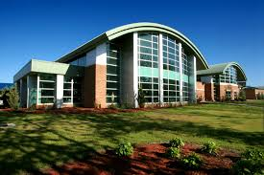

Questions, Comments, Concerns
Michael Bullard
Environmental, Health, and Safety Officer
O: 910.521.6792 C: 910.620.9553
Charles Chavis
Environmental, Health, and Safety Professional
O: 910.775.4772 C: 910.316.6356
Email: safety@uncp.edu

Slide 33
Post-Test
Congratulations! You have reached the end of the laser safety tutorial. If you have any questions, please contact the Laser Safety Officer at 910-521-6792.
We would like to assess your training and also to document your participation in this self-study. To do this we have provided a short multiple choice test, please proceed to the online quiz at the following link:
Online Laser Safety Quiz

