Slide 1
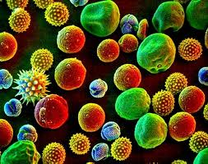
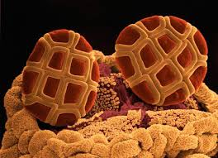
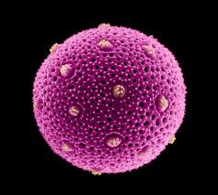
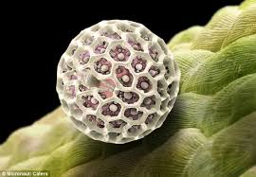
Discipline Literacy in the Science Classroom: Pollen, Pollinators, and People
Dr. Rita Hagevik, Dr. Martin Farley, and Brittany Stokes The University of North Carolina at Pembroke
Pembroke, NC, USA

Slide 2
Workshop Agenda
Introductions
Kids in the Garden program
What is pollen and palynology
Dissect a flower
Pollinators, pollinator gardens, citizen science
Pollinators and flowers activity
Pollen and the study of climate activity
Literacy strategies and book give away
Questions?

Slide 3
Kids in the Garden Program: Two Week “Bee Camp” during the summer (~24 middle and high school students) — Intro to plant and bee biology Science and research Learn how to use science equipment Development of research topics for academic year program
Academic year program on Saturdays for three hours each morning (about 15 students)
Primarily Research Outlets – Science competitions like science fair and presenting at science meetings such as the NC Student Academy of Science

Slide 4
Kids in the Garden and STEM Connections
Establish learning communities – scientist in residence program
Engage students in STEM experiences in natural settings
Cultural connections and focus on sustainability
Individual research
Science journals
Science equipment
Visit other universities
Embedded college and career program
Field trips to other natural areas
Science presentations and competitions

Slide 5
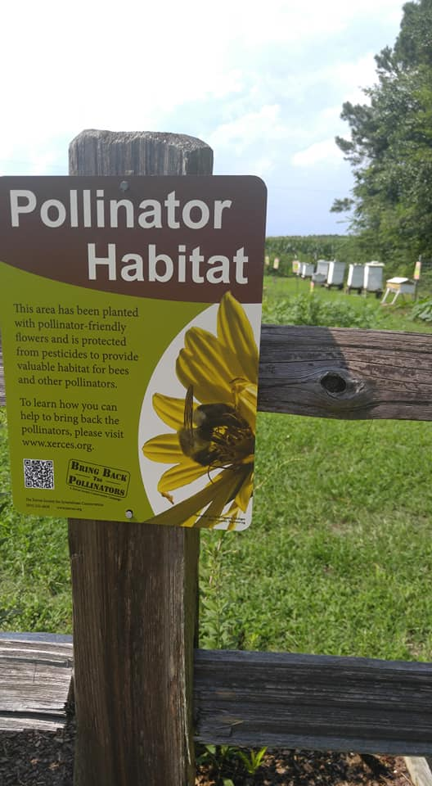
UNCP Campus Garden and Apiary
A pollinator haven
50+ raised beds, over 100 varieties of plants
Has become gathering point for
Research
Outreach
Summer and Weekend KIG Programs
Citizen Science Projects
Student Clubs
And More!

Slide 6
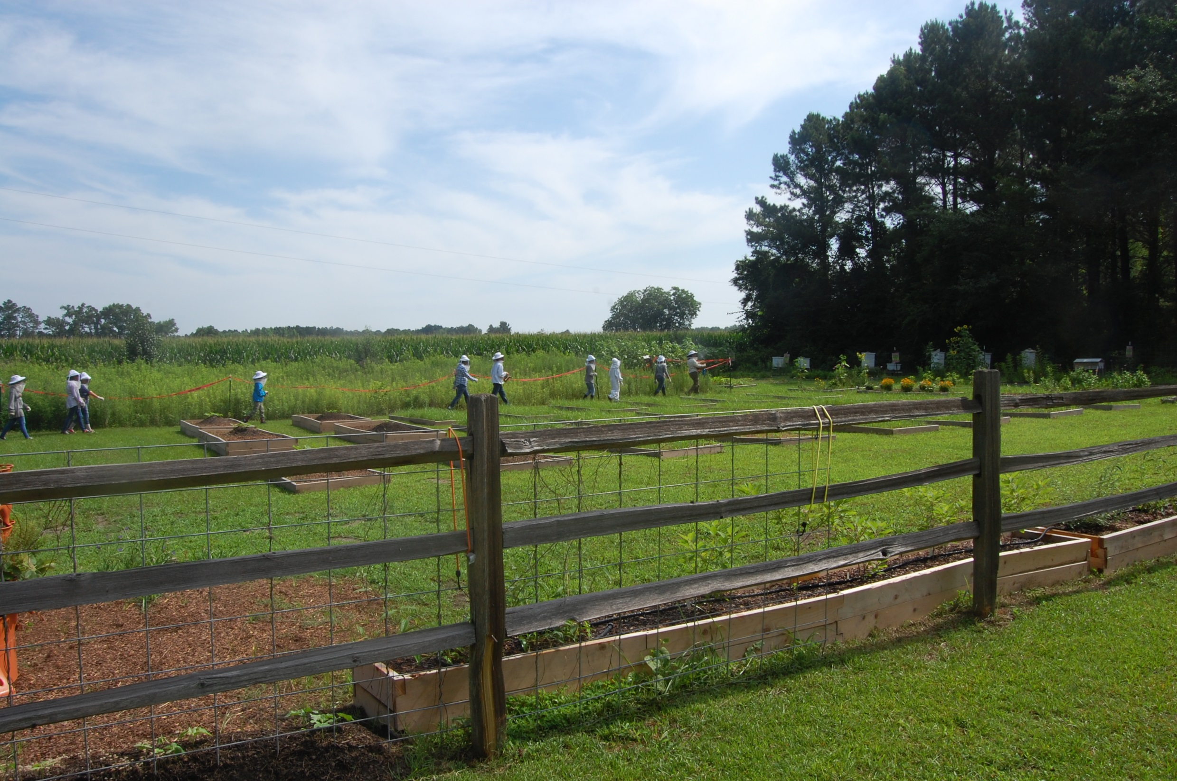

Slide 7
Research On How Pollen Moves Through the Environment
Honey bee health
Native bees
Pollen in honey and from bee hives
Using biosensors to track bees

Slide 8
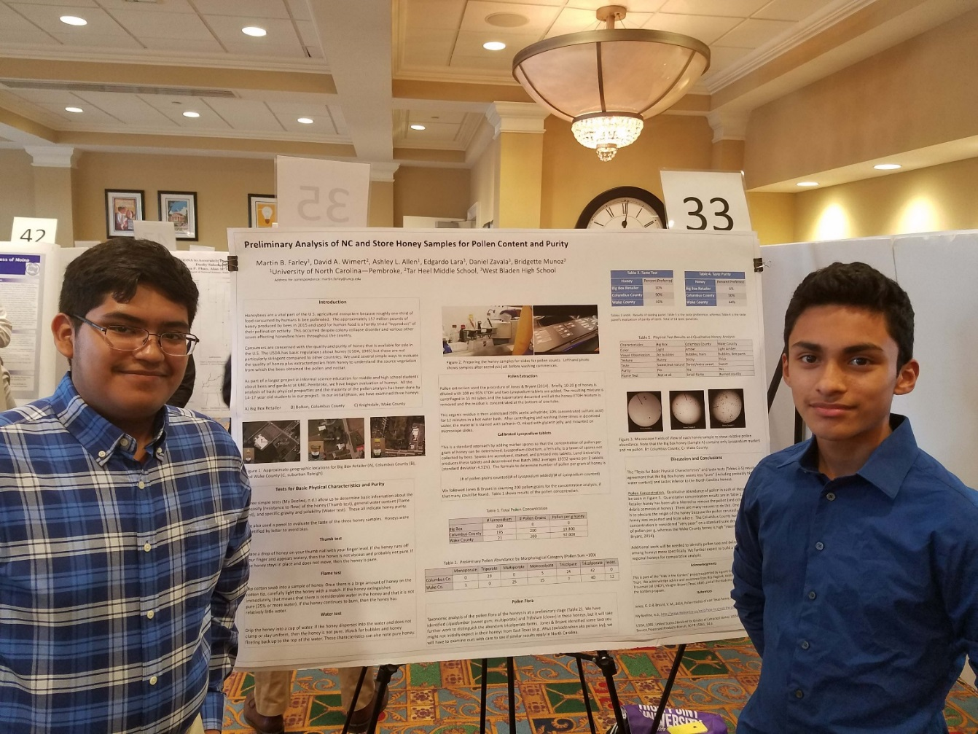
Edgardo Lara and Daniel Zavala, West Bladen HS
NC Academy of Science
Annual Meeting High Point Univ. 2017
Notes:
Asterisk on previous slide means we started with just HS and MS students, but we now have UG students too

Slide 9
Outlets
Regional Science Fair
Five Regional Entries (2 yrs)
Two HS 1st Place Winners (Biology)
One HS 2nd Place
One MS 1st Place Winner (Technology)
Best overall Regional Science Fair
State (NC)
One 1st Place Winner (Biology)
Scientific Meetings
Six Poster Presentations:
NC Academy of Science 2017, 2018 -One Poster each
Association of Southeastern Biologists 2018 –
Four Posters

Slide 10
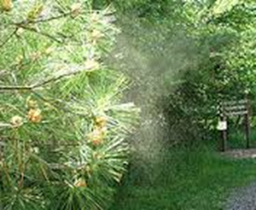
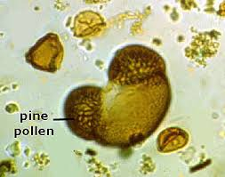
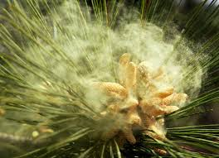
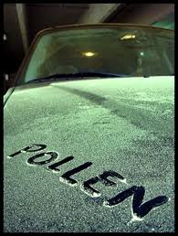
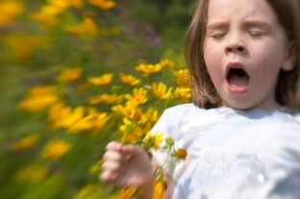
Pine pollen grain
AHHH-CHOOO!!
Notes:
Examples of pollen….. Pine pollen grains look like Mickey Mouse! Spring has sprung!!

Slide 11
What is Pollen?
Pollen -- a fine powdery substance consisting of microscopic grains released from the male part of a flower or cone.
Palynology -- study of pollen and spores of living and fossil plants
Melissopalynology -- pollen in honey

Slide 12
Why is Palynology important?
Climate change, Past Environments, and Plant Evolution
Study of Allergies
Archaeology
Forensic Analysis
Honey!

Slide 13
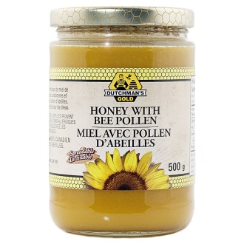
Why Pollen in Honey?
Where did the bees go? (Is it really sourwood or orange blossom honey?)
Identifying Honey imported from Country A but listed as from Country B.
Illegal honey brokers have been known
to create counterfeit product using
sugar water and coloring
Notes:
For importation: It is possible such honey could be tainted with heavy metals, pesticides, and illegal antibiotics.

Slide 14
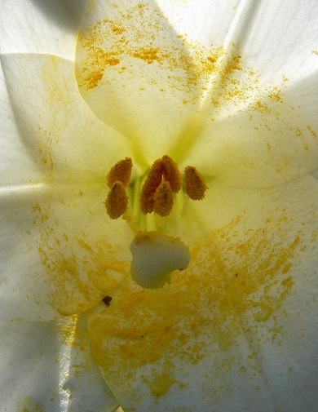
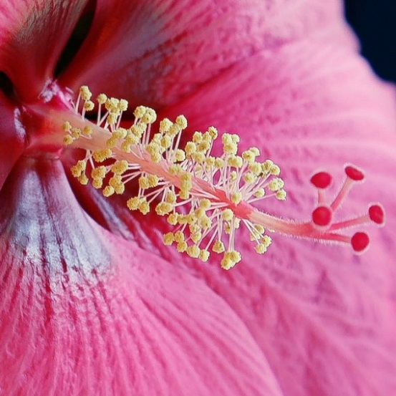
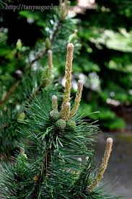
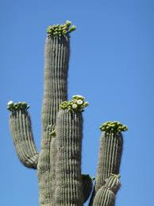
How do plants disperse their pollen?
In the air
In the water
By animal pollinators
Notes:
Pollen in flowers, and cactus, pine

Slide 15
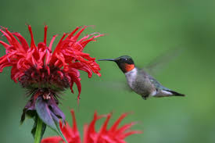
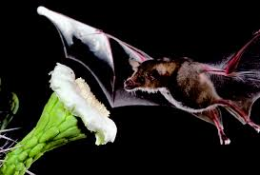
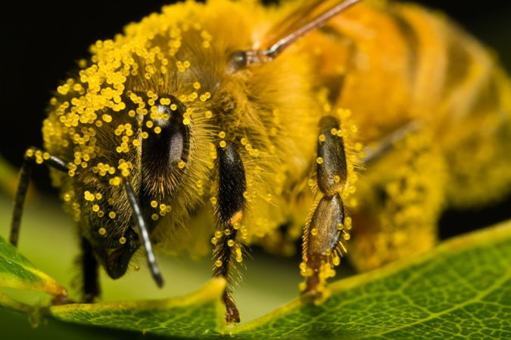
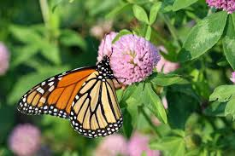
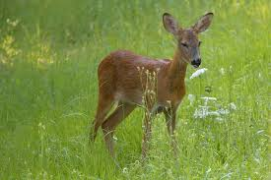
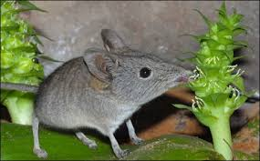
Who are the pollinators?
Notes:
Hummingbird, bee covered in pollen, bat pollinating a cactus, shrew, deer also act as pollinators, monarch

Slide 16
Why are pollinators important?
Reproduction of flowering plants:
Our food supply:
Every third bite you eat can be attributed directly to a pollinator, mainly bees
Many crops depend solely on bees for pollination e.g. almonds, apples, oranges, cherries, grapefruit, tomatoes
Wildflowers (ecosystems depends on it)

Slide 17
Dissect a Flower Activity
Brittany Stokes
MAT High School Graduate Student
Science Education Program Graduate Research Assistant

Slide 18
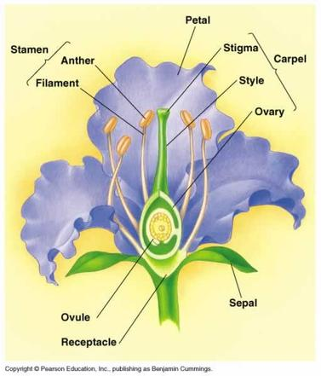
Parts of a Flower
Notes:
Introducing students to the parts of a flower

Slide 19
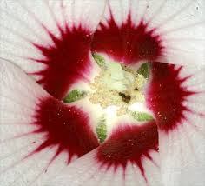
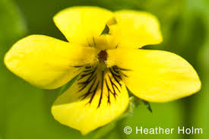
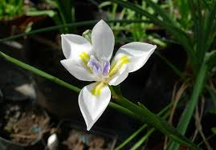
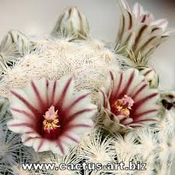
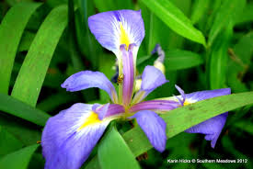
What are nectar guides?
Markings or patterns seen in flowers that guide pollinators
Notes:
The pink coloration in the center of the white flowers guide the pollinators to the right “spot” or the black lines on the yellow flower, the yellow landing strip on the iris serves as a guide for potential pollinators

Slide 20
Citizen Science and Native Bee Activity
Dr. Rita Hagevik
Activity handouts -
https://drive.google.com/drive/folders/1-h5oOjnQHyVeOPSIMia6EfjP9F4GfRpF?usp=sharing

Slide 21
Citizen Science
Public participation to answer scientific questions or to gather data
All age groups
Will involve: People who want to help!
May involve
Smart phone technology
Submission of images or data
Communication directly with scientists
Training in identification
Little time or lots of time

Slide 22
Value of Citizen Science
Gets people outside
Conservation
Scientific literacy
Demystifies science
Encourages inquiry
Interaction with scientists

Slide 23
How Many Bee Species are There?
How many honeybee species are there in the US?
World
20,000
North America
4,000
NC 500+
Triangle area 100+
Single yard 70+
Notes:
Just how diverse are they? These numbers indicate the approximate number of bee species in each area.

Slide 24
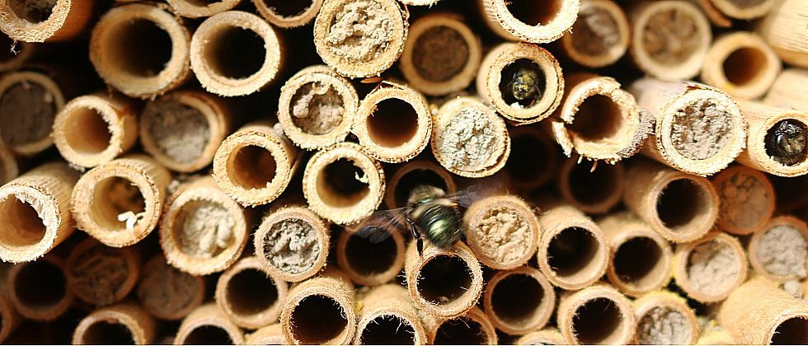
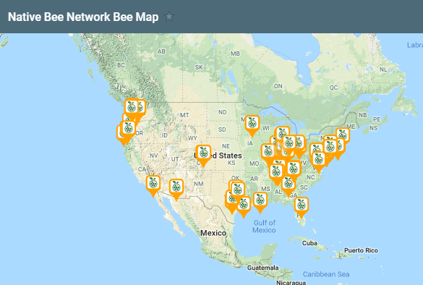
Crown Bees Native Bee Network
https://crownbees.com/native-bee-network
Aims to find, identify and raise twig nesting bees
Support sustainable agriculture and pollinators
Mason and leafcutter bees

Slide 25
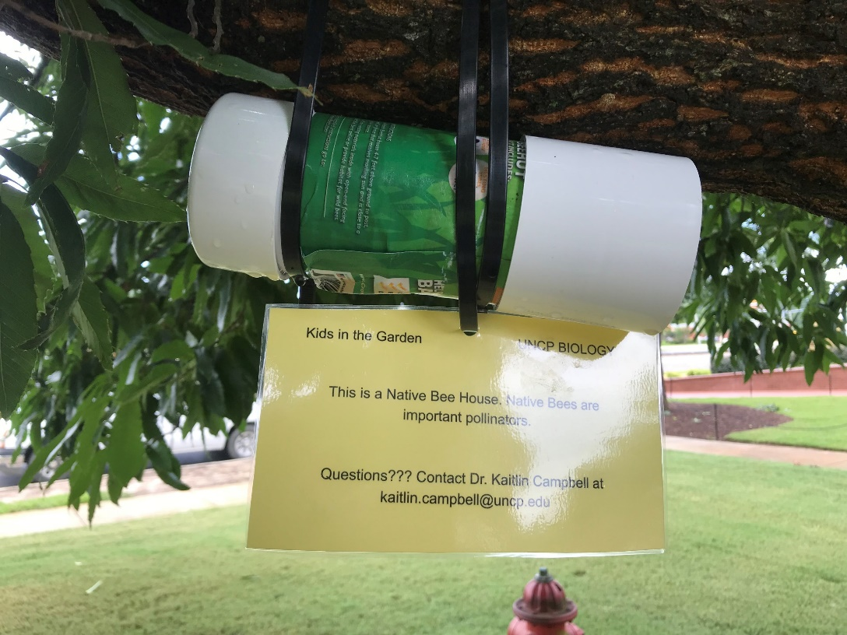
If you Build it They will Come
Set out bee houses
Document location
Identification stickers

Slide 26
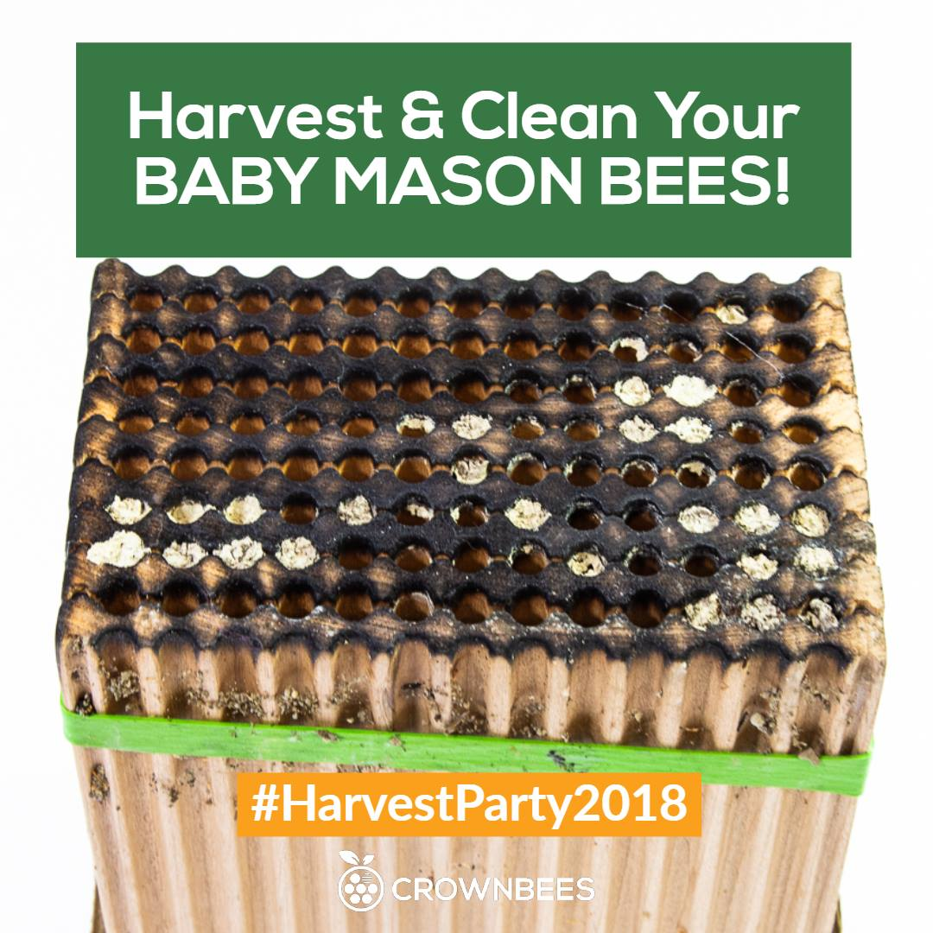
Collect and Store Cocoons
Store over the winter
Bee buyback program

Slide 27
The Great Sunflower Project
www.greatsunflowerproject.org
Count number of flower visitors
Bees
Non-bees
5 minute observations
What sort of flowers are most important for pollinators?

Slide 28
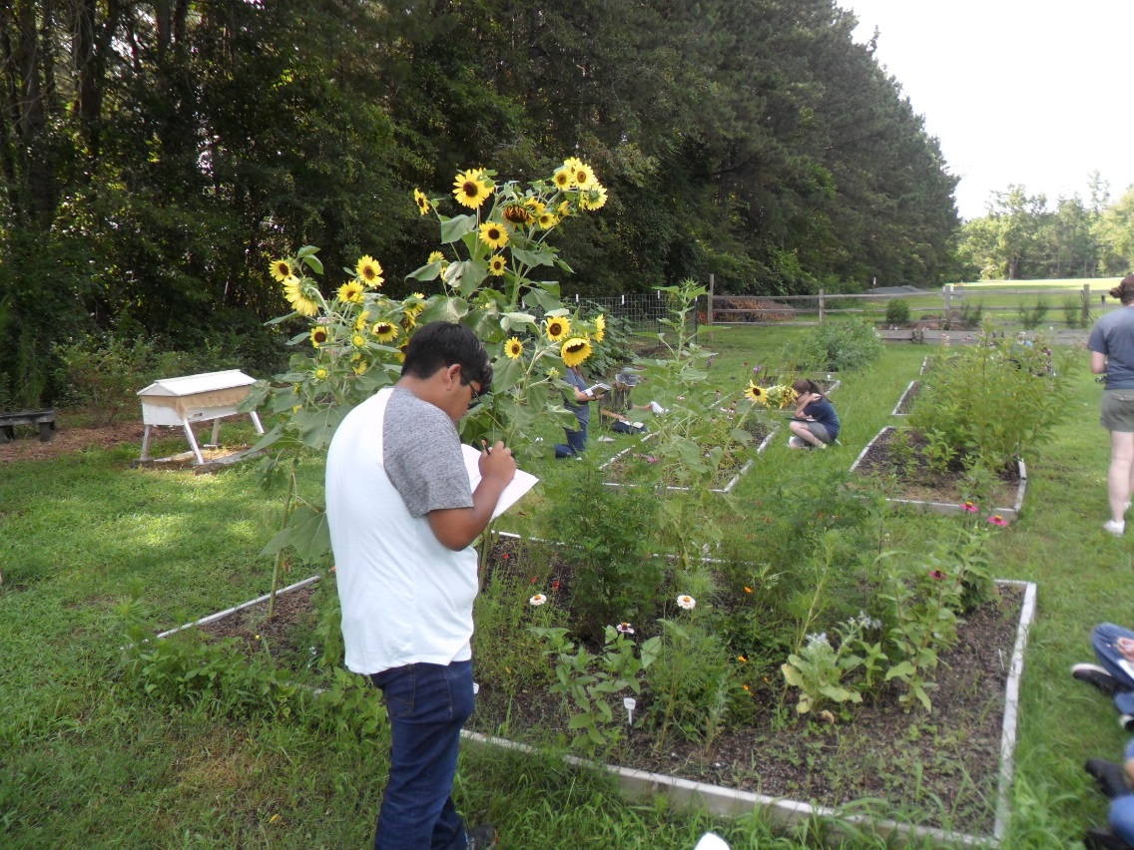
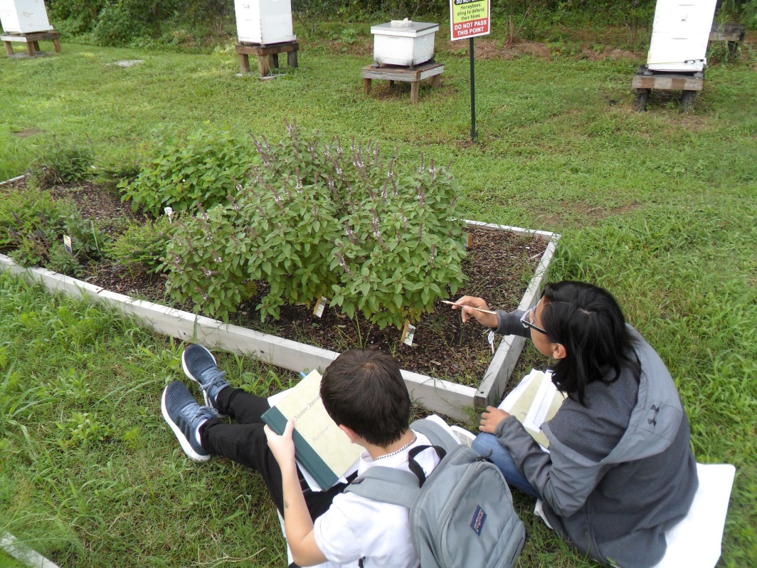

Slide 29
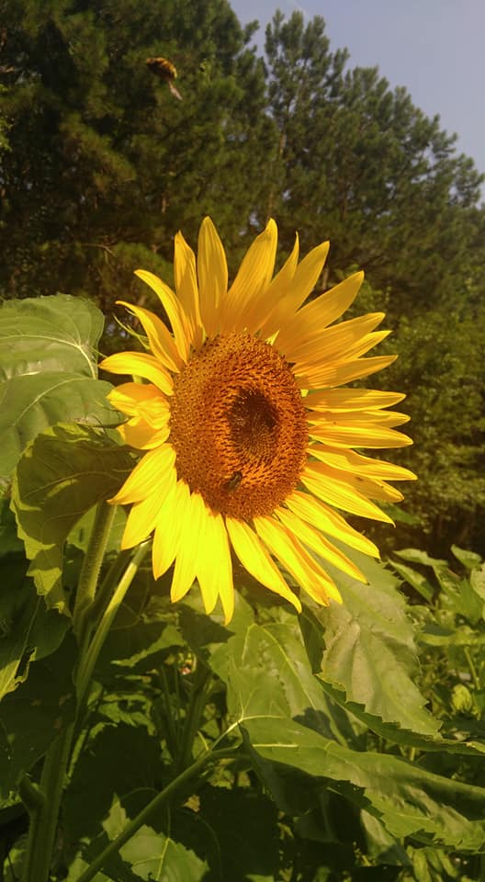
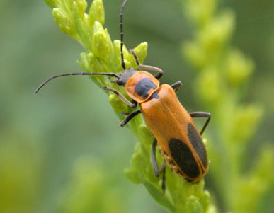
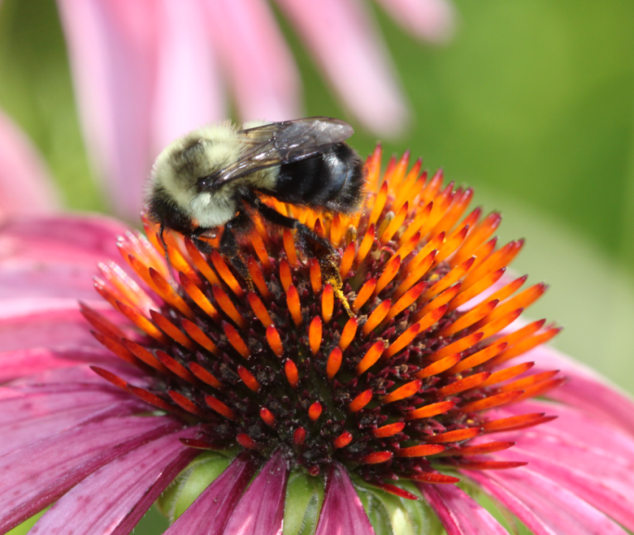

Slide 30
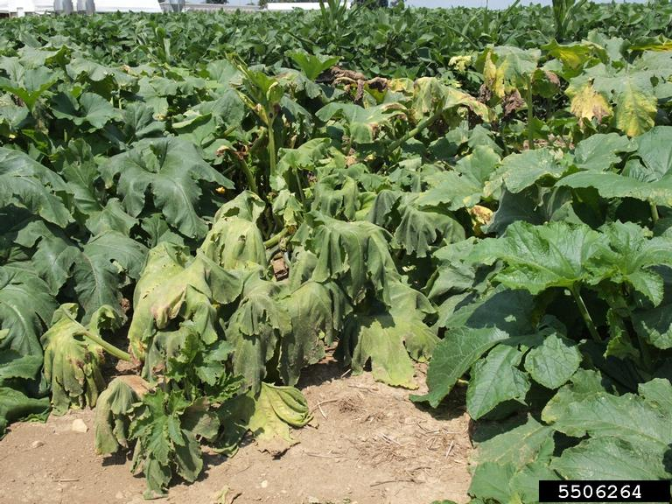
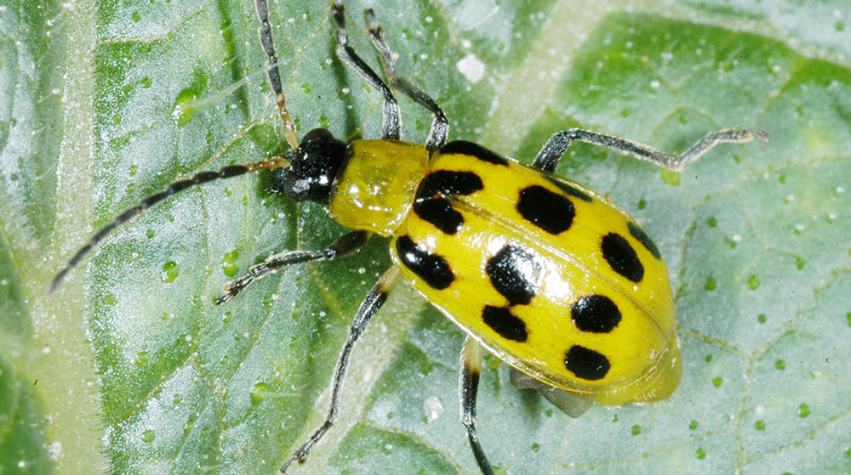
The Great Pumpkin Project
http://studentsdiscover.org/lesson/the-great-pumpkin-project/
Documenting insects and microbes of cucurbits (squashes, cucumbers)
Focus on bacterial wilt disease
Inspection for beetles and diseases, 10 minute observations

Slide 31
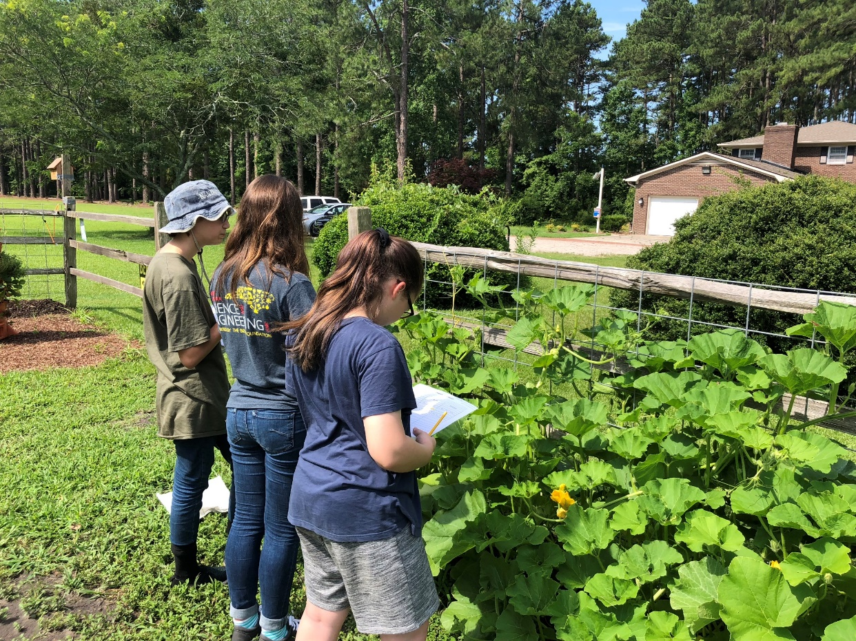
The Great Pumpkin Project

Slide 32
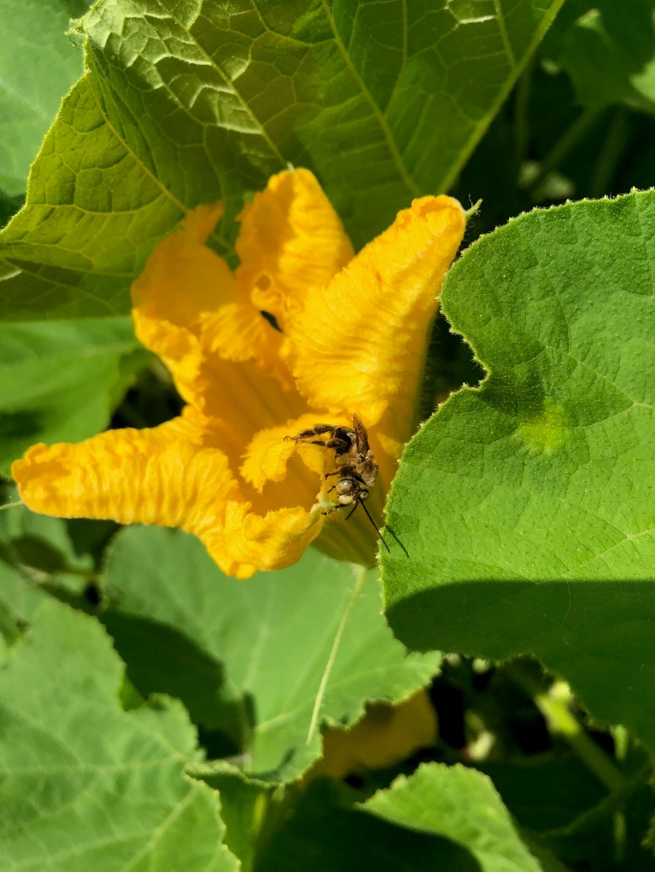
The Great Pumpkin Project

Slide 33
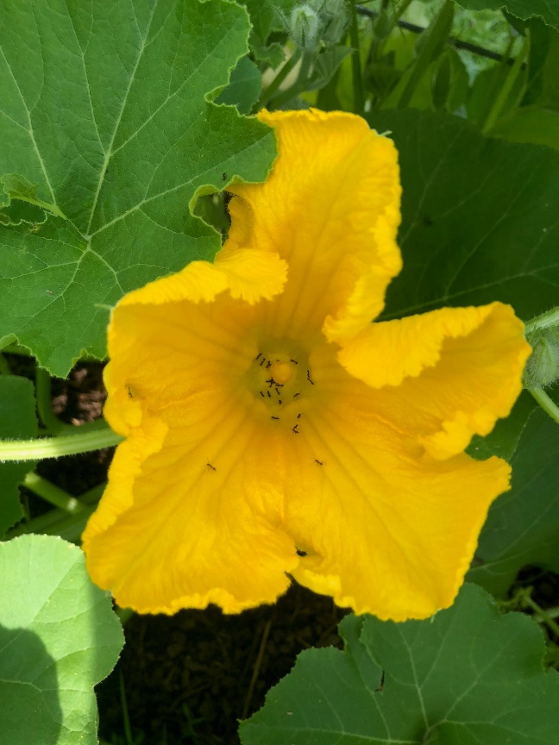
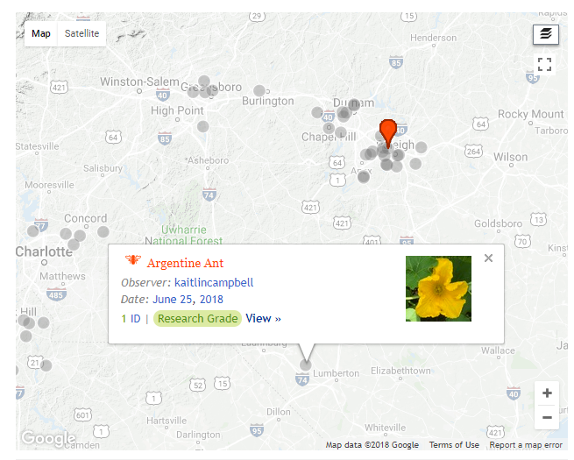

Slide 34
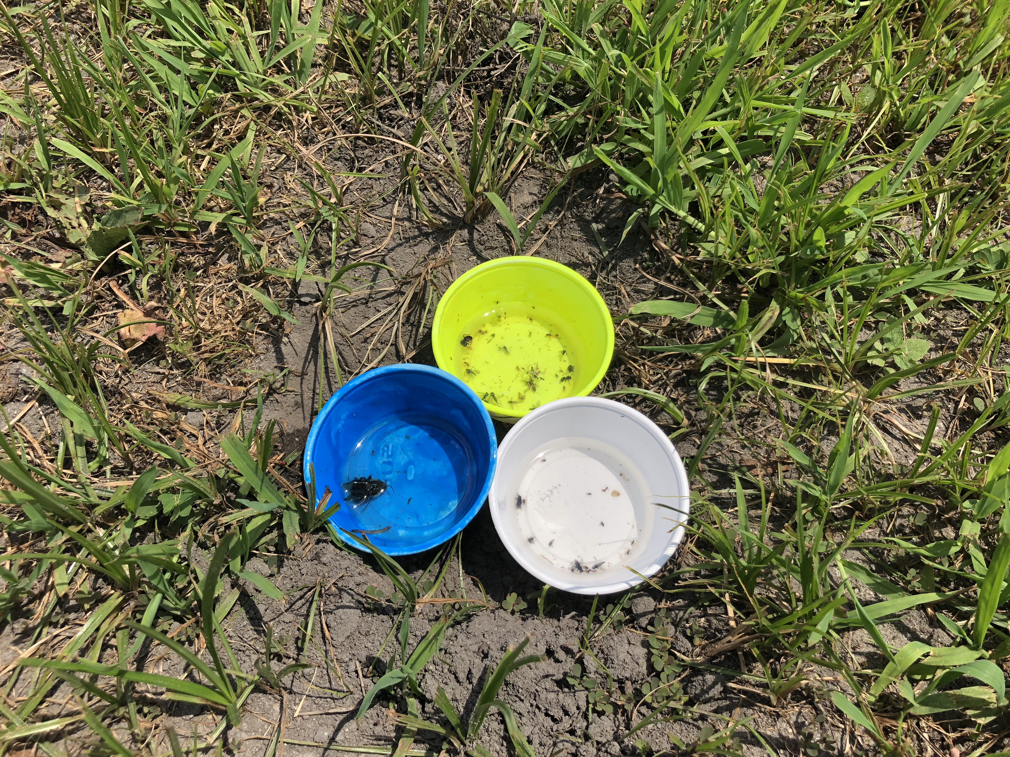
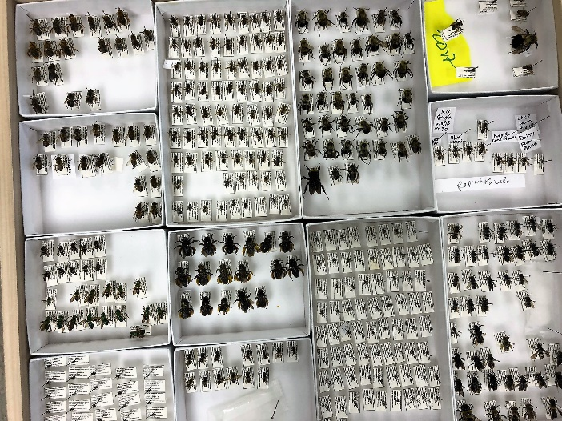
Research in the UNCP Garden
Native bee biodiversity
Floral resource use
Twig nesting bees
Change over time
Habitat use
Honey bee research
Bee health
Pollen collection
Parasites

Slide 35
Garden= 14 sampling points
UNCP

Slide 36
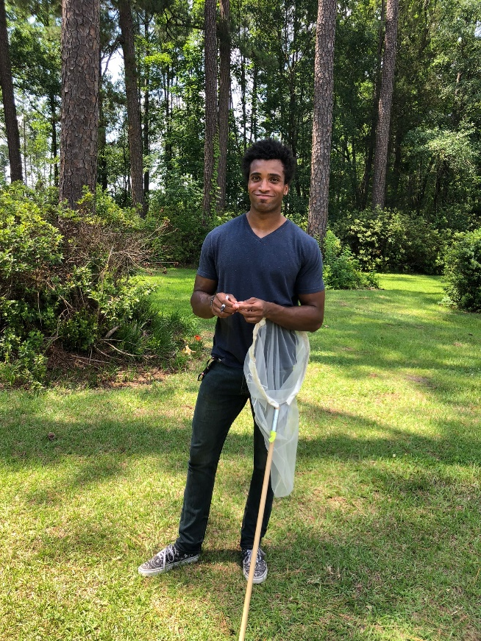
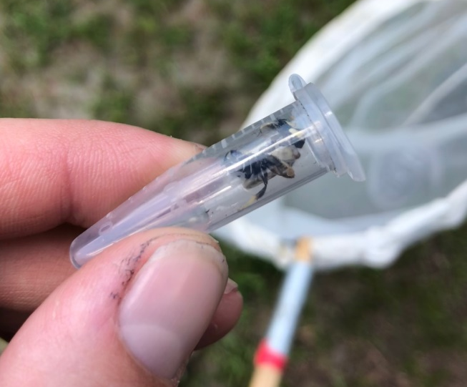
Lawn= 14 sampling points
UNCP

Slide 37
Pollinator Syndromes

Slide 38
Pollen and the Study of Climate Activity
Dr. Martin Farley

Slide 39
Ice Age Vegetation and Climate Change in North Carolina
Glacial Ice never reached North Carolina
But Ice Ages had profound effect here
Recorded in Carolina Bays
And students can learn about this

Slide 40
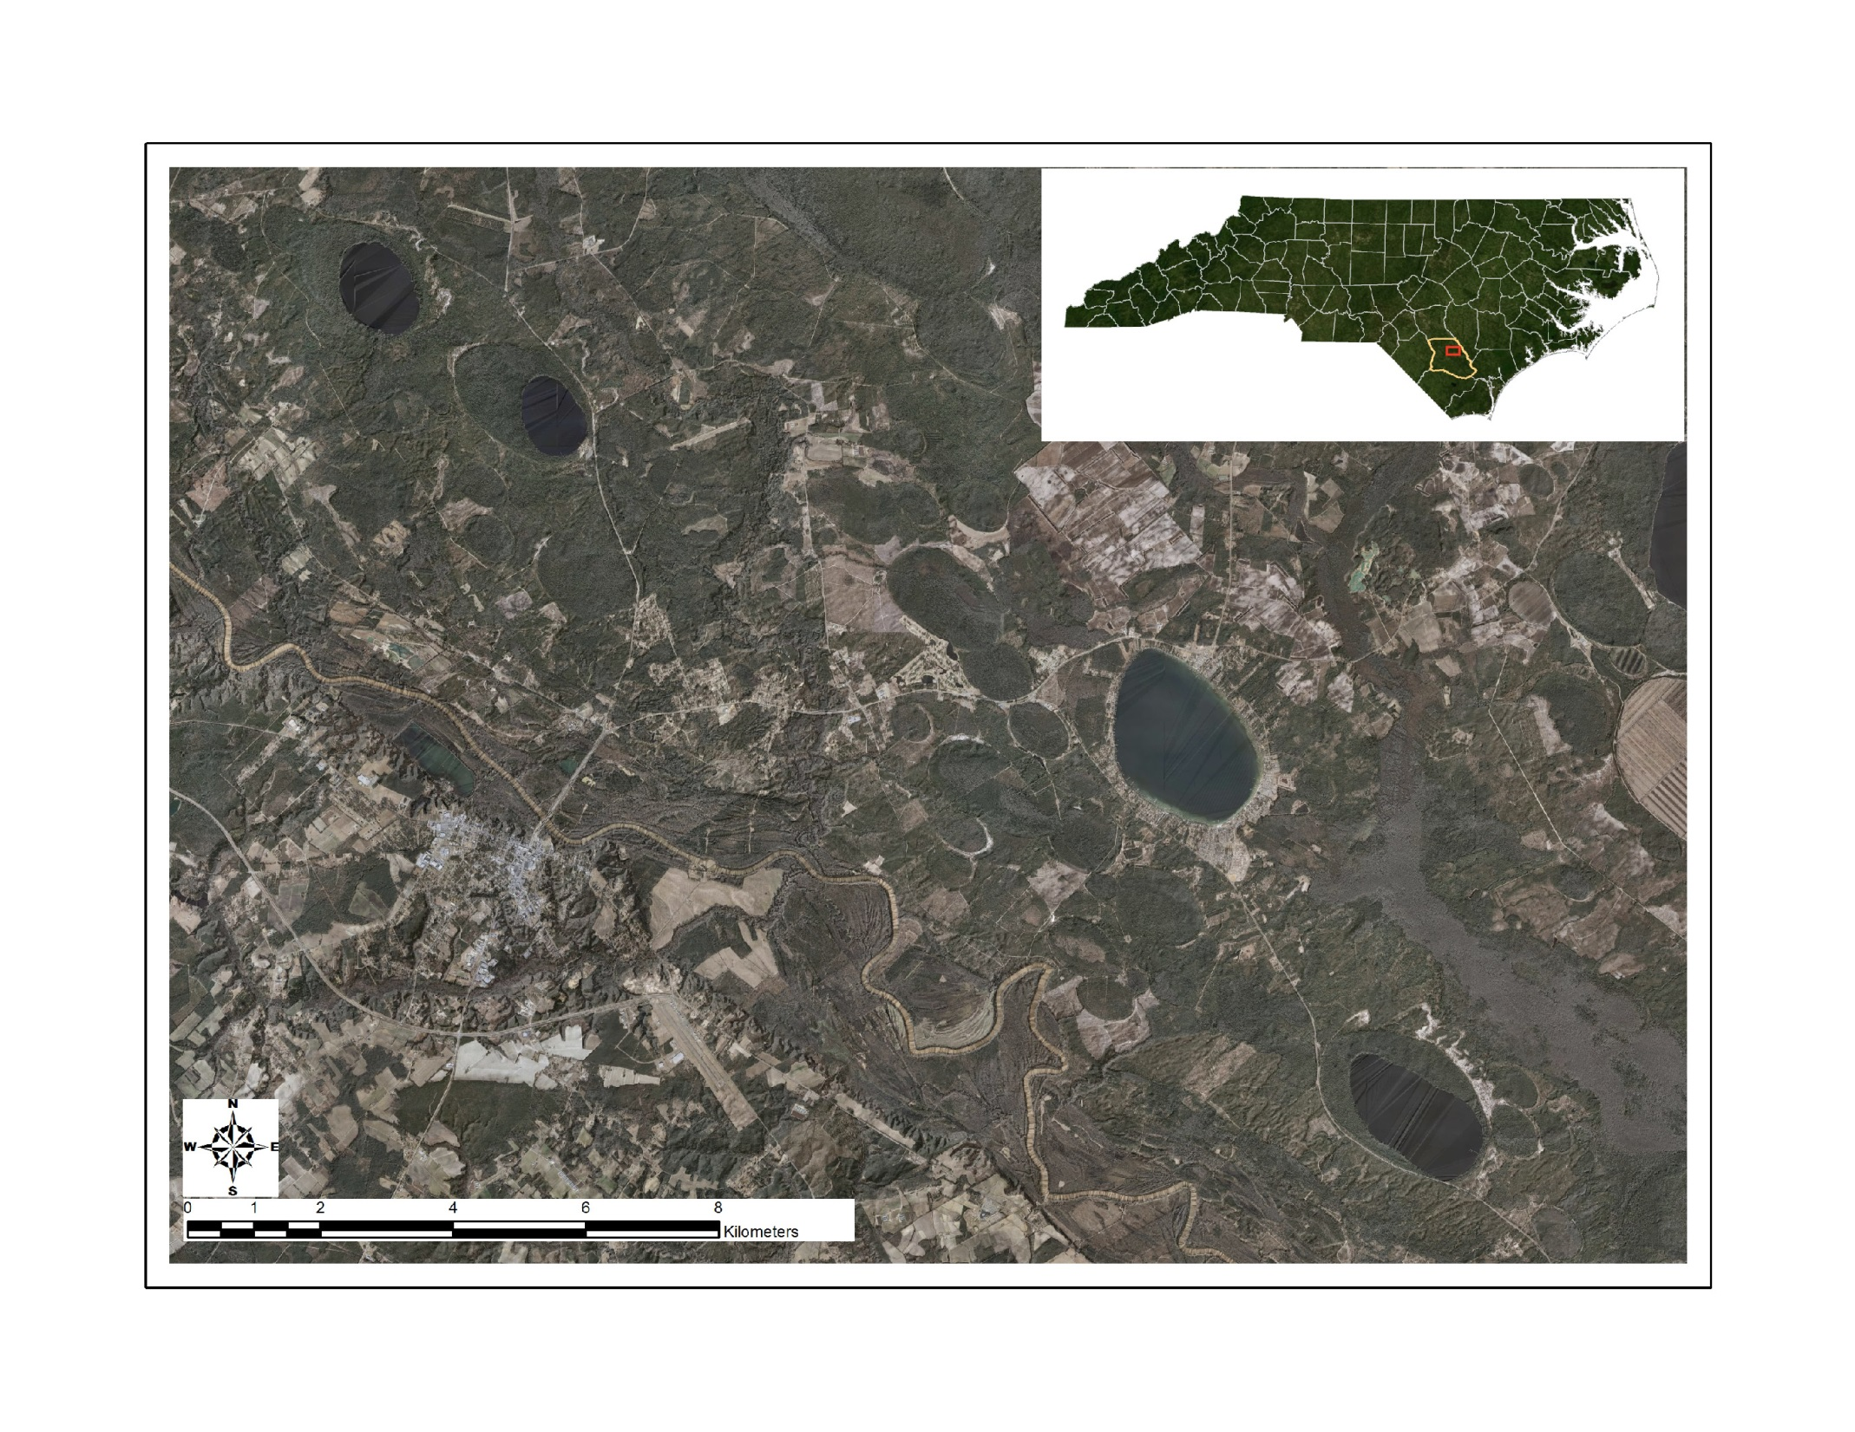
Bladen Bay Lakes
Salters and Jones Lakes
White Lake
Elizabethtown
Singletary Lake
Notes:
Aerial photo-lidar composite. 1000’s of bays in NC

Slide 41
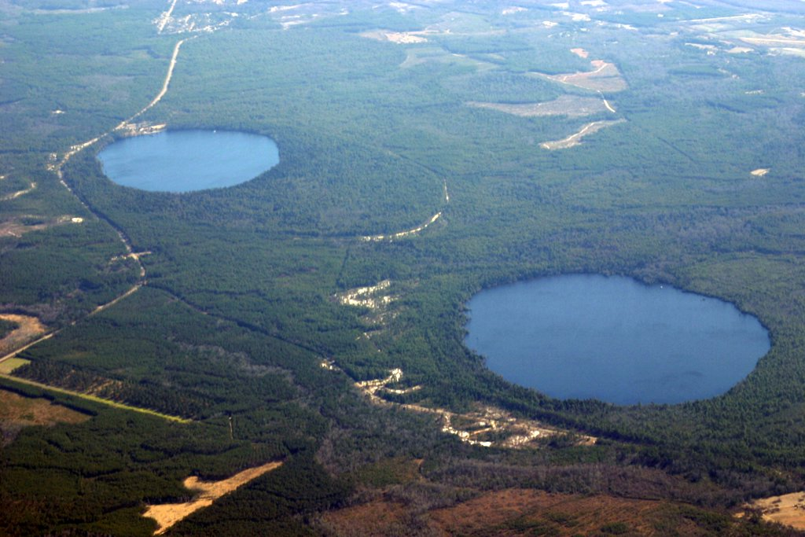
Carolina Bay Lakes
These lakes are Jones Lake (upper left) and Salters Lake (lower right) Bladen County, NC. View looking roughly south.
Notes:
The edge of the Jones Lake bay can be seen extending as the oval to the right of the lake outlined by the whiteish sand. The trees surrounding the edge of each lake are commonly bald cypress. These are both part of Jones Lake State Park.

Slide 42
Pollen Through Time
Notes:
Synthesis diagram of multiple cores through Bay lakes. Pollen micrographs on bottom; drawings of plants on top. Width of color bar is relative abundance. Superposition rules (oldest at bottom). Lefthand rectangle is sediment type in core.

Slide 43
Literacy Strategies
Science Notebooks – Claire Leslie Walker nature notebooks and instruction books
Text dependent reading – Use the Scientist in the Field series: Hidden Worlds and The Hive Detectives
Scientific argumentation – honey collapse disorder and why are native bees disappearing ex. some bumblebee species
Close reading activity – write a paragraph from the queen bees perspective, worker bee perspective, drone bee perspective

Slide 44
Acknowledgements
All the High School and Middle School students
Faculty: Dr. Grant Pilkay, Dr. Jeffery Warren, Dr. Debby Hanmer, Dr. Lisa Kelly, Dr. Ben Bahr, Krissy Smith
Undergraduate Students: Courtney Moore, Grant Wood, Hannah Swartz, Kennedy Tillman, Marica Thomas, Brandon Le, Brandon Herron, Stephanie Macklin, Sally Bond, Abigail Canela, Joshua Perry
Staff and Graduate Students: Brittany Stokes, Anastasia Oxendine, Mychael Strickland, Timothy Jacobs, Melissa Harris, Cameron Troutman, Dave Wimert
General Advice: Vaughn Bryant, Clemson University
Primary Funding: Burroughs Wellcome Foundation, Duke Energy, UNC-Pembroke, BIOTECH Center at COMtech, Robeson County Farm Bureau, Bayer Bee Care

Slide 45
Questions?
Contact Information:
Dr. Rita Hagevik- rita.hagevik@uncp.edu
Dr. Martin Farley- martin.farley@uncp.edu
Dr. Kaitlin Campbell- kaitlin.campbell@uncp.edu

