Slide 1
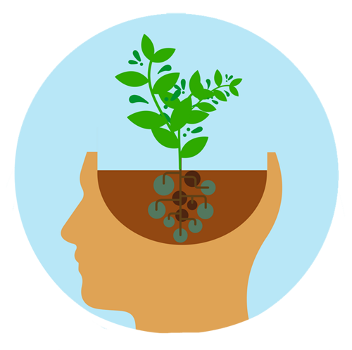
THE EFFECTS OF GARDENING ON STEM IDENTITY FOR UNDERREPRESENTED YOUTH
Dr. Rita Hagevik
Professor and Director Graduate Studies in Sci. Ed.
Dr. Kathy Cabe Trundle
Professor and Dept Head

Slide 2
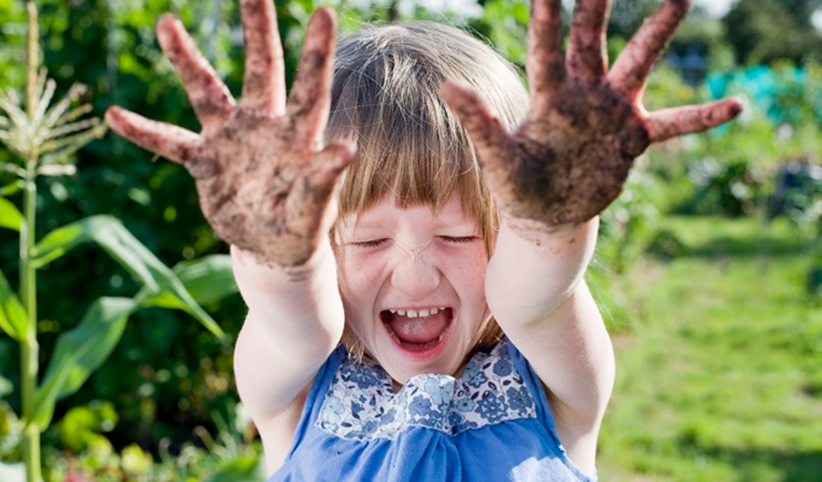
Why Gardening?
“Spare time in the garden, either digging, setting out, or weeding; there is no better way to preserve your health.”
― Richard Louv, Last Child in the Woods

Slide 3
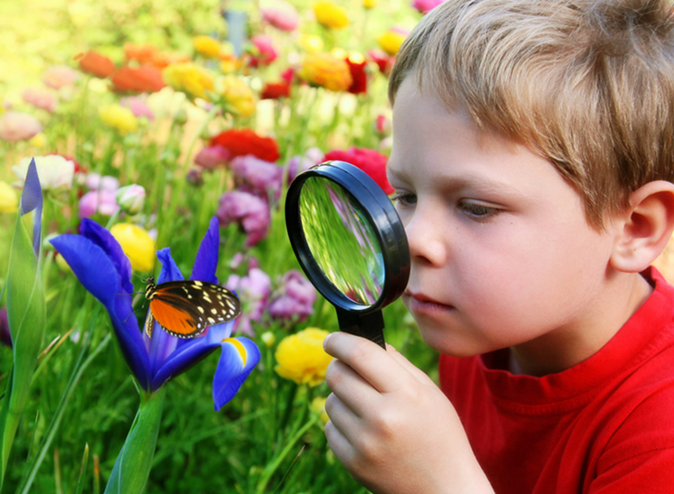
Why Gardening and Science?
Actively engages children with science concepts (basic needs, heredity, life cycles, weather)
Develops science process/inquiry skills

Slide 4
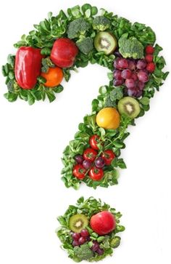
Research Questions
RQ1: What are the potential benefits of integrating gardening into science instruction?
RQ2: What obstacles might impede effective implementation of gardening into science teaching and learning?

Slide 5
Methodology
Selection of databases
Keyword searches in databases
Manual search of journals
Article analysis

Slide 6
Databases
These two databases are administered by the two main hosts of educational research, EBSCO and ProQuest

Slide 7
Keywords and Parameters
gardening AND children
gardening AND science AND learning
“school garden” AND science
From peer-reviewed journals only
Temporal parameters set to 1980 to 2017

Slide 8
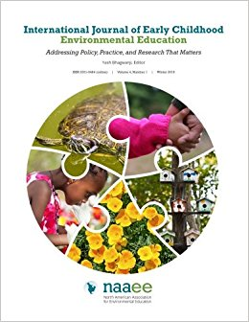
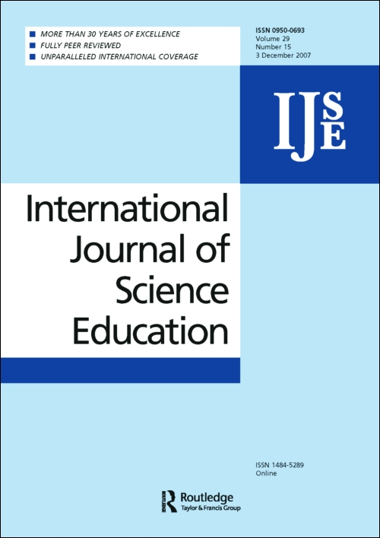
Search Results
9,099 results returned
65 relevant articles in 47 peer-reviewed journals

Slide 9
Age/Grade Study Focus
PRESCHOOL
14
ELEMENTARY
40
MIDDLE
4
HIGH
2

Slide 10
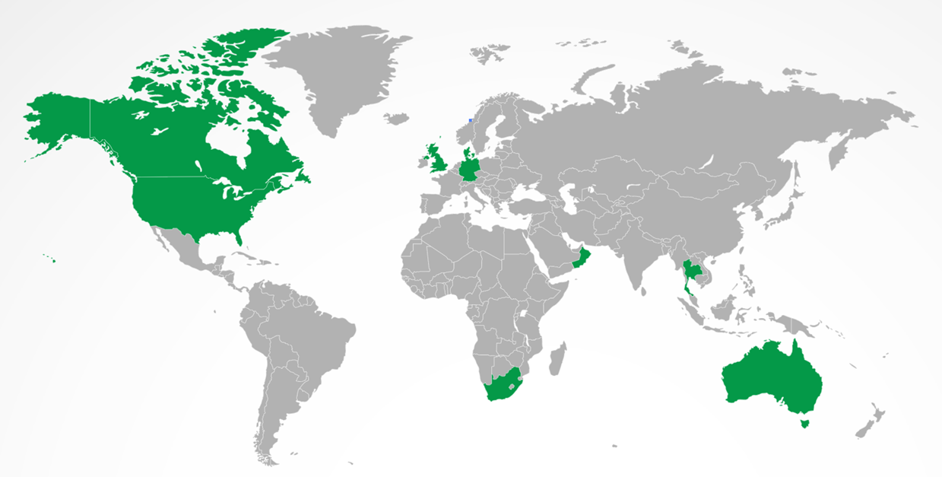
Geographic Focus of Studies
Australia
Canada
Denmark
Germany
Oman
South Africa
Thailand
UK
US

Slide 11
Criteria for Exclusion
Tangential but irrelevant topics such as:
Research outside of the preK-12 spectrum
Research on integrating gardening into a single subject other than science (e.g., math or language arts)
Research on gardening in non-school settings (e.g., at home)

Slide 12
Manual Search Results
1685 results returned
1 additional relevant article in 1 journal
JRST (0), Sci Ed (0), JSTE (1), IJSE (0), RISE (0)

Slide 13
Literature Matrix
Study | Type | Journal | Purpose | Sample | Methods | Conclusions
School Gardening in Oman: A Pilot Project with Grade 7 Students Ambusaidi, et al. (2017) | Mixed methods experimental design | International Journal of Environmental & Science Education | Determine whether school gardens can be effective teaching and learning resource in Oman; impacts on science content knowledge, process skills and attitudes, and healthful dietary habits | Oman; grade 7; n=233 students | Control and experimental groups; pre and post assessments, attitudinal surveys; interviews; students constructed gardens; curriculum development; GBL intervention (3 months) | Improved 5/6 process skills for GBL compared to control group; no difference in content knowledge compared to control; improved attitudes toward gardening; females showed particular improvements
“We won’t hurt you butterfly!” Second-graders become environmental stewards from experiences in a school garden Fisher-Maltese (2016) | Case study | International Journal of Early Childhood Environmental Education | School garden/GBL curriculum on insects to improve student environmental attitudes and develop as stewards | US; grade 2; n=71 students | Four-week curriculum incorporating the school garden; pre/post tests for content knowledge and environmental attitudes; pre/post attitudinal surveys; interviews; observations and conversations | Quantitative survey data did not show statistically significant improvements in attitudes, but pre/post tests, interviews and conversations do show change in views/attitudes and suggest development as stewards with positive attitudes toward nature
The impact of nutrition education with and without a school garden on knowledge, vegetable intake and preferences and quality of school life among primary-school students Morgan, et al. (2010) | Experimental design | Public Health Nutrition | Investigate impact of garden-enhanced nutrition education on FV consumption, preferences, knowledge, and quality of school life | Australia; grades 5 & 6; n=127 students | 10 week intervention; 3 groups (control, nutrition education only, and nutrition education + gardening); baseline and 4-month follow up; FV ratings, taste tests, knowledge and QOL questionnaire, and recall methods | Compared to control, NE&G and NE groups improved willingness to taste and taste ratings for veggies; NE&G improved ability to ID vegetables, willingness to taste certain FV; no impact on FV actual intake, or quality of school life

Slide 14
Benefits of Gardening: Academic
Increased science learning gains
(e.g., Blair, 2009; Berezowitz, et al., 2015; Hachey & Butler, 2009)
Developed process skills
(e.g., Ambusaidi, et al., 2017; Mabie, 1996; Vandermaas-Peeler & McClain, 2015)
Improved learning gains in other content areas
(e.g., Miller, 2007; Starbuck & Olthof, 2008; Wistoft, 2013)
Notes:
Analysis of 48 extant studies found that 93% of studies reported positive academic outcomes for science. Outcomes included test scores, course grades and overall GPAs. (Williams & Dixon, 2013)
Study in Oman: 7th grade experimental group incorporated gardening into science curriculum. Experimental Group showed statistically sig gains in 5 of 6 process skills tested. Control group improved in only 1 process skill area. (Ambusaidi et al., 2017)
Observing +, - EXP
Inferring -, + CONTROL
Predicting +, - EXP
Interpreting data +, - EXP
Hypothesizing +, - EXP
Identifying variables +, - EXP

Slide 15
Benefits of Gardening: Environmental Stewardship
Increased awareness and understanding
(Morgan, et al., 2009; Vandermaas-Peeler & McClain, 2015)
Changed values and more positive attitudes
(Blair, 2009; Fisher-Maltese, 2016; Upitis, et al., 2013)
Demonstrated mindful behavior and active involvement
(Fisher-Maltese, 2016; Upitis, et al., 2013; Vandermaas-Peeler & McClain, 2015)
Notes:
Study of a gardening and insects unit with 71, 2nd graders reported that children held a more empathetic view of nature after completing the gardening unit. (Fisher-Maltese, 2016)

Slide 16
Benefits of Gardening: Soft Skills
Increased student motivation and science identity
(e.g., Berezowitz, et al., 2015; Blair, 2009; Wistoft, 2013)
Encouraged community building
(e.g., Morgan, et al., 2009; Nimmo & Hallett, 2008; Passy, 2012)
Improved inter- and intrapersonal skills
(e.g., Hoffman, et al., 2004; Miller, 2007; Nedovic & Morrissey, 2013)
Enhanced positive student interactions
(e.g., Passy, 2012; Nedovic & Morrissey, 2013)
Notes:
An Australian study with K children who were involved in a school garden project reported increased positive interactions among children and decreased anti-social, aggressive behaviors like pushing, shoving, and kicking. Teachers reported that children were calmer, less stressed, and more relaxed when they were outside and gardening. (Nedovic & Morrissey, 2013)

Slide 17
Benefits of Gardening: Wellness
Improved knowledge and interest in fruits and vegetables
(e.g., Berezowitz, et al., 2015; Morris & Zidenberg-Cherr, 2002; Ratcliffe, et al., 2011)
Increased physical activity
(e.g., Phelps, et al., 2010; Rees-Punia, et al., 2017)
Developed motor skills
(e.g., Roach, 2010; Starbuck & Olthof, 2008)
Notes:
A study with 213, 1st grade children in US compared children involved in a gardening intervention with nutrition education to children who received nutrition education only to children in a control group with no gardening or nutrition education. Results indicated
Compared to Control: Gardening + Nutrition = higher nutrition K + more vegetable preferences + retention of vegetable preferences 6 months post intervention
Nutrition only = Some improvement but not as high as Gardening + Nutrition

Slide 18
Potential Obstacles
Time
(e.g., Blair, 2009; Hazzard, et al., 2011; Rye, et al. 2012)
Training and skills
(e.g., Blair, 2009; Hanscom & Leipzig, 1993; Wirth & Rosenow, 2012)
Temporal limitations
(e.g., Montsalvatge, et al., 2013)
Funding
(e.g., Hazzard, et al., 2011; Rye, et al., 2012; Kirby, 2008)
Teacher attitudes
(e.g., Passy, 2012; Montsalvatge, et al., 2013)

Slide 19
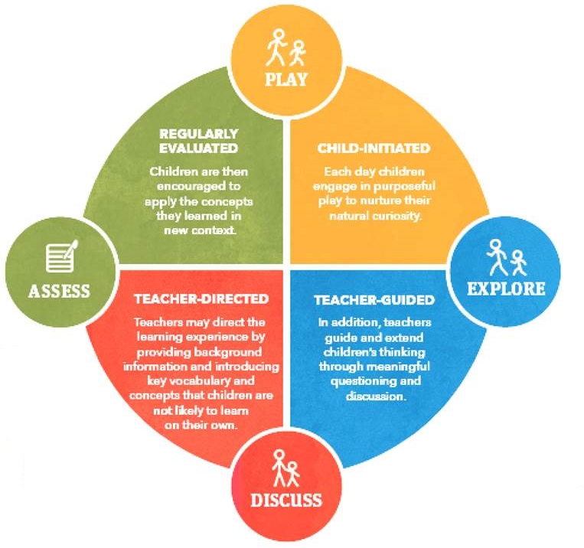
Examples - STEAM Curriculum
Early Learning Cycle by Trundle & Smith, 2017

Slide 20
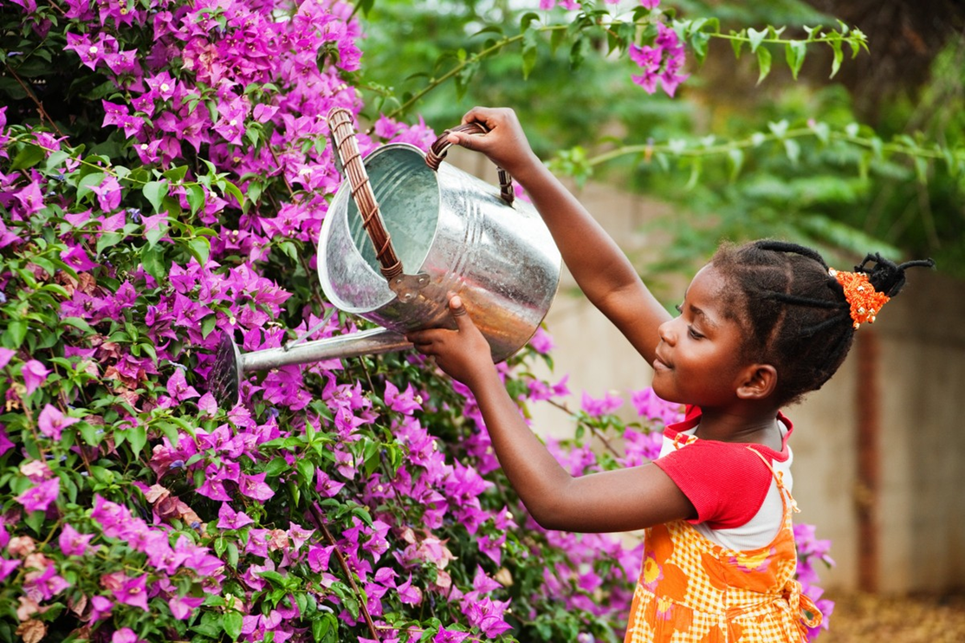
Targeted Concepts: Living Things, Plants
Taking care of plants and their needs

Slide 21
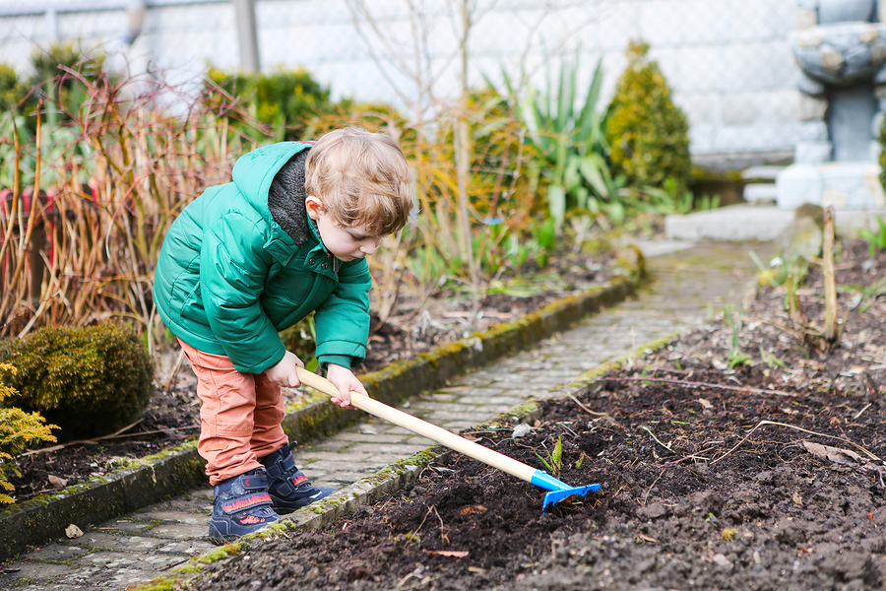
Targeted Concepts: Living Things, Plants
Life cycle of plants

Slide 22
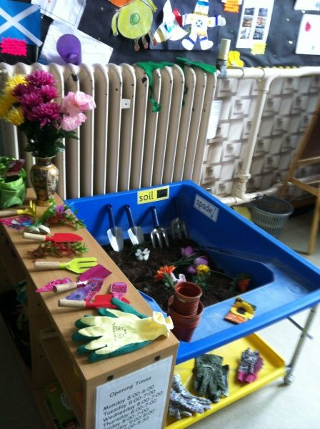
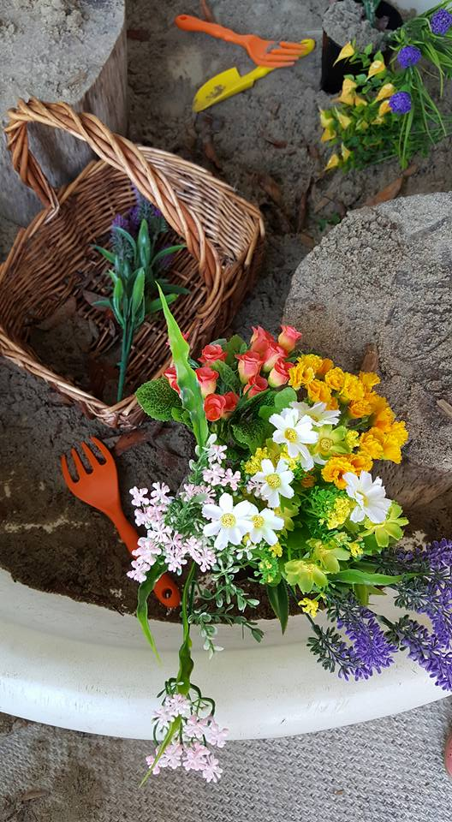
Playing with Plants: Hearts-On

Slide 23
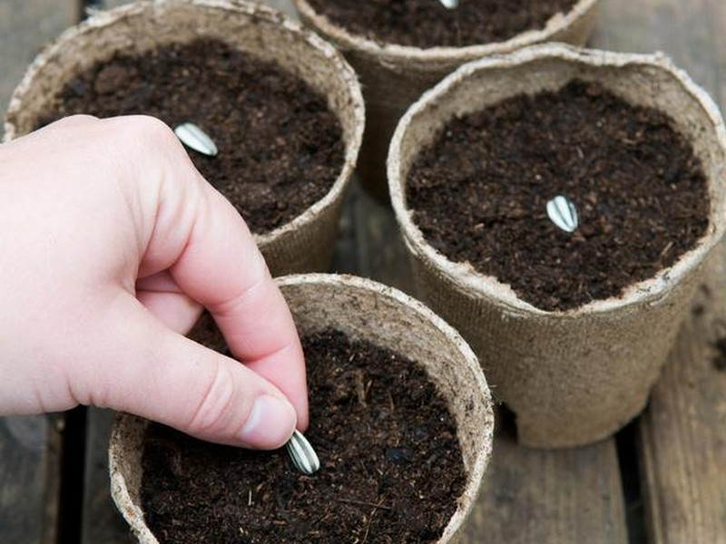
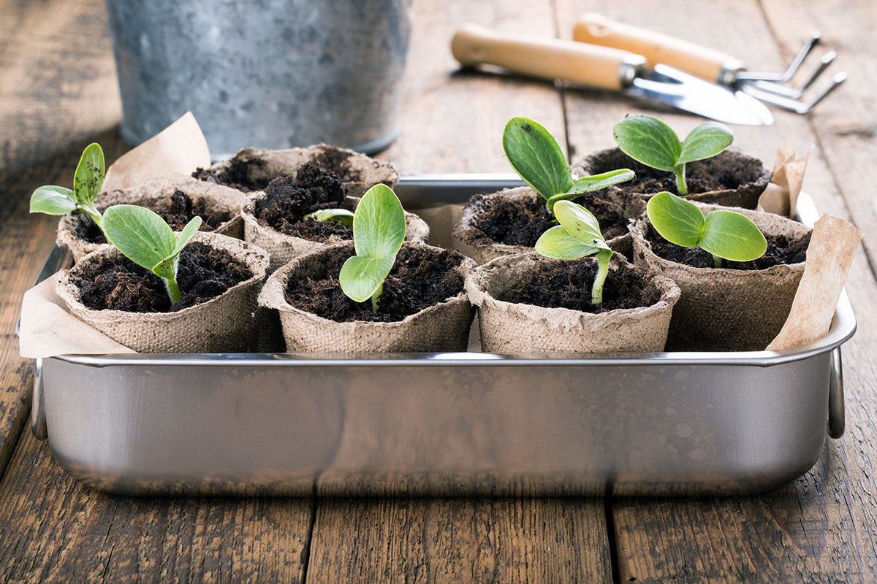
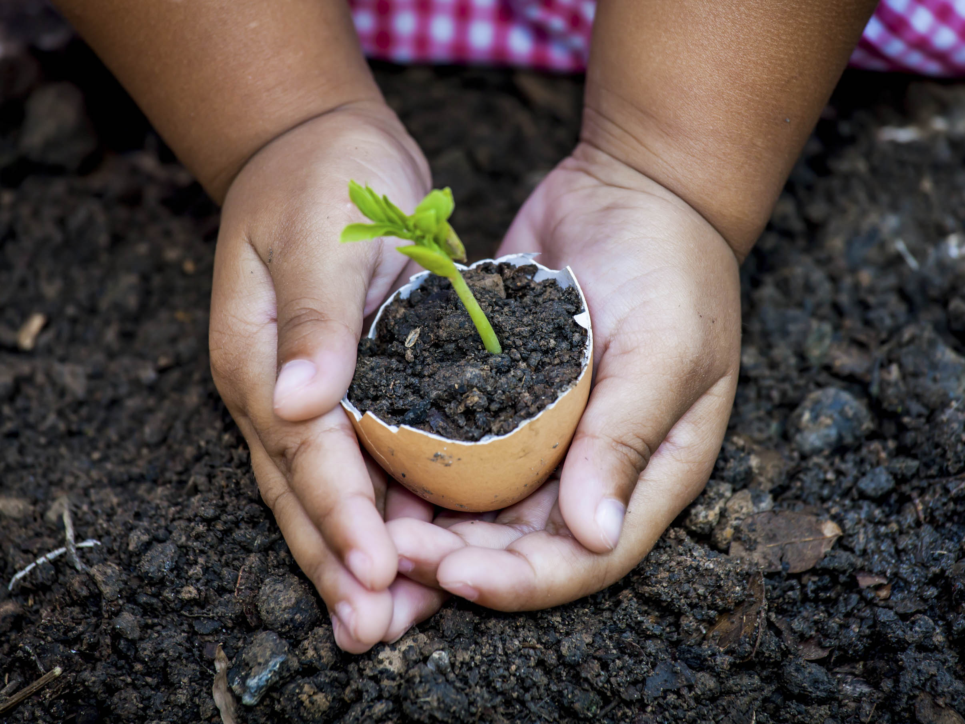
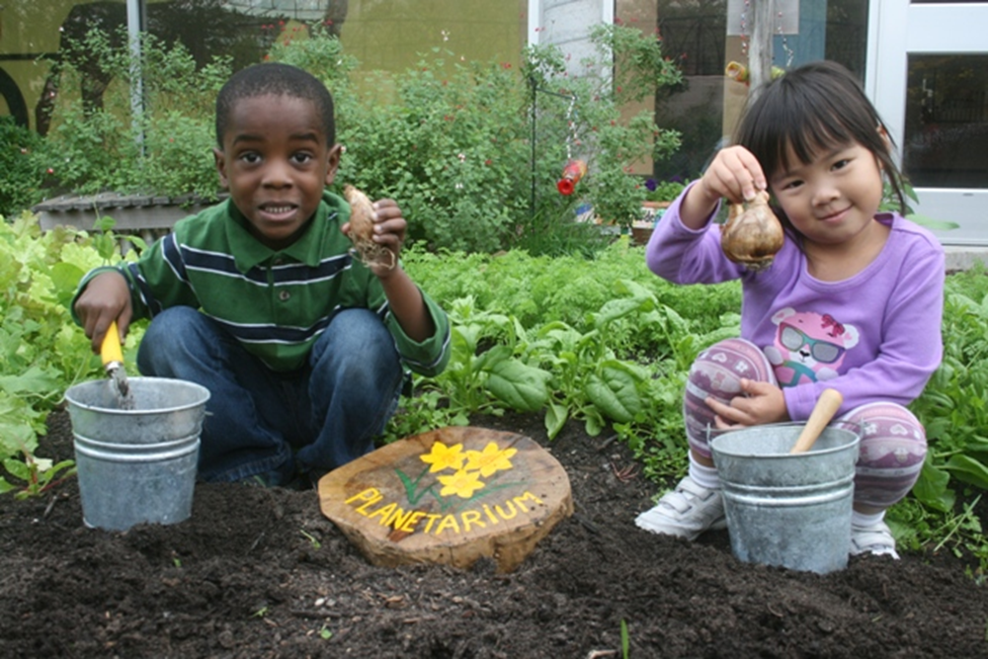
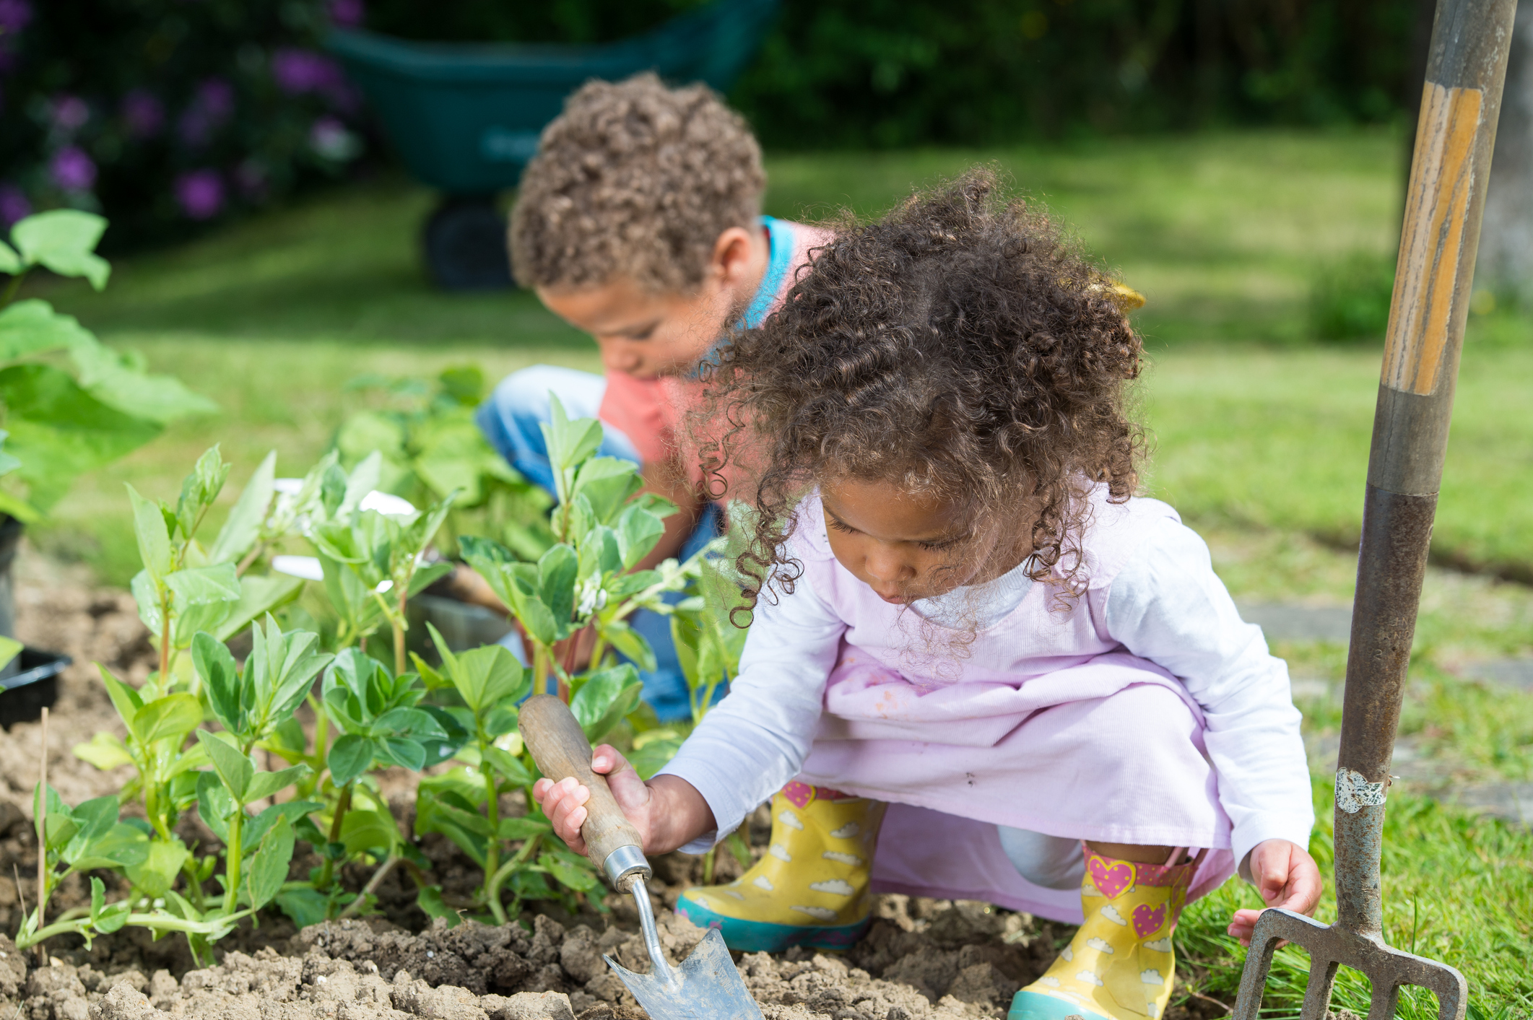
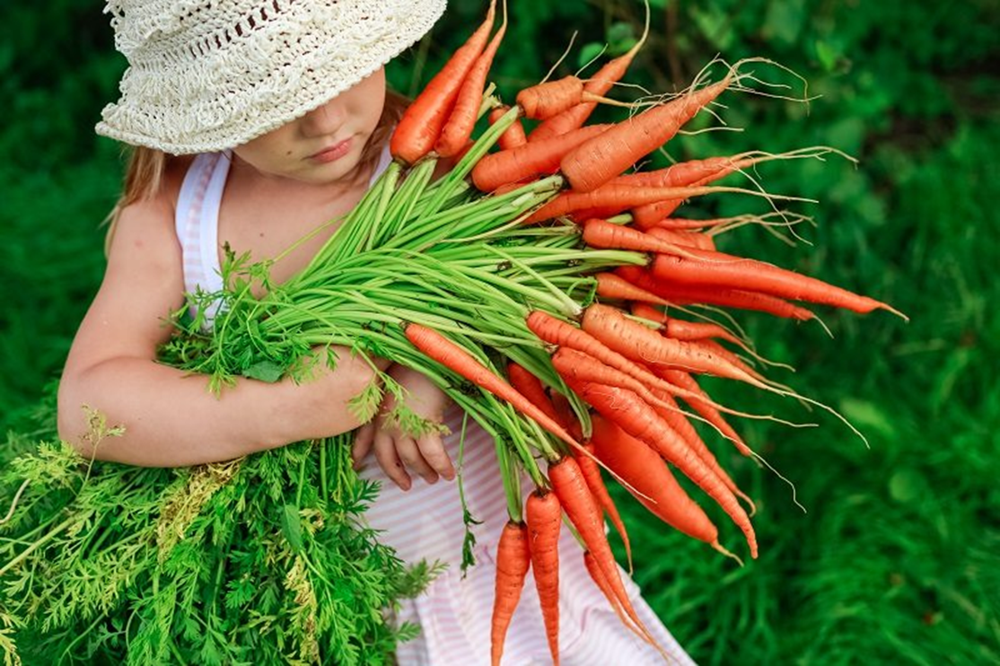
Exploring with Plants: Hands-On

Slide 24
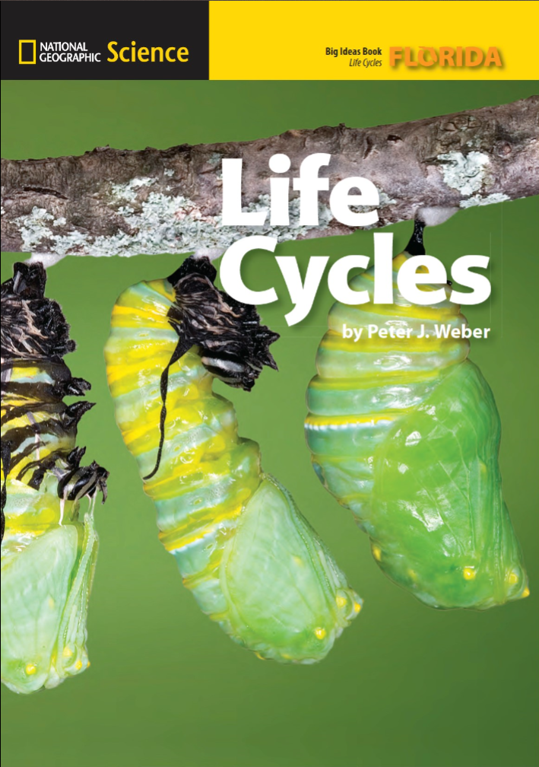
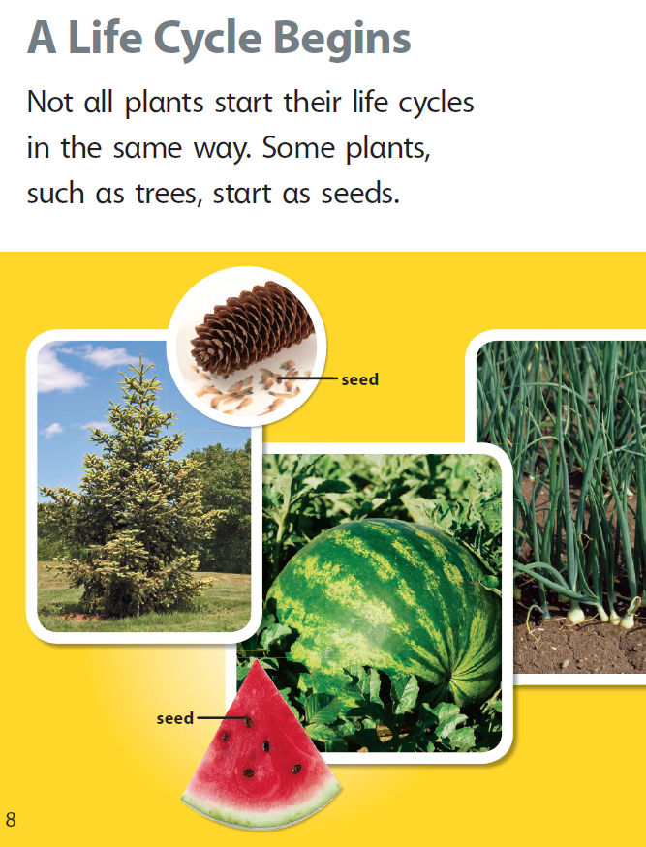
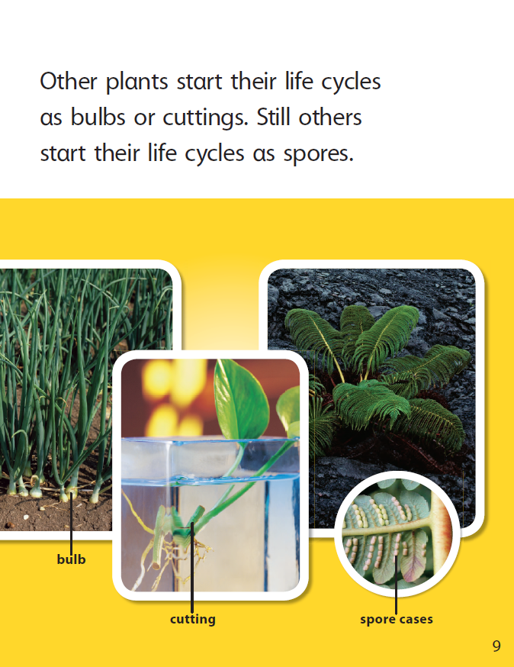
Discussing Plants: Minds-On

Slide 25
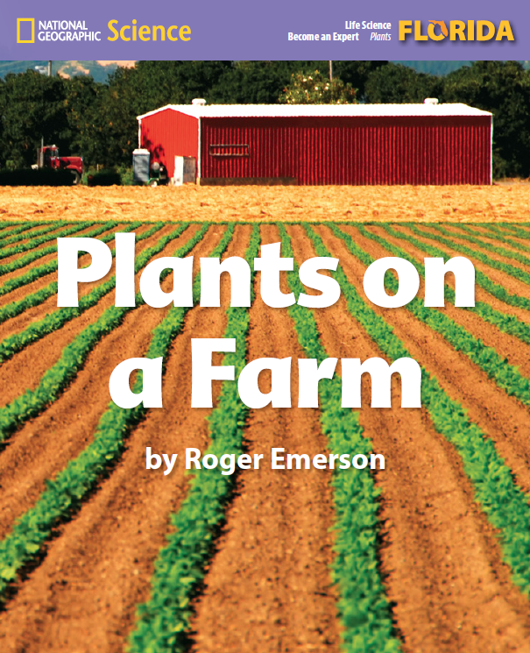
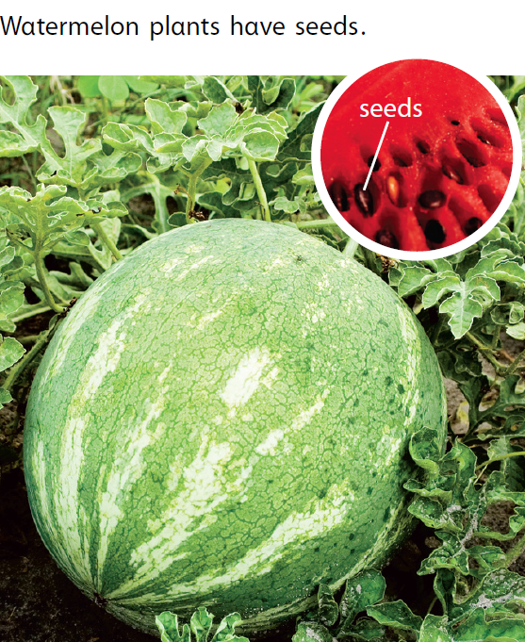
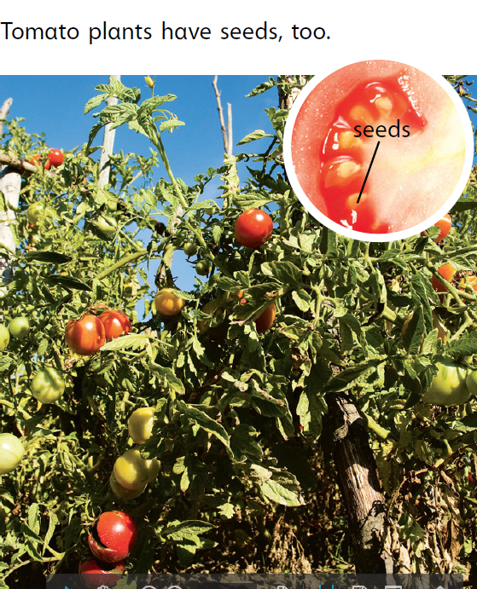
Discussing Plants: Minds-On

Slide 26
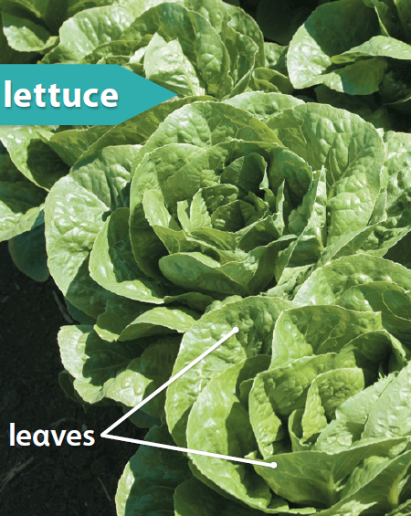
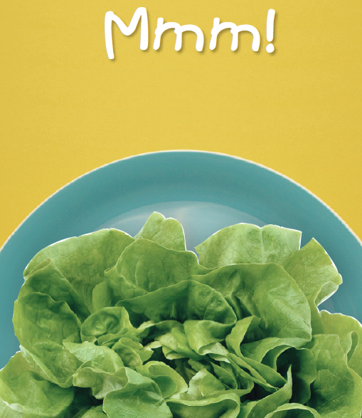
Discussing Plants: Minds-On

Slide 27
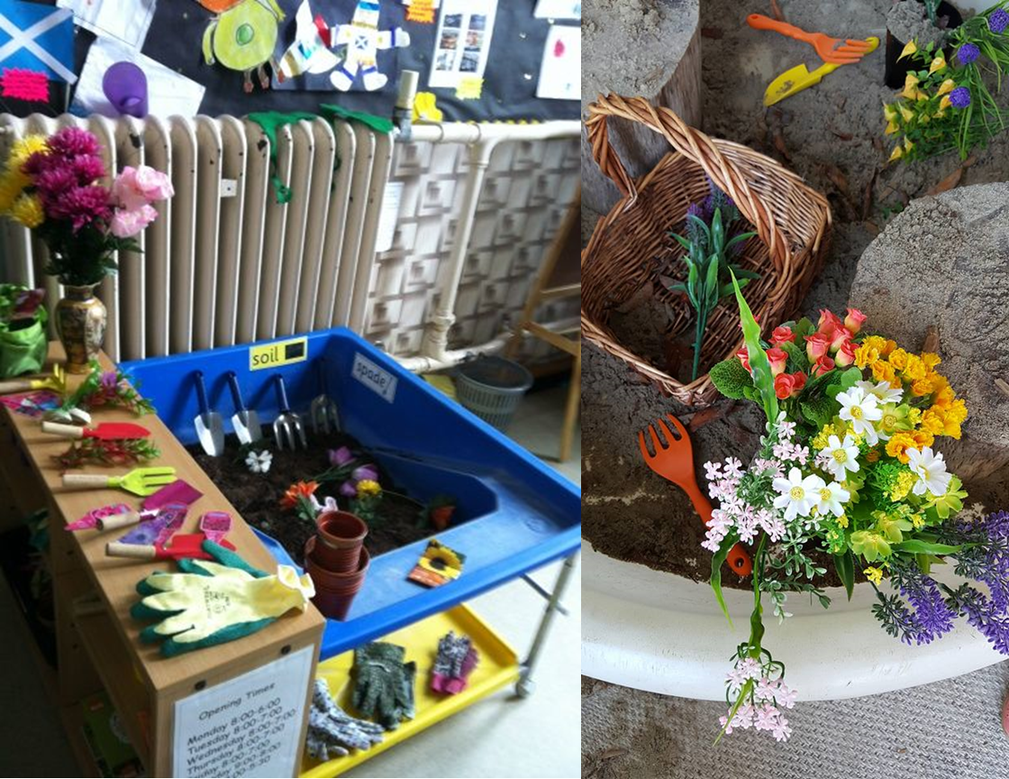
Returning to Play: Hearts-On

Slide 28
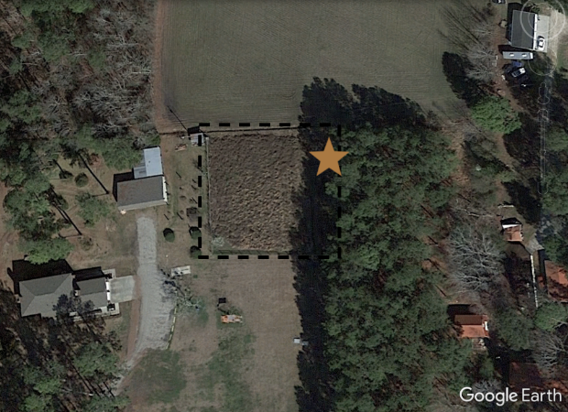
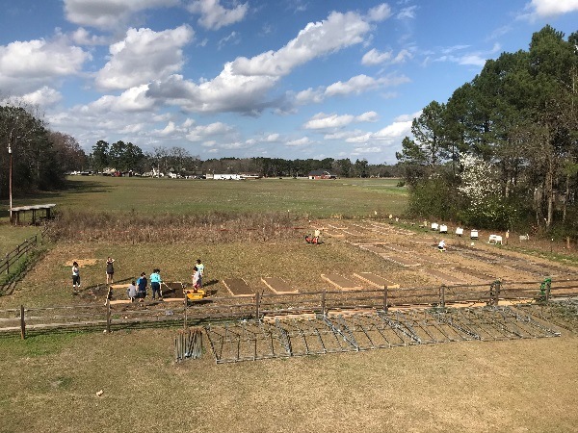
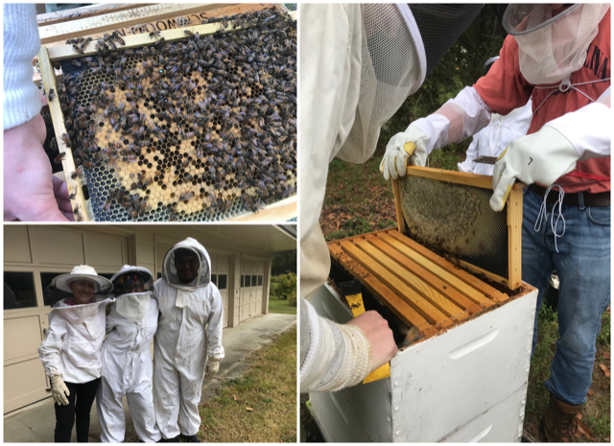
Targeted Concepts: Pollen, Pollinators, and Plants
Habitat enhancement: Studying pollinators and pollen
0.2 hectares on Univ. campus
9 honey bee hives
4 native bee houses
59 raised garden beds
Herb garden, tea garden, three sisters garden, vegetables
3 compost bins
Gourd/pumpkin/squash trellis
Pollinator-Wildflower garden – sunflower and clover areas
Managed meadow
Blueberry/strawberry/ blackberries

Slide 29
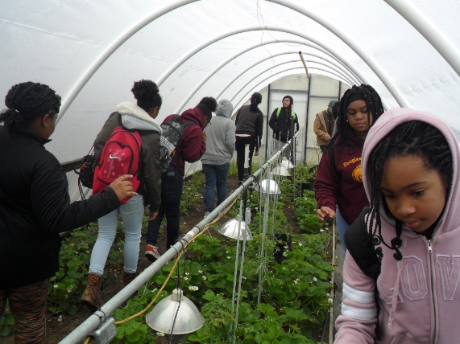
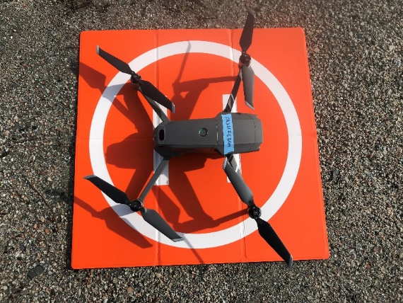
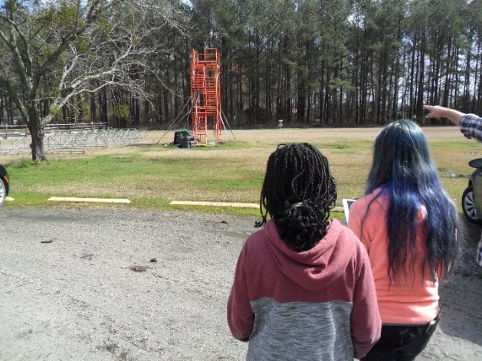
Playing with Pollen, Pollinators, and Plants: Hearts-On
Kids in the Garden Program: Two Week “Bee Camp” during the summer 24 middle (12-14 yrs. of age) and high school (15-18 yrs. of age) students — Intro to plants and bees and pollen Science and research Learn how to use science equipment Development of research topics
Academic year program on Saturdays for three hours each morning for 12 days in fall and 12 days in the spring for 18 students conducting six research projects —
Primarily Research Outlets – Science competitions like science fair and presenting at science meetings
In three years we have had 105 students of which 85% were considered minorities.

Slide 30
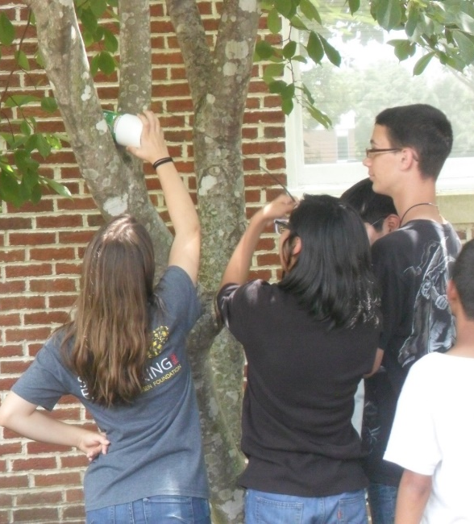
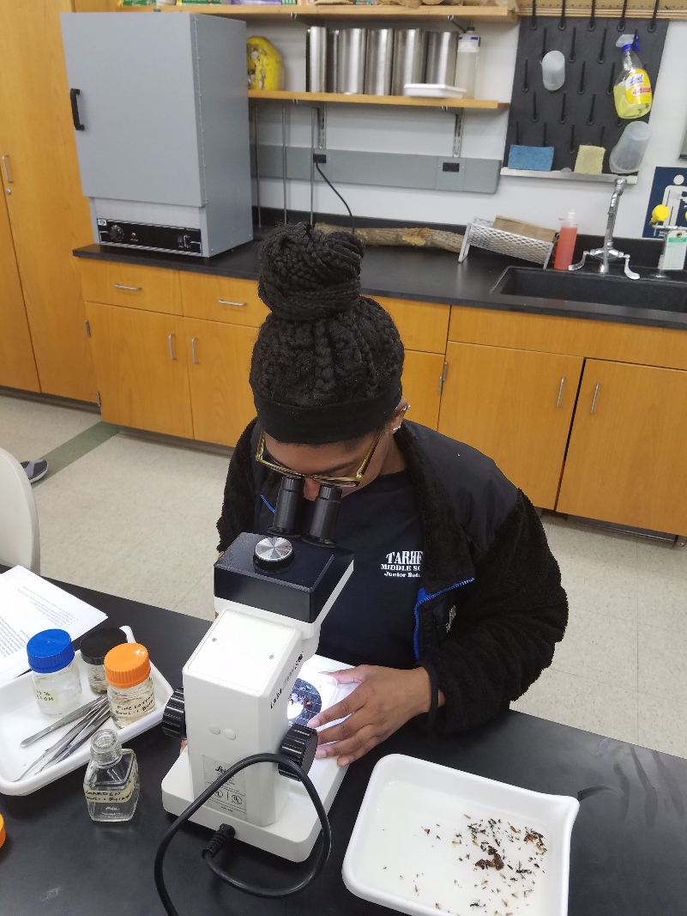
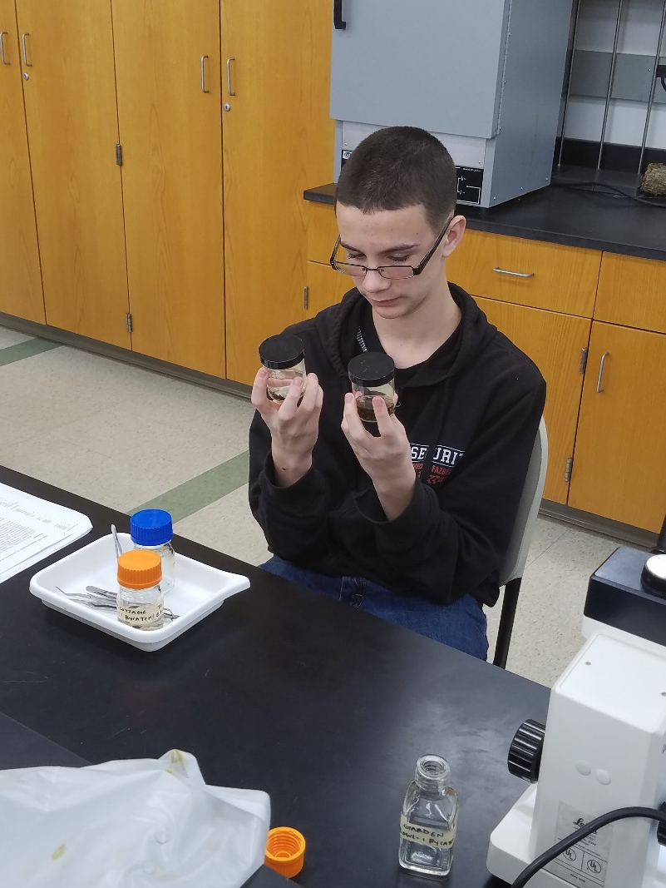
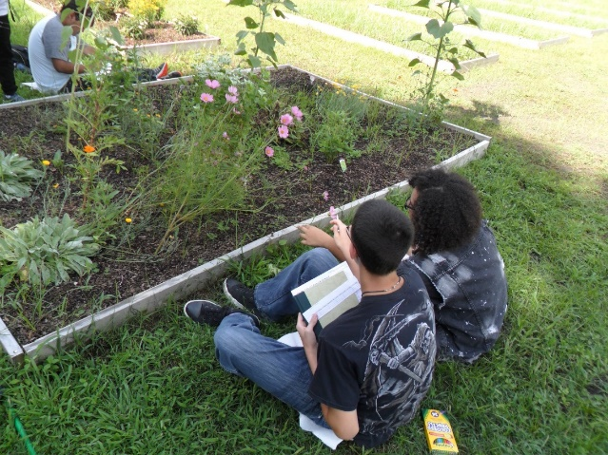
Exploring with Pollen, Pollinators, and Plants: Hands-On

Slide 31
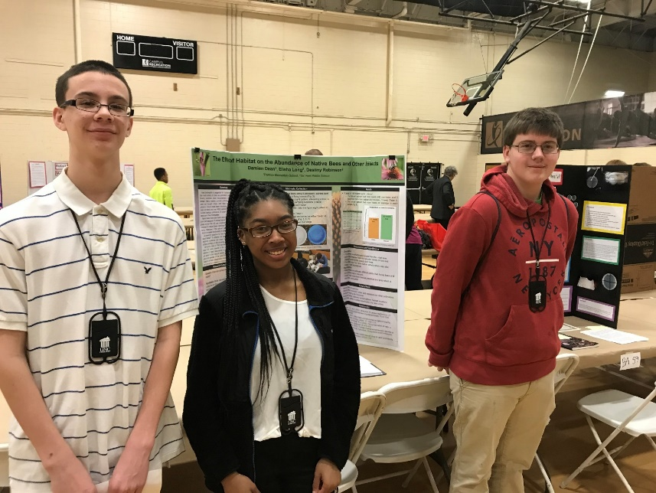
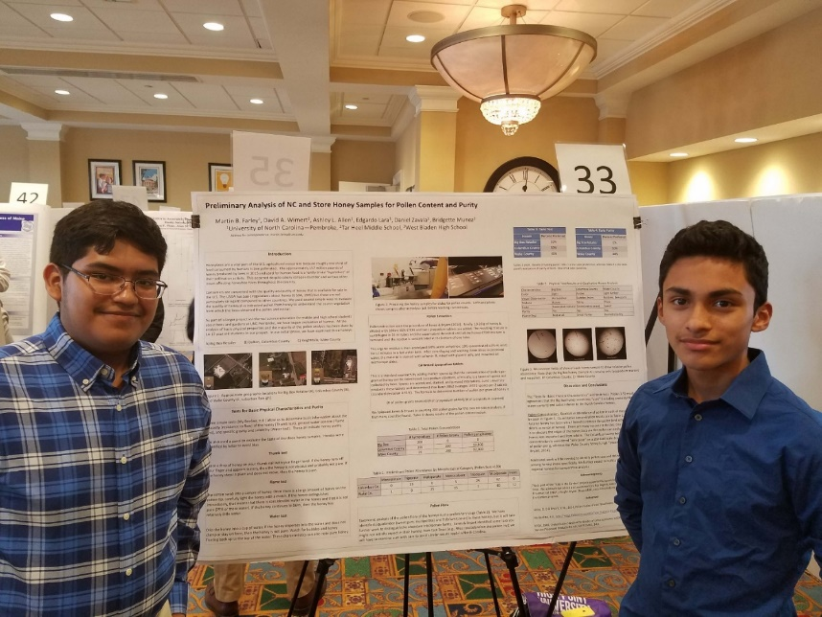
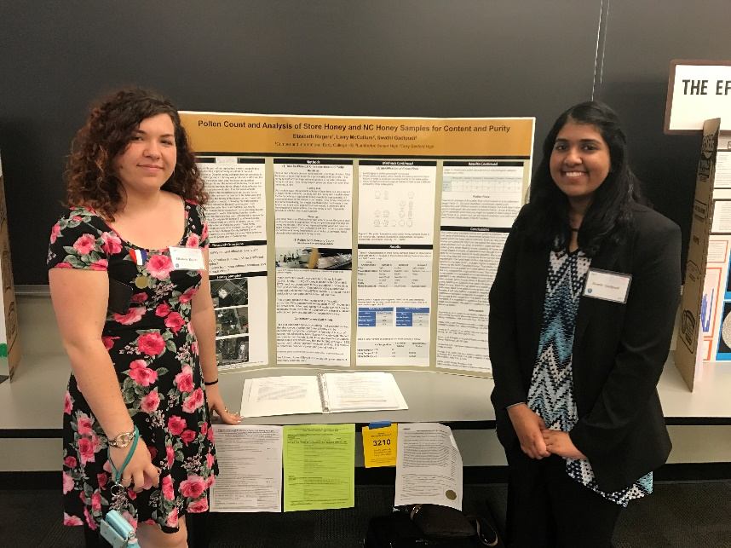
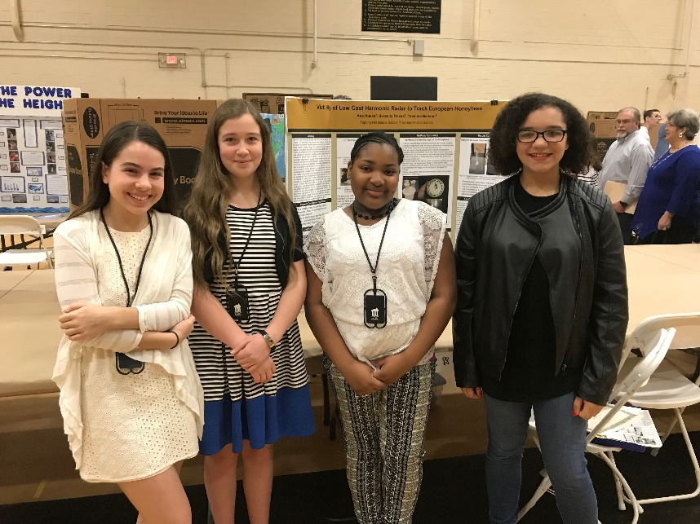
Discussing Pollen, Pollinators and Plants: Minds-On

Slide 32
Returning to Play: Hearts-On
Results from questionnaires and surveys showed that:
Overall students’ knowledge of pollen and pollinators dramatically increased
As well as use of scientific equipment
For those students that entered the science competitions and presented their research at science meetings, their ability to be interviewed, to create a science poster, and to communicate science to others increased dramatically
Students knowledge of science and science careers increased
Students were more hopeful and confident in their abilities as well as more tolerant of doing work that is boring or that there is quite a bit of it to do
Students identified with the pollinators and said that they had become “bee ambassadors”
Students expressed greater interest in science and were surprised by how much creativity was involved

Slide 33
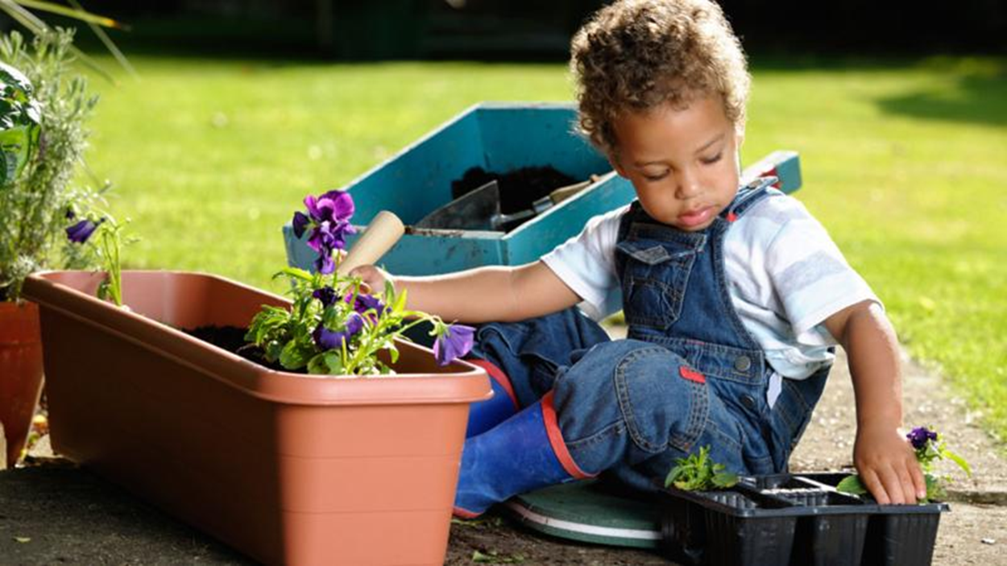
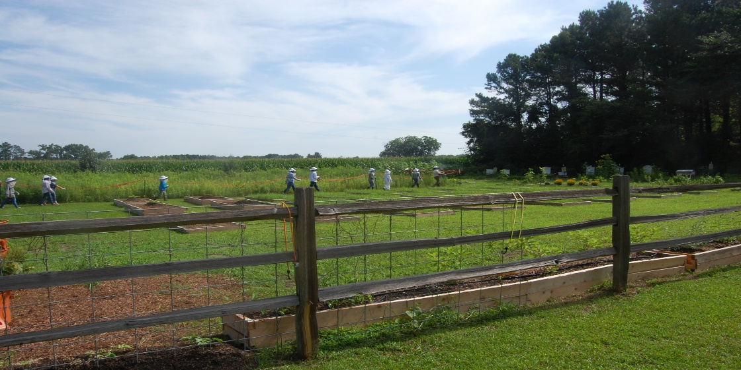
Conclusions/Implications
Benefits included:
Academic gains
Environmental stewardship
Soft skills development
Wellness
Training and support needed
Partnerships are key

Slide 34
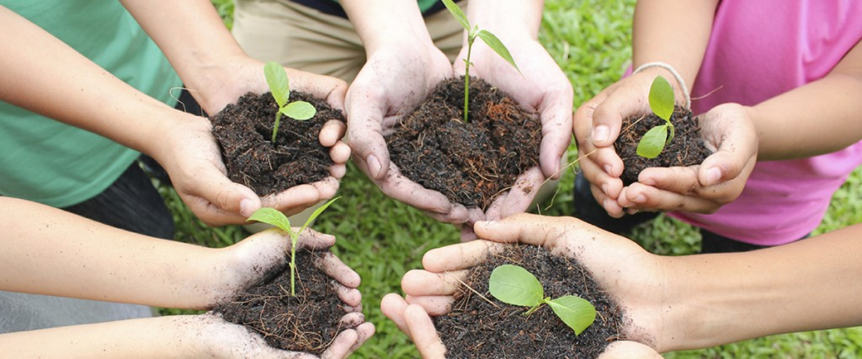
Thank you!
Dr. Rita Hagevik
rita.hagevik@uncp.edu
Dr. Kathy Cabe Trundle
kctrundl@ncsu.edu

