Slide 1
UNC-Pembroke
Autoclave Safety

Slide 2
Introduction
North Carolina medical waste rules (15A NCAC 13 B .1200), require that "Regulated Medical Waste", defined as "blood and body fluids in individual containers greater than 20 ml, microbiological waste, and pathological waste,” be treated before disposal in order to render the waste nonhazardous.
Autoclaving changes the biological character of the waste to reduce or eliminate its potential for causing disease.
Additional autoclave information can be found on the UNCP EH&S webpage under the Autoclave Safety link.

Slide 3
Proper Disposal of Biohazard Waste

Slide 4

Principles of Autoclave Operation
Steam penetrates objects in the autoclave
Condensation creates negative pressure and draws in additional steam
Moist heat kills microorganisms via coagulation of proteins
Two types of autoclaves
  Gravity Displacement
  Vacuum/Gravity Assisted

Slide 5
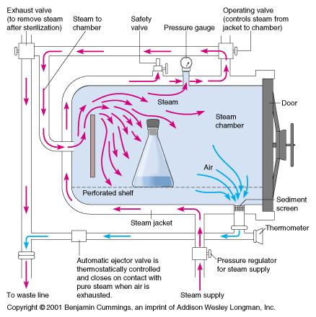
Gravity Displacement
In a gravity displacement autoclave, cold air escapes through the bottom of the chamber as steam displaces it from above. The valves should never be obstructed and the chamber must not be overfilled in order for this system to function efficiently.

Slide 6
Vaccum/Gravity
A vacuum/gravity autoclave pulls pressure from the chamber.

Slide 7
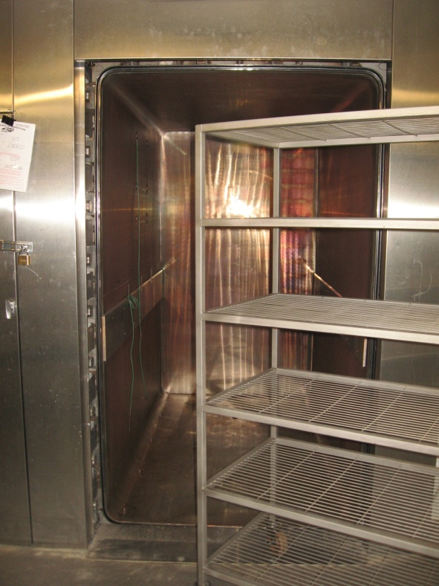
Types of Autoclaves
Bulk Autoclaves
  Each autoclave may operate differently.
    Training on the use of each facilities autoclave is to be conducted and documented by the facility supervisor.

Slide 8
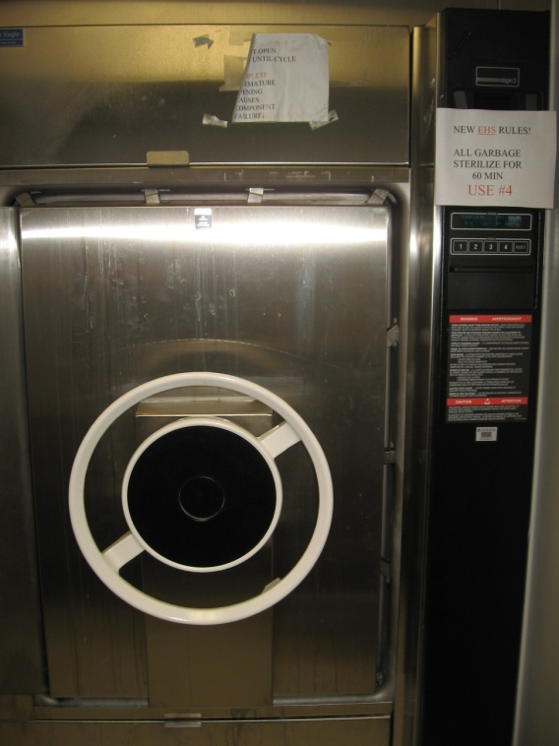
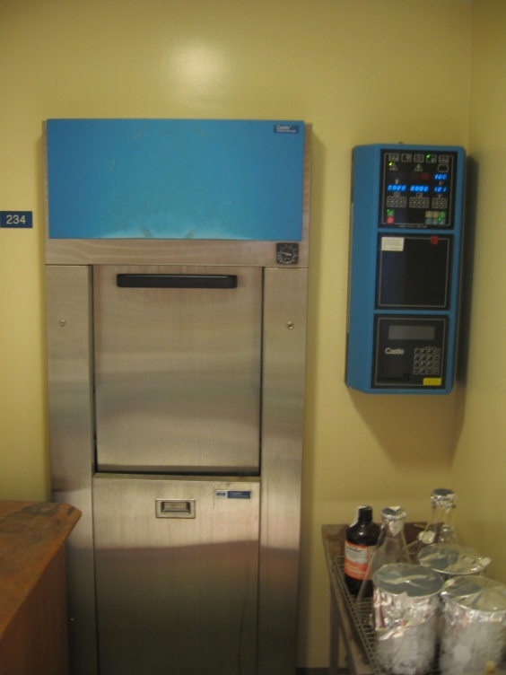
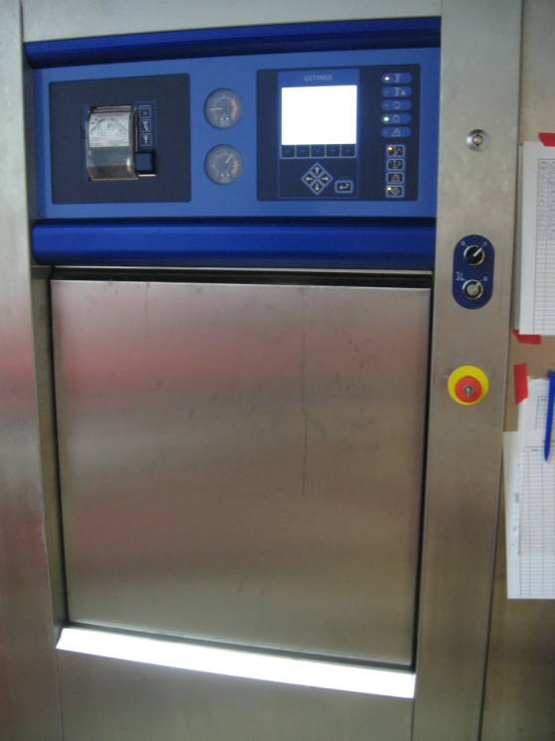
Types of Autoclaves
Other Manufacturers:
NOTE: Even though autoclaves on the UNCP campus operate similarly in the context of mechanics, training is required in the use of each autoclave since not all autoclaves are programmed the same.
Steris
Castle
Getinge

Slide 9
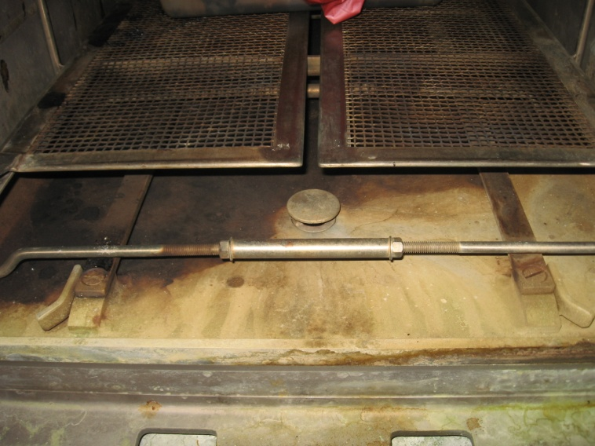
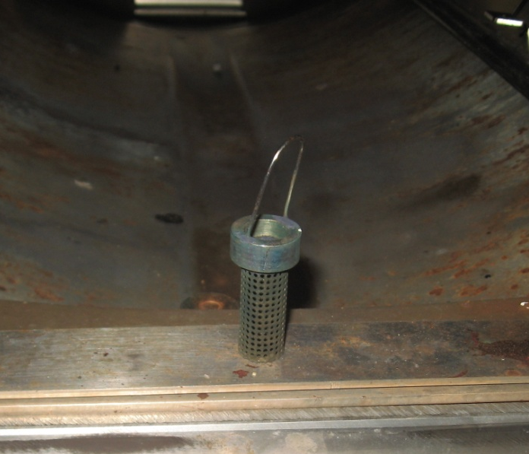
Preventative Maintenance
Plug Screen/Drainer:
  In order to maintain the autoclave’s effectiveness:
    The plug screen or drainer should be removed with heat-resistant gloves, checked, and cleaned frequently to ensure that it is free of dirt, dust, or sediment which may collect and cause a clog. Look out for any sharps that may have become loose and caught in the plug screen/drainer.
Plug screen/drainer location.
Plug screen/drainer.

Slide 10
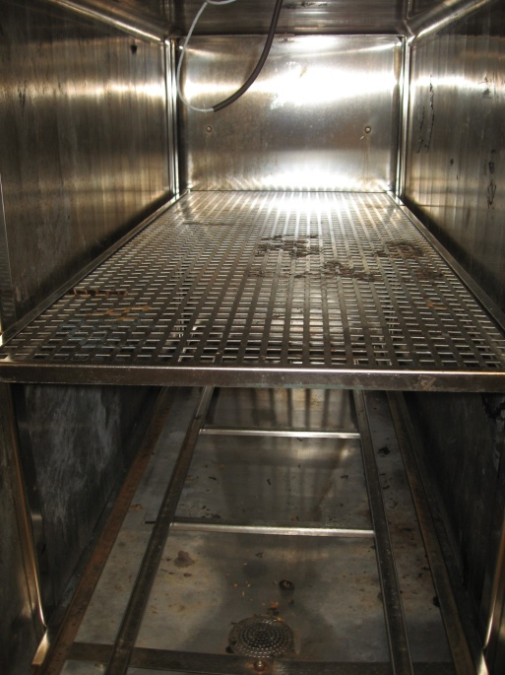
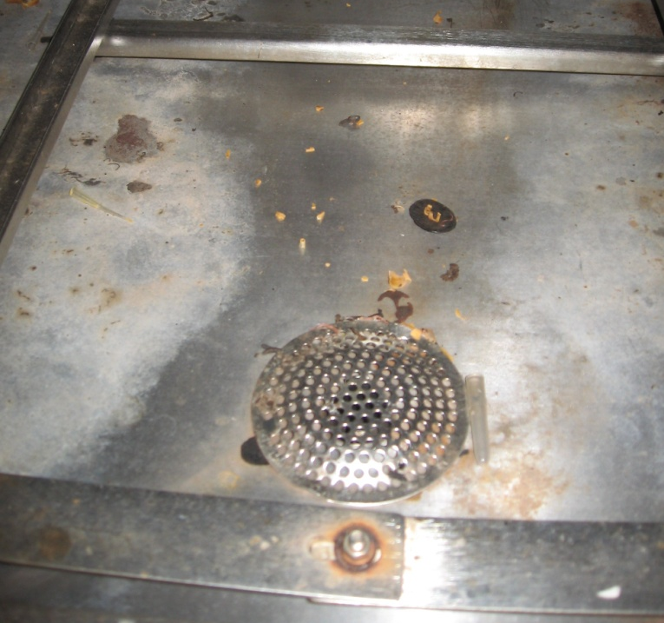
Preventative Maintenance
Surfaces:
  The interior surfaces should be cleaned (according to manufacturer’s specifications) of any residues that collects over time.
Interior of autoclave.
Debris around drain inside autoclave.

Slide 11
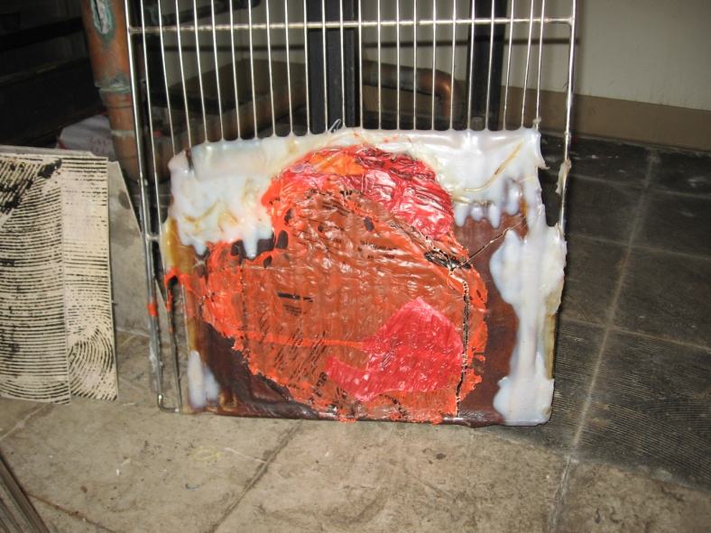
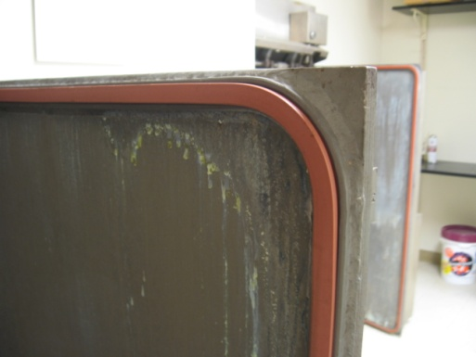
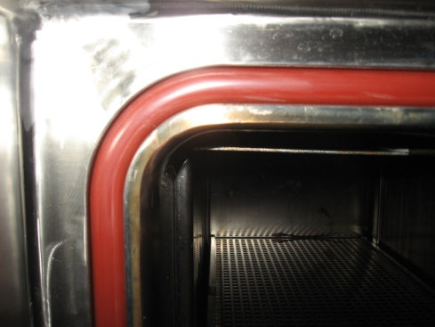
Preventative Maintenance
Surfaces:
  On a regular basis, gaskets, doors, shelves and walls should be visually inspected for residue buildup and wear.
  **NOTE If any problems are experienced with the autoclave
  contact Facilities Operations (x6233) immediately.
Melted plastic on a shelf from an un-autoclavable container.
Gasket Around Door
Gasket Around Autoclave Jacket

Slide 12
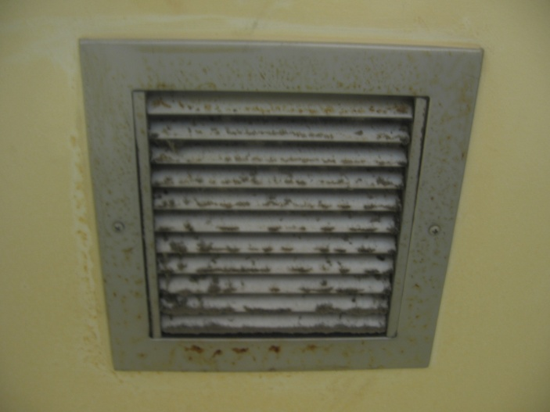
Preventative Maintenance
Air Filters:
  Some autoclaves have air filters in the exhaust located directly above to allow for the exhaust of steam when the autoclave is opened.
    Check the filter from time to time to ensure that it is not clogged. Contact the appropriate personnel to replace the filter and clean off any debris that has collected.

Slide 13
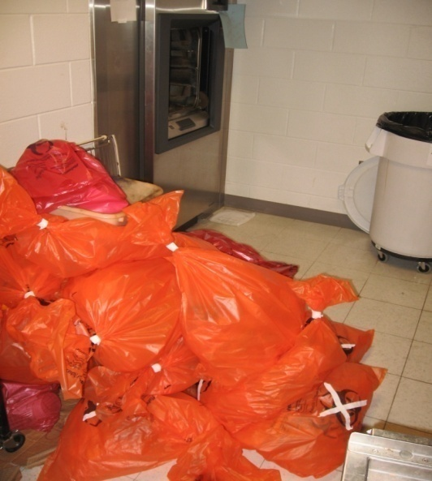
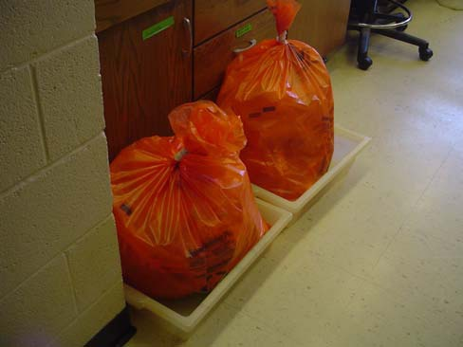
Pre-Autoclaving Procedures
Before being autoclaved:
  Contaminated materials should remain in the laboratory.
  Never overfill bags or sharps containers. Biohazard waste bags/containers should be prepared for autoclaving when they are 2/3 full, regardless of what the manufacturer’s fill limit/disposal line states.
  Biohazard bags should be closed and placed within secondary containers (bins, trays).
  Always handle biohazard bags by the top, taped area. Never handle by holding the sides or bottoms.
  DO NOT USE RED BIOHAZARD BAGS AS THEY WILL MELT
INCORRECT
Un-autoclaved bio-hazardous bags left on the floor beside an autoclave.
CORRECT
Bio-hazardous waste stored
in secondary containment

Slide 14
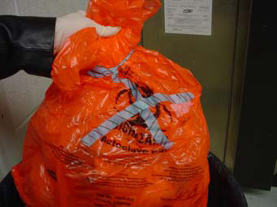
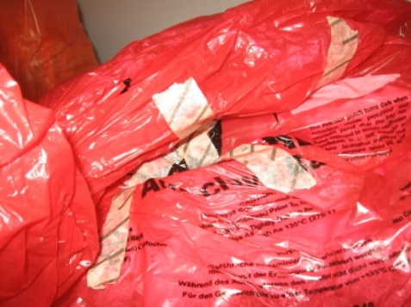
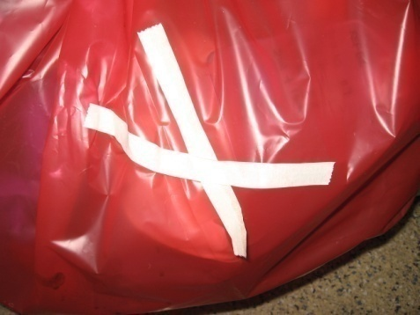
Pre-Autoclaving Procedures
  Indicator Tape (Heat Sensitive Tape):
    Indicator tape should be applied to the biohazard bag as it will aid in reducing the handling of the biohazard waste during removal.
      The indicator tape should be placed in an “X” pattern over the biohazard symbol.
      Indicator tape should change color after autoclaving (i.e. the word ‘Autoclaved’ appears on the tape after treatment.)
      Indicator tape is available through Fisher Scientific (www.fishersci.com)
Indicator tape in an “X” pattern.
Autoclaved
(markings on tape)
Not autoclaved
(no markings on tape)

Slide 15





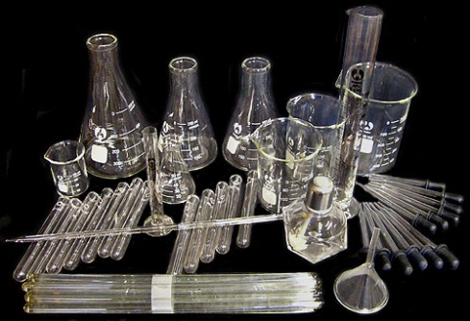
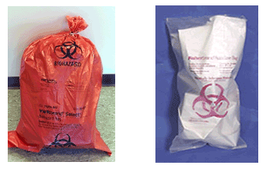
What can be autoclaved
Surgical Instruments
Plastic Sharps containers
Glassware
Plastic tubes and pipette tips
Solutions and water
Animal food and bedding
Biohazardous waste

Slide 16
Proper Autoclave Use
  Proper temperature and exposure time are critical in ensuring the reliability of the autoclaving process.
    These factors are dependent upon steam penetration to every part of the waste load.
    If all the air is not allowed to escape from the waste during the autoclave cycle, then steam will not replace the air.
    The autoclave user must be mindful to prevent the entrapment of air. (i.e. leaving the biowaste bag open inside the autoclave, removing the lid on sharps containers inside the autoclave.)

Slide 17

PPE for Autoclave Users
Eye Protection
Lab Coat, Buttoned
Closed-toed Shoes
Heat-resistant Gloves

Slide 18
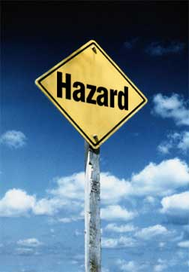
Hazards Associated with Autoclaves
  High temperatures and presence of extremely hot water which is not vented creates potential for burns and scalding
  Inadequate decontamination allows for the potential of biological hazards and personnel and environmental contamination
  Large heavy doors and loading carriages also present an ergonomic and pinch hazard to employees.

Slide 19
Hazards Associated with Autoclaves
  How to prevent hazards associated with autoclave use:
    Read the owners manual as manufacturer recommendations vary.
    Make sure autoclave doors and gaskets are firmly locked into place before operating the autoclave.
      These interlocking mechanisms help to prevent a sudden release of high pressure steam.
      If the autoclave does not have interlocking mechanisms, take additional precautions to ensure the door is closed.

Slide 20
Hazards Associated with Autoclaves
  How to prevent hazards associated with autoclave use:
    Post a warning sign stating, “Hot Surfaces, Keep Away” on or next to the autoclave to remind people of the heat hazard as older autoclaves may have little or no heat shielding around its exposed sides.
    Never stack or store combustible near an autoclave.
    Never autoclave toxic, volatile, or radioactive material.

Slide 21
Hazards Associated with Autoclaves
  How to prevent hazards associated with autoclave use:
    Remove solutions from the autoclave slowly and gently.
      Some solutions have the potential to boil over when moved or exposed to room temperature.
      Heat-resistant gloves, safety goggles and a face shield, and a rubber apron must be worn when removing hot liquids from the autoclave.
    Clean up spills immediately.
    Report malfunctions or accidents to your supervisor immediately.

Slide 22
Autoclave: Performance Indicators
How to know if autoclave is functioning correctly:
Physical | - Annual testing every two years by N.C. Dept. of Labor - Pressure, Temperature, Cycle times, recorded
Chemical | Heat sensitive autoclave tape - Not an indicator of successful sterilization, useful to keep track of autoclaved and un-autoclaved items
Biological | - Tests ability of autoclave to sterilize effectively - Geoacillus stearothermophilus spore strips often used because they are resistant to steam sterilization.

Slide 23
Autoclave Sterilization Procedures- Liquid Materials
  The autoclave must have a ‘LIQUID’ setting that can be used for liquid materials. The settings for liquids run for a longer period at a lower temperature to minimize liquid evaporation and spills.
  Liquids should be placed in borosilicate (Kimax or Pyrex) or polypropylene containers for autoclaving and these containers should be filled to no more than 75% capacity.
  ****Add an additional 20 minutes to the liquid cycle to ensure maximum sterilization****

Slide 24
Autoclave Sterilization Procedures- Liquid Materials
  The caps/stoppers on the containers should be loosened.
    Never autoclave sealed containers of liquid as this could result in an explosion of superheated liquid.
  Liquid containers should be placed in a stainless steel or polypropylene tray with ¼ to ½ inch of water in the bottom on the tray.
    This tray should be placed on a shelf in the autoclave, but not on the bottom of the chamber.
    Polyethylene trays should NOT be used as they may melt and cause damage to the autoclave.

Slide 25
Autoclave Sterilization Procedures- Solid Materials
  Never overfill biohazard waste bags or the autoclave.
  Waste bag should be at least three fingers wide at the opening of the taped bag.
  Keep biohazard waste bags slightly opened to allow for proper steam penetration.
  Place packaged material in a secondary container
    Stainless steel tray or autoclavable polypropylene bin
  Add between 50-100 ml (¼ – ½ cup) of water to each bag of solid waste to promote steam penetration.
    Note: If there is naturally occurring water in the load, adding additional water is not necessary.

Slide 26
Loading the Autoclave
Load material to allow efficient steam penetration (do not overfill the chamber)
Do not allow material to touch the sides or top of the chamber
Autoclave clean items and waste separately

Slide 27
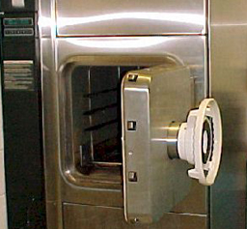
Operating the Autoclave
Be sure the autoclave is functioning properly before use
Record information in User Log
Check strainer and remove any debris
Close door properly and securely
Choose the correct conditions for your material
  Make sure door to autoclave room remains closed as this prevents the loss of negative air pressure, therefore preventing the release of odors.

Slide 28
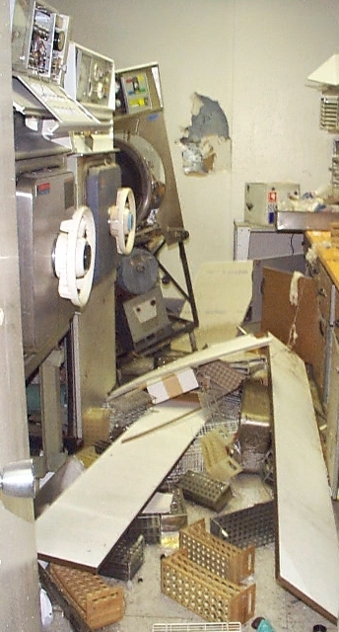
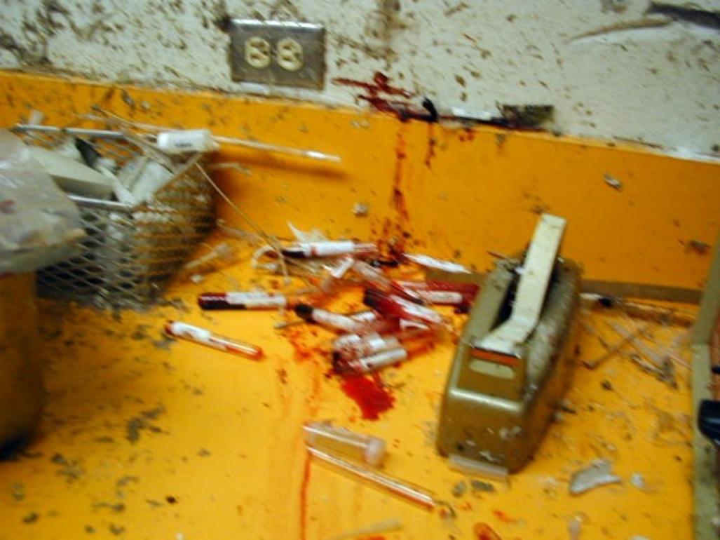
Autoclave Explosion
These pictures represent the results of an improperly closed autoclave door.

Slide 29
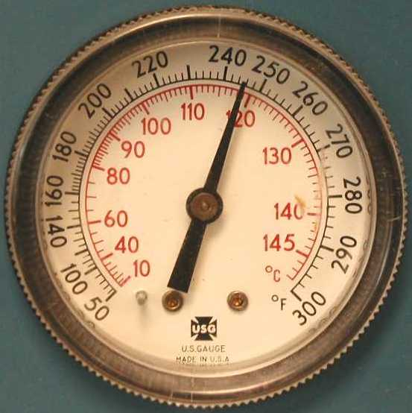
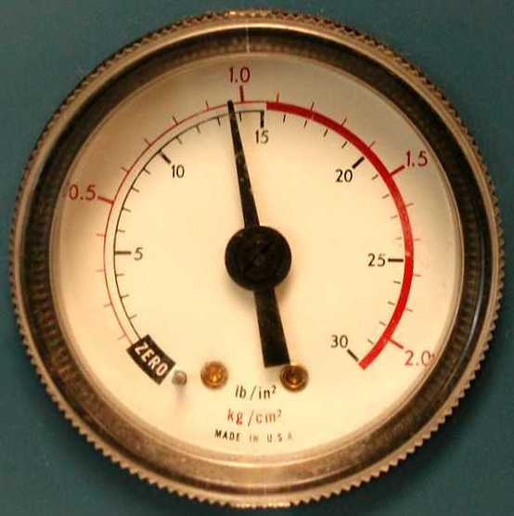
Autoclave Waste
Decontamination Procedures
Autoclaves are to be operated at 121°C (250°F) or higher for a minimum of 60 minutes.
  Some biohazard waste may be required to be autoclaved for a different set amount of time.

Slide 30
Autoclave Waste
Decontamination Procedures
Material | Temperature | Time
Laundry | 121°C (250° F) | 30 Minutes
Trash (Biohazard bags containing infectious waste.) | 121°C (250° F) | 1 Hour
Glassware | 121°C (250° F) | 1 Hour
Liquids | 121°C (250° F) | 1 Hour
Animals | 121°C (250° F) | 8 Hours

Slide 31
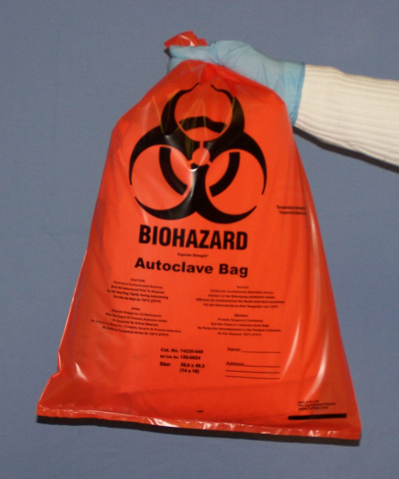
Unloading the Autoclave
    Put on Personal Protective Equipment
    Allow the autoclave to completely finish cycle
      Pressure gauge must read zero
    Verify cycle conditions were met
    Open door slightly to allow steam to escape
    While slowly opening the autoclave door, make sure to keep head, face, and hands away from the opening.
    Verify that heat sensitive tape has changed color or word “autoclaved” has appeared.
    Allow contents to cool before removal
    When removing biohazard bags, always pick up from the top, taped area of the bag. Never handle biohazard bags by grabbing from the sides or bottom.

Slide 32
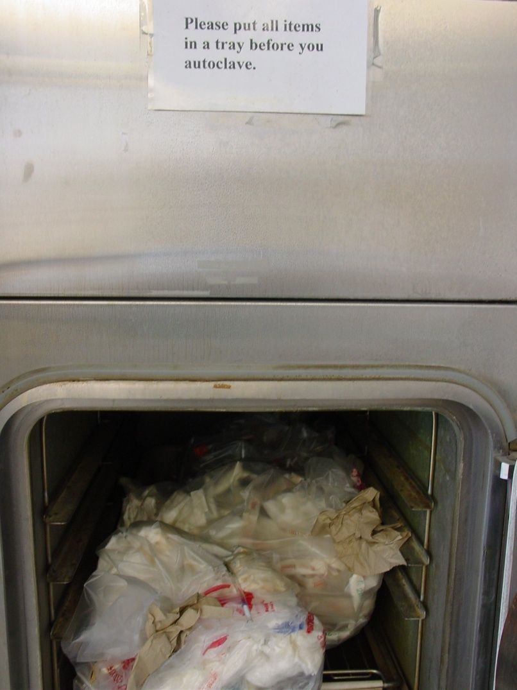
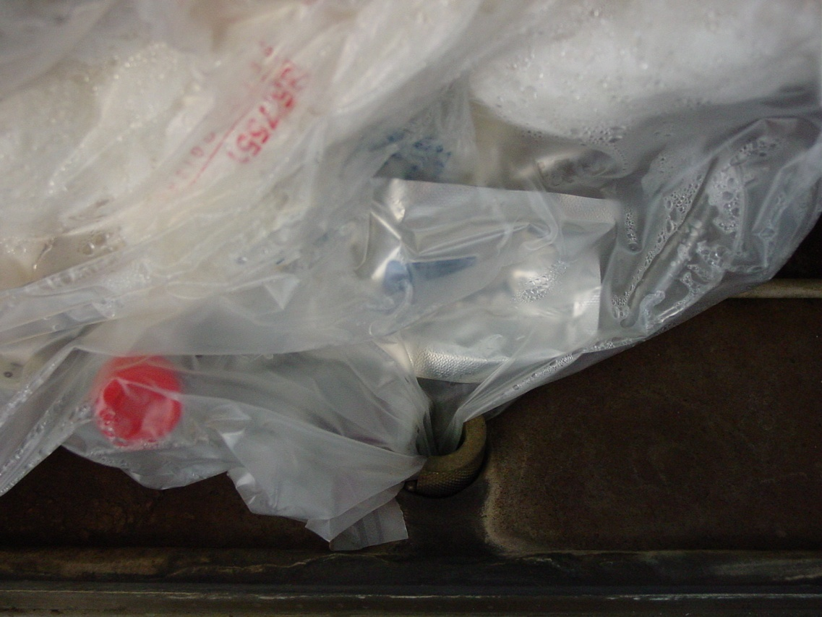
What’s Wrong With
These Pictures?
No secondary container (bin/tray)
No autoclave tape

Slide 33
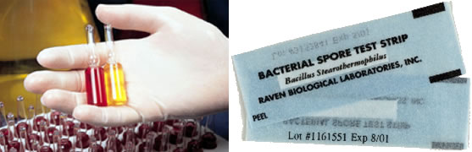
Autoclave Testing & Verification
N.C. Medical Waste Rules require that:
  Autoclaves be monitored and tested weekly under conditions of full loading for effectiveness in killing microorganisms.
  This is achieved through the use of Biological Indicators such as Geobacillus stearothermphilus (with average spore populations of 10⁴ to 10⁶ organisms).

Slide 34
Autoclave
Testing & Verification
Use of a Biological Indicator:
  Tape the indicator to a brightly colored sheet of paper OR tie it to a long piece of string hanging out of bag so that it can be retrieved after the autoclaving cycle has completed.
  Run the autoclave cycle for 60 minutes at the designated decontamination cycle.
  Once the cycle has completed and the contents have cooled, don all proper PPE and remove the indicator from the waste bag.

Slide 35
Autoclave
Testing & Verification
  Incubation of Biological Indicator:
  The autoclaved indicator and an un-autoclaved control indicator are then incubated as recommended by the manufacturer.
  Check for signs of growth at regular intervals during the incubation period (8, 12, 24, and 48 hours).
    There should be signs of growth on the controlled indicator or the test is considered to be invalid.
    If there is growth on the autoclaved indicator, then the material was not properly autoclaved.

Slide 36
Autoclave
Testing & Verification
Incubation of Biological Indicator:
If growth is discovered on the autoclaved indicator:
    The autoclave process needs to be re-evaluated:
      Time, temperature, and autoclaving procedures should be reviewed.
    If a mechanical problem is determined to be the culprit, Facilities Operations should be contacted immediately for repair (x 6233).
      The waste does not have to be held until the results of the testing confirm effectiveness.
      However, the autoclave should not be used until it is repaired.
      Once repaired, the first load run in the autoclave should be tested with a biological indicator to ensure that the autoclave is functioning properly.

Slide 37
Autoclave
Testing & Verification
Autoclave Testing Results:
  Autoclave Testing Log
    A log of each test should be maintained and kept near the autoclave.
    The log should include the following information:
        The type of indicator used.
        Date the test was conducted.
        Time the test was conducted.
        Result of the test.
An autoclave testing log can be printed off the UNCP EH&S website and is available at the following link:

Slide 38

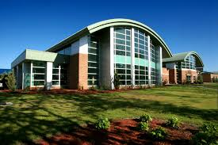

Questions, Comments, Concerns
Michael Bullard
Environmental, Health, and Safety Officer
O: 910.521.6792 C: 910.620.9553
Charles Chavis
Environmental, Health, and Safety Professional
O: 910.775.4772 C: 910.316.6356
Email: safety@uncp.edu

