Slide 1
Collaborative Institutional Training Program (CITI) Tutorial
UNCP
Human Subjects Training
Responsible Conduct of Research Training
Conflict of Interest Training

Slide 2
To register for use of CITI training Modules Step 1) go to: citiprogram.org
The page where you will land will look something like this (since this is a “What’s New” screen for the site the actual highlighted news will change from time to time). Step 2) Select the “register” button

Slide 3
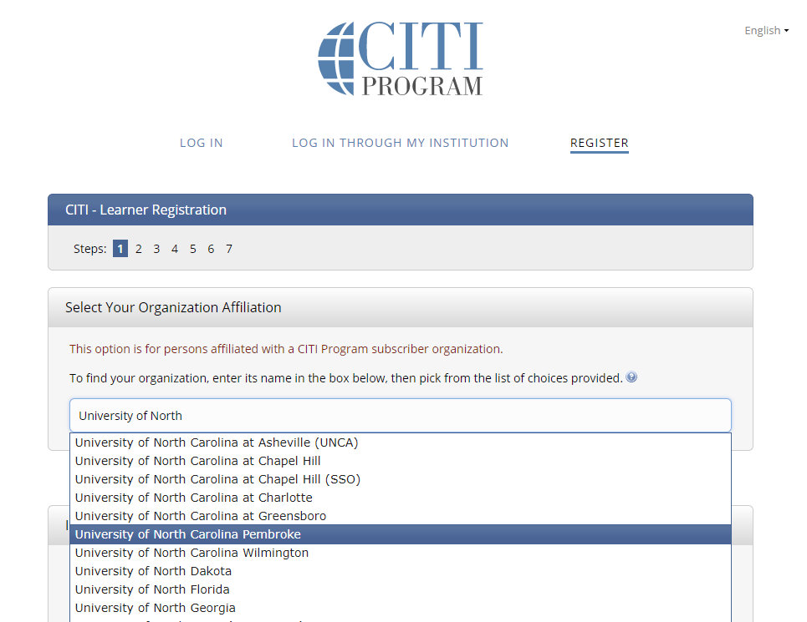
The next screen should look like the one below. STEP 3) Select your organization by beginning to type “University of North”… by this time the drop down menu will appear and you can choose the University of North Carolina Pembroke. Once you do so, you will be asked to create a username and password and agree to the terms of service.

Slide 4
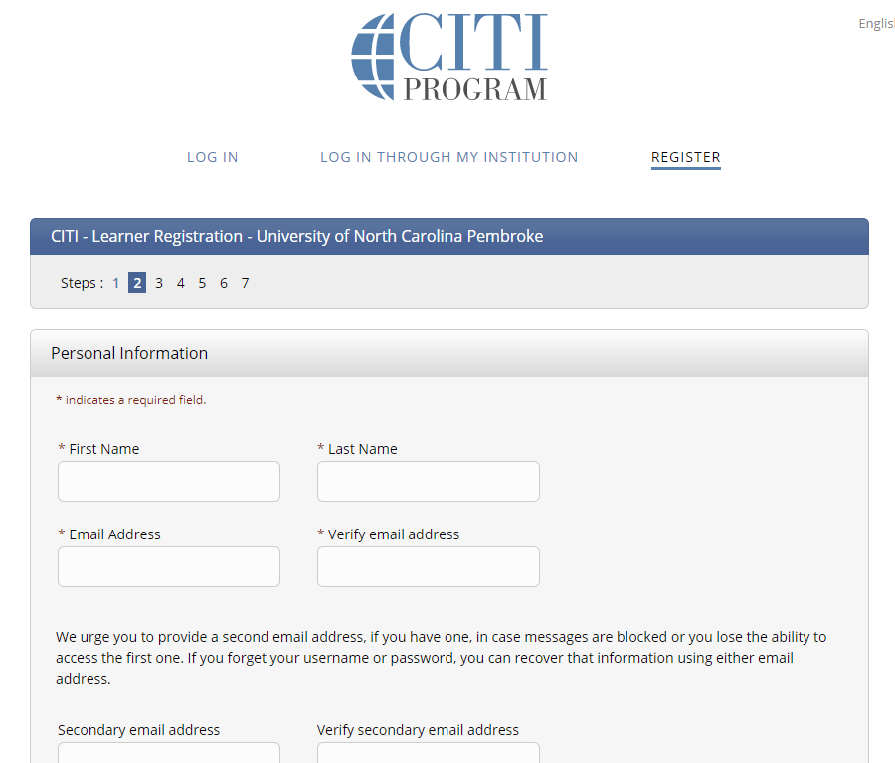
On the screen that pops in next you will complete STEP 4: provide name and email addresses

Slide 5
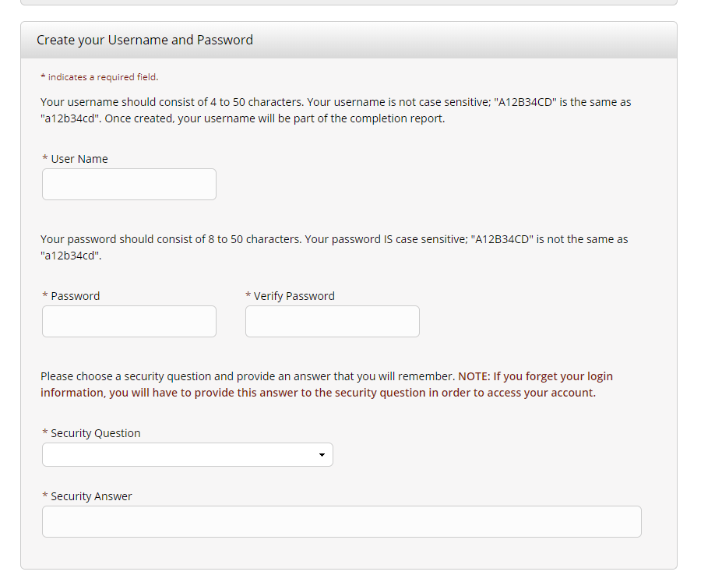
The next Step (5) will allow you to create your username and password. You will also need to choose a
security question.

Slide 6
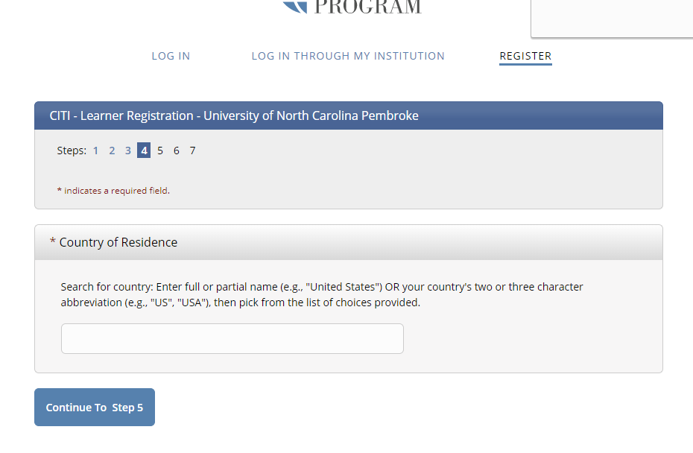
The next screen will ask you to choose a country of residence. As before, once you begin to type, the drop down list should pop in and allow you to select.

Slide 7
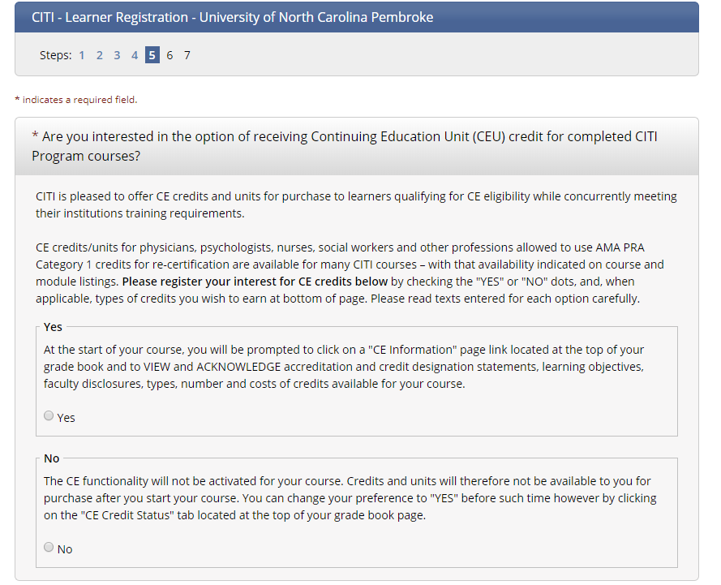
The next screen that appears will ask whether or
not you are “interested in the option of receiving
Continuing Education Credits (CEU) for completed
CITI Program Courses.”

Slide 8
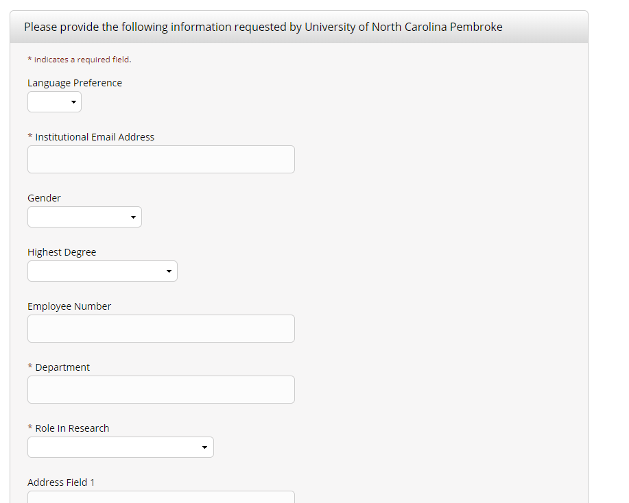
Your Next Step (6) will be to provide further
registration information that is required by
UNCP. Be careful if you auto-populate because
your telephone number will appear in the
“Employee Number” box. This is not the correct
response for that box. You will need to replace
the phone number with your Banner ID. The
telephone number box appears further down the
Page (not shown here).

Slide 9
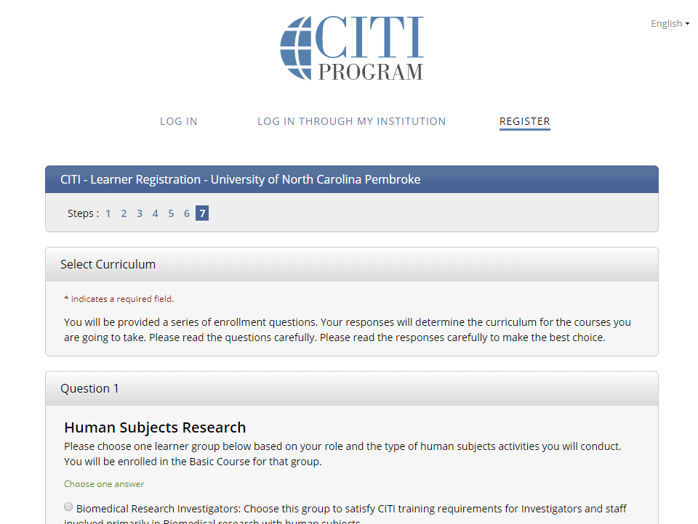
The Final Step (7) will be to select your curriculum.
The “complete registration” button is at the bottom
of the screen (not pictured to the right →)

Slide 10
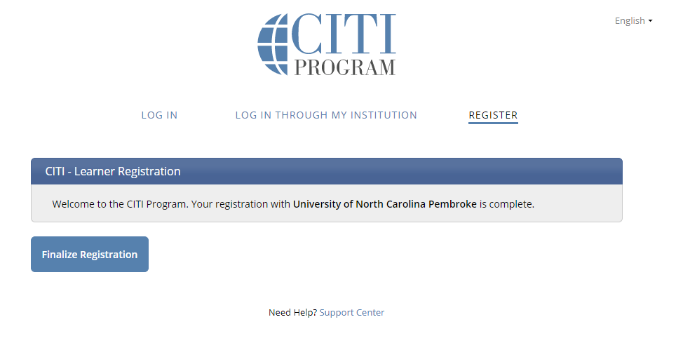
The final registration screen will ask you to “finalize.”

Slide 11
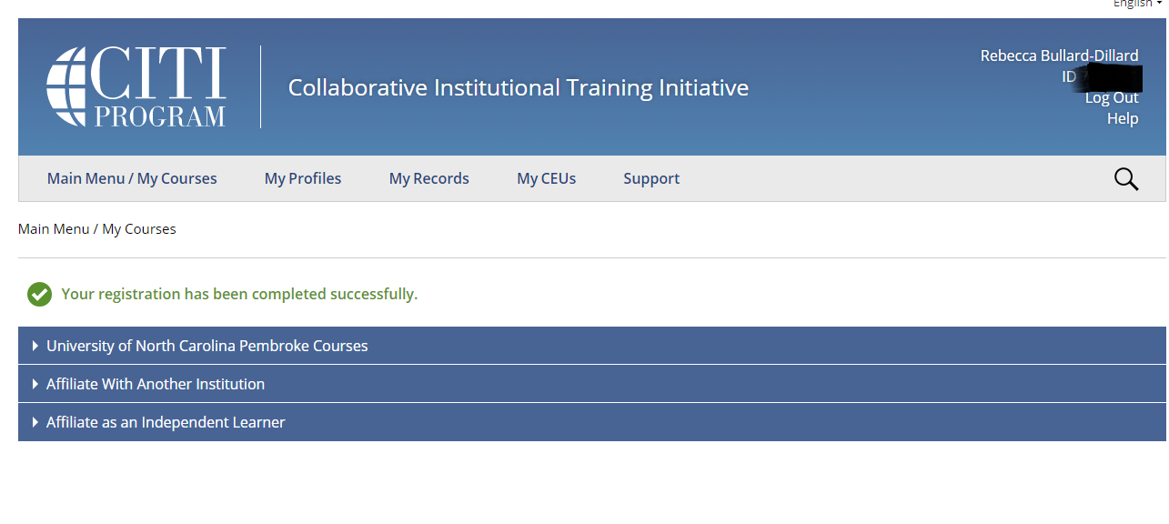
Once you finalize your registration you will
be taken to a screen that looks like the one below. You will see your CITI ID on the top banner.

Slide 12
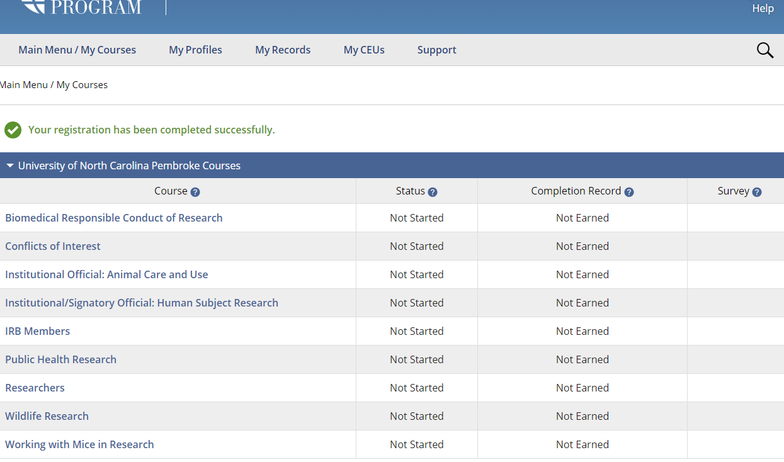
When you select the UNCP courses you will see a screen that looks like this one. You are now ready
to proceed to your
training course. Select
the one you wish
to complete.

Slide 13
HAPPY LEARNING
If you have further questions you may contact
the UNCP Office of Sponsored Research and Programs: 910.775.4249

