Slide 1
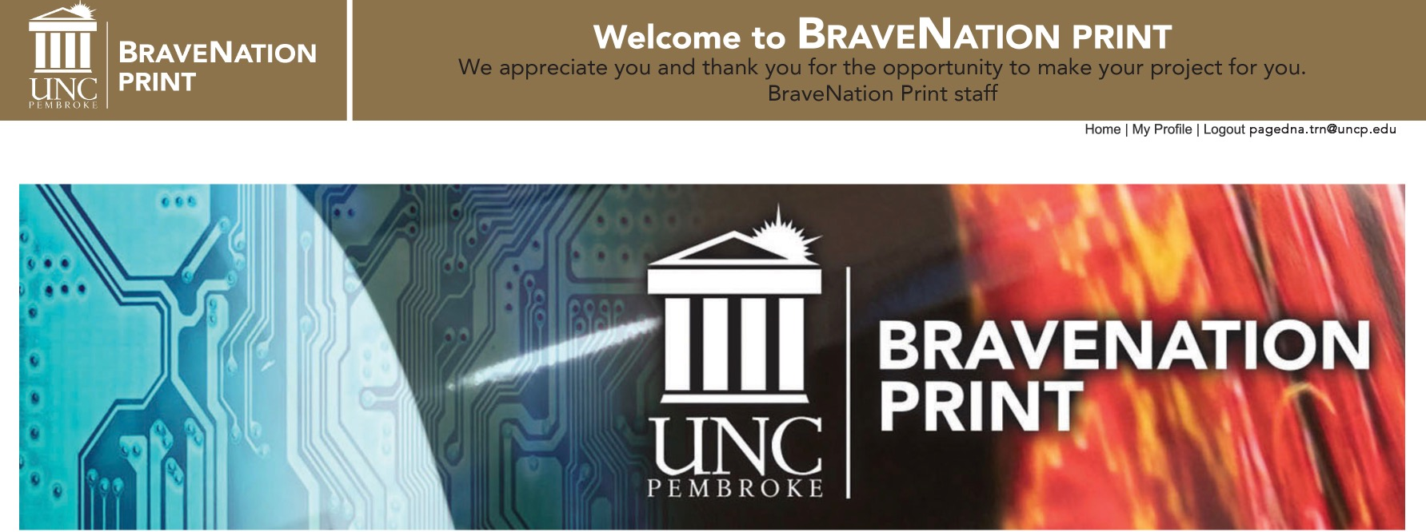
How to Approve an Order
Anyone that is designated to submit an order to the BraveNation Print Store Front can do that once they have created a profile. We still need the approval of the fund manager before that job is moved into our production queue.

Slide 2
Order Received
Once you see this page you know
that your order has been received by BraveNation Print.
This triggers an email to the requestor to confirm the job is submitted.
Another email is sent to the fund manager to approve the funds to
produce the job.
Once the fund manager responds to the link in that email and approves,
the job it is automatically moved to our Production Queue.
Waiting for approval will delay your job and end up costing you a rush fee.
We will send a reminder in 2- 3 days. A requestor sending a personal
reminder to the fund manager at the time of the order is helpful to these
very busy fund managers and to us.

Slide 3
Sample of Requestor’s email. This can be printed for your records and serves as an invoice.

Slide 4
Sample of Fund Manager’s email

Slide 5
We are Here for You
BraveNation Print is here to assist you in anyway that we can.
Contact us if you need assistance with the ordering process.
We can help you to understand how your file needs to be produced before you get to the submittal process
Large Format: ext. 4220, Digital Press: 4260, Business Office: 6331
Thank you for choosing BraveNation Print.
View our other PowerPoint demos here: https://www.uncp.edu/resources/ucm/print-services

