Slide 1
How to make an Appointment with your Advisor through EAB

Slide 2
To schedule an appointment with your advisor once you login to EAB using your UNCP credentials you will choose the blue block saying “Get Assistance”

Slide 3
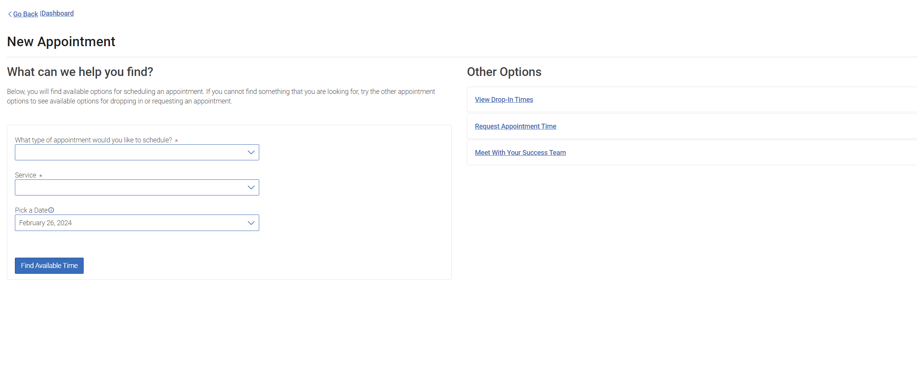
To schedule an appointment with your assigned advisor you will need to choose the option to “Meet With Your Success Team”

Slide 4
Your advisor should then appear on this screen and you will choose their name

Slide 5
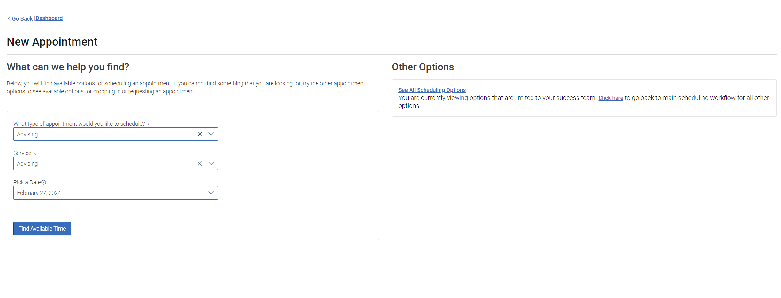
Next, you will need to fill in the information in the drop-down boxes on the left side of the screen. You would make the following selections What type of advising appointment would you like to schedule? -Advising Service –Advising Pick a Date- Choose the date you would like the meeting to take place Once you have done this click “Find Available Time”

Slide 6
Now you will need to choose your day and time from your advisors' availability. If you do not see a time that works for you, then you may need to email your advisor to see if there is another option for you.

Slide 7
Once you have chosen your day and time you are finished you will just need to click “Schedule” after completing this you have successfully made your advising appointment with your advisor

